Slide 1
Injector upgrade
23 Oct. 2015
Toshi Higo (on behalf of Injector linac group)

Slide 2
Contents
Beam requirement
Schedule and upgrade scenario
Positron status and near future plan
Emittance related issues
Conclusion

Slide 3
SuperKEKB schedule
Based on Miura-Furukawa, B2GM in June 2015
Commissioning is divided into three stages.
(phase1, phase2, phase3)
Calendar
2015
2016
2017
2018
Power restriction
in summer
Power restriction
in summer
Power restriction
in summer
Power restriction
in summer
Linac
Current plan on going
Phase 1
Phase 2
Phase 3
w/o QCS
w/o Belle II
QCS, Belle II install
w/ QCS
w/ Belle II (no VXD)
VXD install
w/ full Belle II
Vacuum Scrubbing
Basic machine tuning
L= 1×10³⁴cm⁻²s⁻¹
(KEKB design)
Add more RF
L= 8×10³⁵cm⁻²s⁻¹
Current=1A
Full Current
Injection Beam
low emittance
low emittance
1 nC/bunch
2 nC/bunch
4~5 nC/bunch
w/o DR
DR commissioning
w/ DR
w/ DR
no Top-up inj.
Top-up injection
Top-up injection

Slide 4
Required beam parameters
Stage | KEKB |  | Phase-I |  | SuperKEKB
Item | e+ | e- | e+ | e- | e+ | e-
Energy | 3.5 GeV | 8.0 GeV | 4.0 GeV | 7.0 GeV | 4.0 GeV | 7.0 GeV
Bunch charge | Primary e-10nC → 1 nC | 1 nC | Primary e- 4nC → 0.2 nC | 1 nC | Primary e-10nC → 4 nC | 5 nC
Norm.Emittance (γβε) (μrad) | 2100 | 100 | 2400 | 150 | 100/20 (Hor./Ver.) | 50/20 (Hor./Ver.)
Energy spread | 0.125% | 0.125% | ±0.5% | ±0.5% | 0.1% | 0.1%
Num. of Bunch / Pulse | 2 | 2 | 2 | 2 | 2 | 2
Repetition rate | 50 Hz |  | 50 Hz |  | 50 Hz
Simultaneous top-up injection | 3 rings (KEKB e-/e+, PF) |  | 3 rings (KEKB e-/e+, PF) |  | 4 rings (SuperKEKB e-/e+, PF, PF-AR)

Slide 5
What and when to be improved from KEKB to SuperKEKB
Present in late 2015
  Prepare low-emittance electron & positron to be cooled at DR
Phase-I in early 2016
  Supply for initial ring tuning and beam-duct baking
  Investigate the strategy for emittance-preserved high charge
Phase-II in 2017
  Gradually improve emittance preservation
  Make effort for higher charge
Phase-III in late 2017
  Emittance to be fully minimized with maximum charge

Slide 6
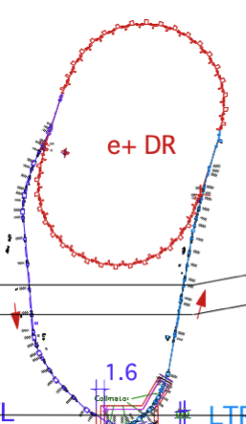
Upgrades of Injector LINAC
Thermionic gun @A1
Collimation @18
Photo-cathode RF gun system
Positron Damping Ring (DR)
< e- beam>
Low emittance (γε ≤ 20 mm⋅mrad)
high bunch charge ( ≥ 5nC)
Low emittance e+ beam
Alignment error tolerance
σ(local)=0.1mm
σ(global)=0.3mm
Positron production @14
1.1 GeV e+
Damping Ring
circ. 136 m
Low emittance preservation
RF gun
Thermionic gun
(10nC primary e-)
1.5 GeV
3.5 GeV
10nC x 2 (prim. e-)
5nC x 2 (inj. e-)
BCS
ECS
PF
ECS
PF-AR
e+
target
chicane
HER
Pulsed Quads & Pulsed Steering Magnets
LER
Positron Capture Section
- Flux concentrator (FC)
- Large aperture S-band accel. Structures (LAS)
4 times higher e+ yield
Event Timing System and Pulsed Modules
Synchronization for 5-rings including DR
200 parameters are switched at 50Hz each mode
Optics at the downstream of DR is switched by using pulsed magnets

Slide 7
Electrons
Electrons
  for HER
  for making positrons
Development on RF gun for electrons has been much advanced
  Targeting ultimately low-emittance, high-charge beam
  RF gun cavity seems well developed but operation in full spec is required for actual use.
  Considerable work is needed to make stable laser system.
We decided to bring thermionic gun for Phase-I to life
  For positron generation and possibly for electrons in phase-I
  Thermionic gun and RF gun were set in parallel at A1

Slide 8
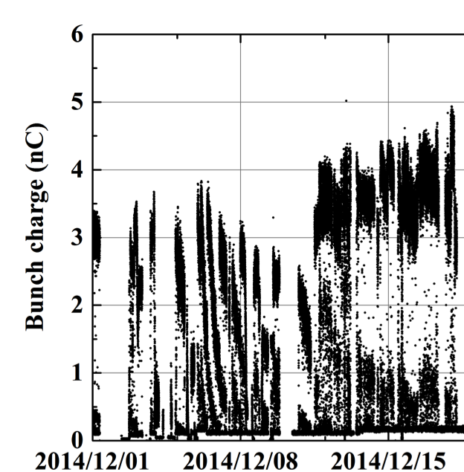
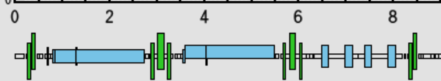
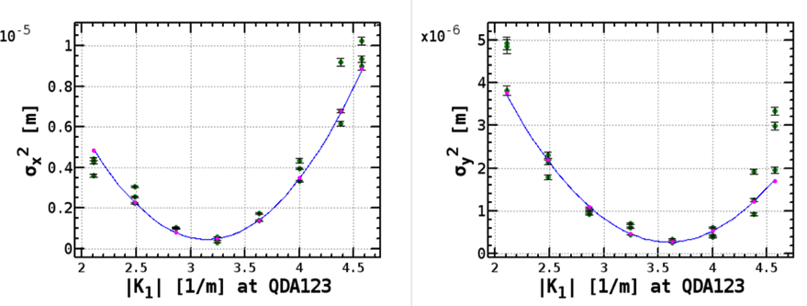
Beam Commissioning of RF Gun
Miura, Furukawa in B2GM in June 2015
Operation Condition
Target : 5nC
γε_{x}=50 mm⋅mrad, γε_{y}=20 mm⋅mrad @ LINAC end
γε_{x} , γε_{y} = 10 mm⋅mrad @ Gun
Laser: 2bunch, 25 Hz
RF gun acc. voltage: limited to 6.5 MV by breakdown (13.5 MV@design)
Bunch charge just after RF GUN (A1_C5)
Emittance measurement by Quad-scan
1 week
(m)
RF GUN
4nC/bunch
Screen monitor (t=30μm)
Bunch charge: 3nC@Screen
Sort for 3h
Beam size was measured shot by shot.
=> Position jitter is not included
γε_{x}=49.2 mm⋅mrad±10%
γε_{y}=26.2 mm⋅mrad±10%
(Y,M,D)
Archived 1/10s
Bunch charge stability depends on the laser stability.
Yb:YAG Thin-disk cooling by soldering Cu plate was Improved.
Measured emittances were higher than target values.
Higher horizontal emittance is due to laser incident angle.
R. Zhang, TUPWA071
Laser power increased and stability was also improving.
Need high acc. voltage of RF gun for small emittance

Slide 9
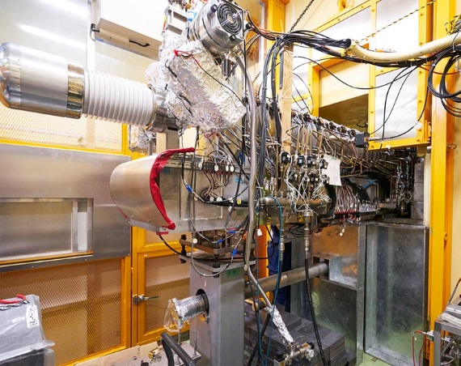
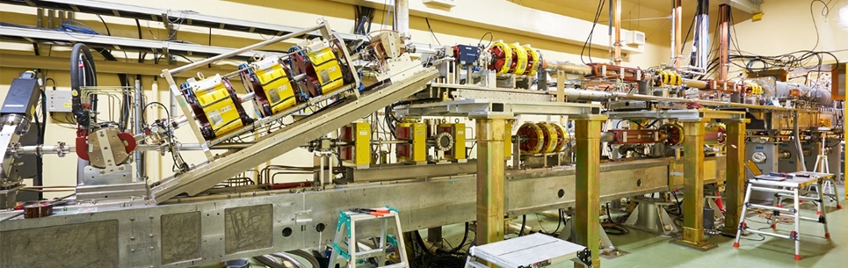
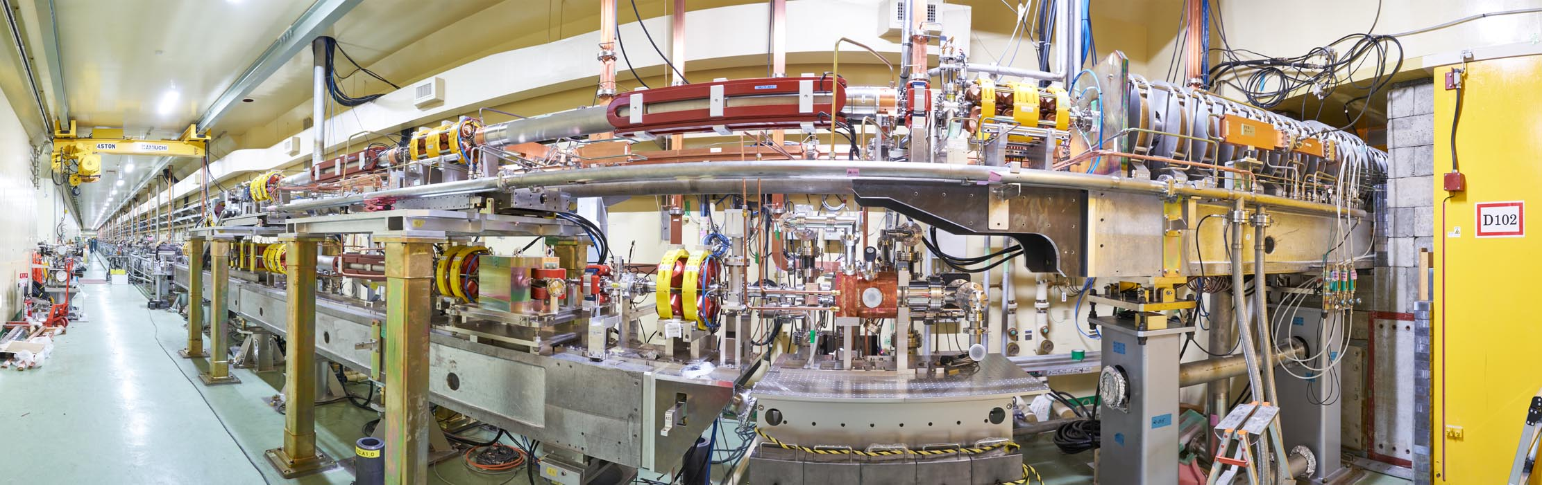
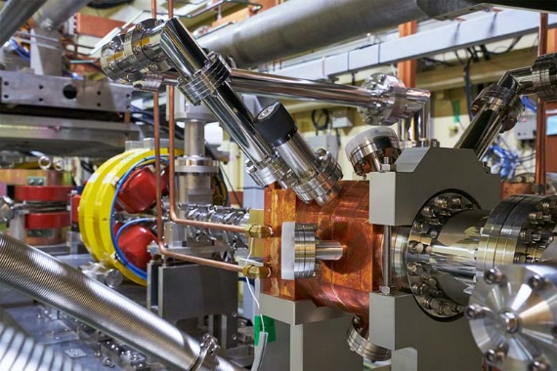
A1 electron gun area in double-deck configuration
Two lines merge
GU-AT
GR-A1

Slide 10
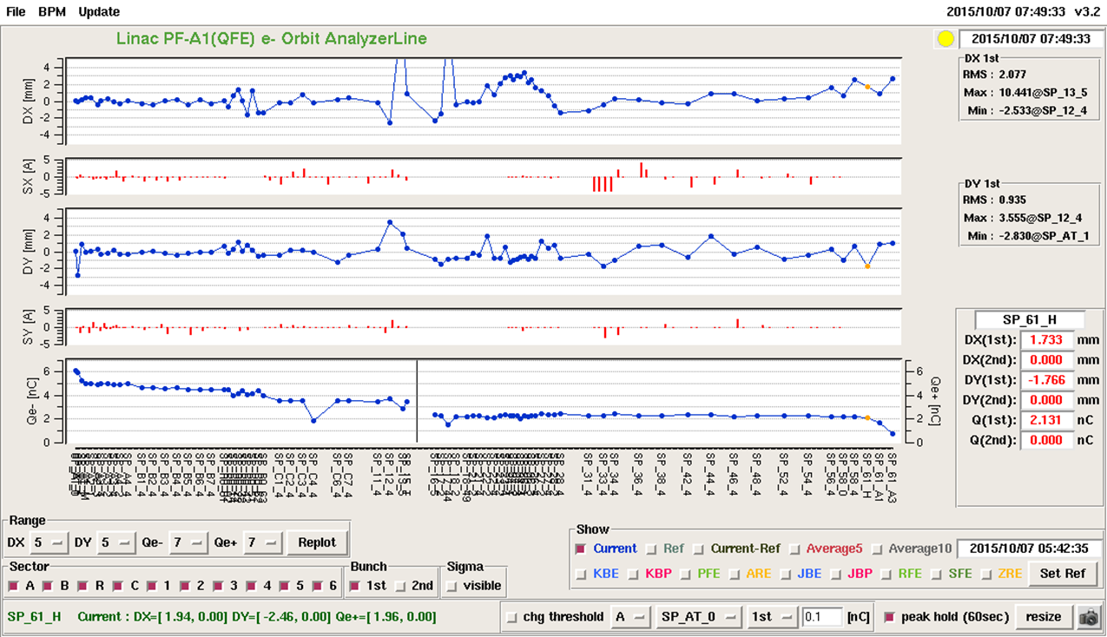
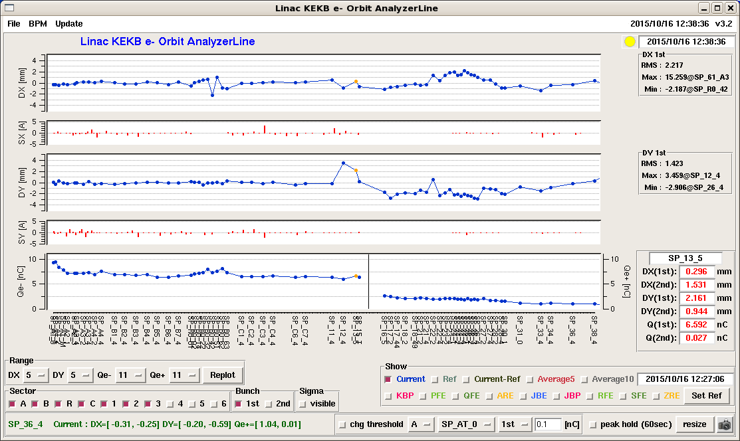
Recent electron bunch charge
Out of 6nC, 2 nC was transported through target center hole to linac end
6 nC was delivered to target
In late January, 2016
Radiation shield at target area will be reinforced
Target drive current of 200nA at present will be increased to 800nA with adding iron shield around target area
It allows drive electron with 8nC/bunch in 2 bunched at 50Hz.

Slide 11
Positron system
For phase-I (without DR)
  Primary drive electron intensity will be increased
  Radiation safety under 800 nA for phase-I will be allowed in late Jan. 2015
  Production rate will be increased with using
  flux concentrator, high solenoid field and large aperture accelerator tube
  Emittance will be reduced by collimation
  Big shield is being prepared for radiation safety

Slide 12
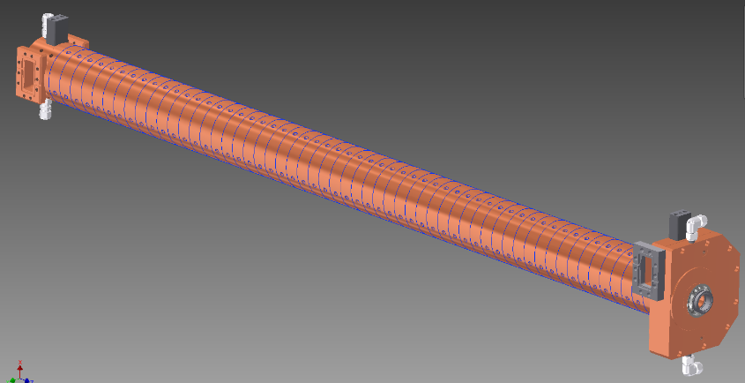
Schematic of positron Capture Section
SLED
SLED
KLY
1-5
KLY
1-6
target
+FC
LAS : Large Aperture
S-band structure
LAS 14 MV/m
deceleration & phase slip
& acceleration
LAS 10 MV/m
acceleration
Solenoids
Large Aperture
S-band structure
(LAS)
LAS with SLEDs for sufficient field gradient
breakdown issue of LAS in solenoid field
needs careful RF conditioning

Slide 13
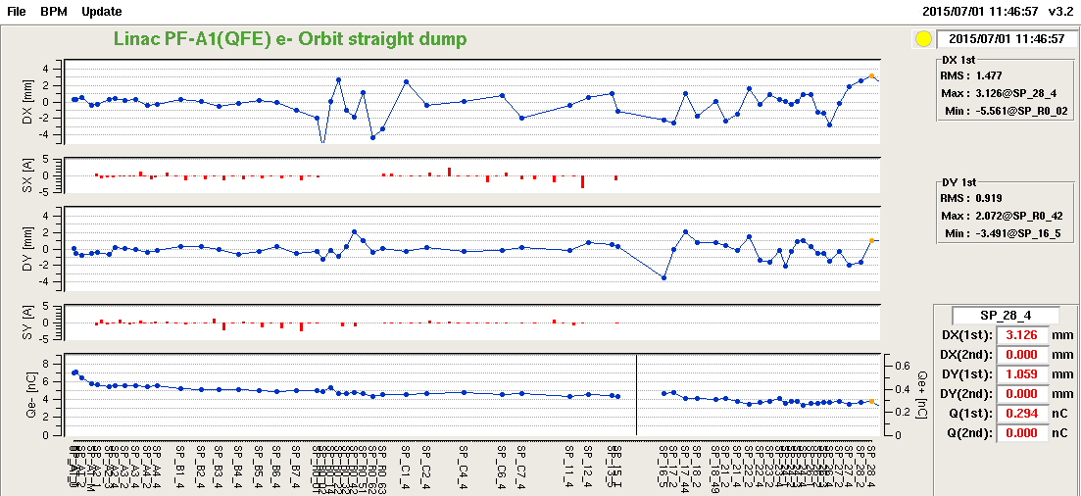
Positron intensity achieved in 1 July, 2015
Kamitani, POSIPOL 2015
e⁻ 4nC
e⁺ 0.4nC
Reached η=0.1 before summer shutdown in this year

Slide 14
Boosting positron yield and intensity
Done with electricity power up
Under processing with magnetic field
Under processing with magnetic field
For Phase-I

Slide 15
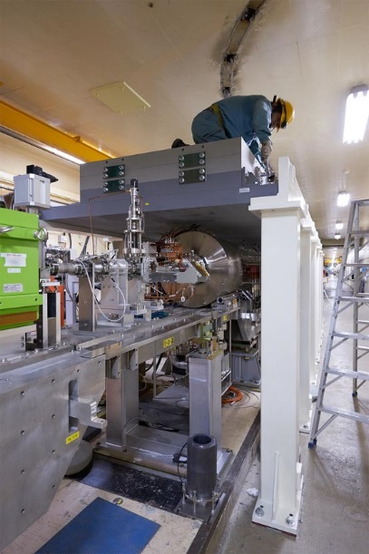
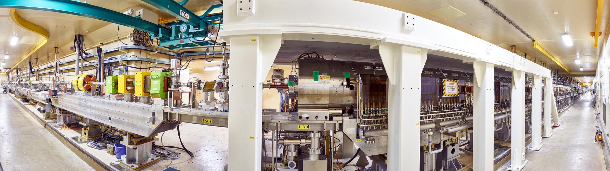
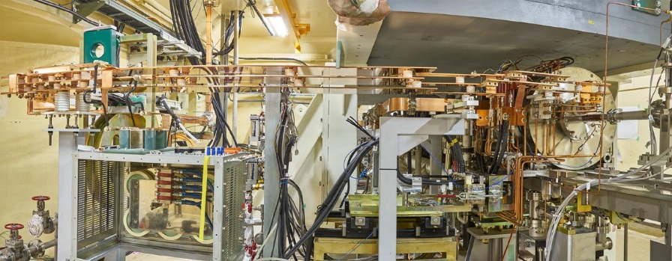
Target / FC / LAS / Solenoid
Radiation shield
Beam
FC & TGT
LAS & Solenoid
FC drive current capacity was doubled in summer 2015
Radiation shield will further increased before phase-I in Jan. 2016
FC & TGT

Slide 16
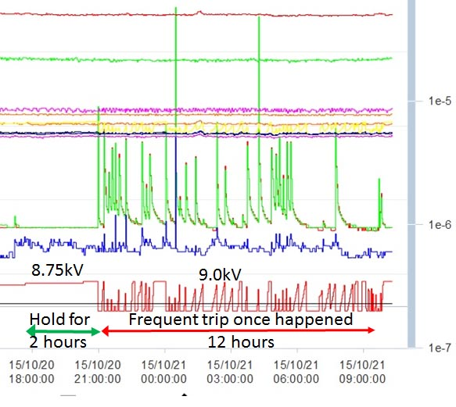
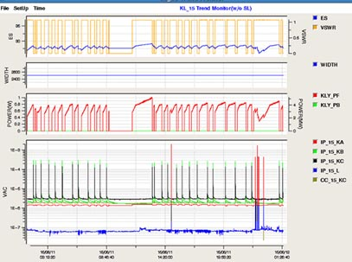
Struggling against gas burst
E_{S}
Gas pressure
RF power
Pressure
Drive voltage
24 hours
Frequent gas burst prevents FC with solenoid field from higher current operation than half-design.
Frequent gas burst and vacuum breakdown prevents LAS in solenoid field from higher field operation than 10 MV/m.
For both, processing is kept under way.

Slide 17
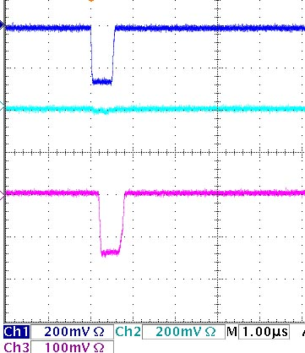
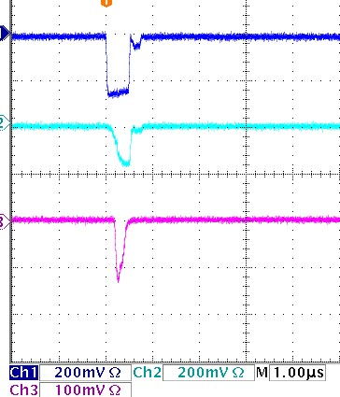
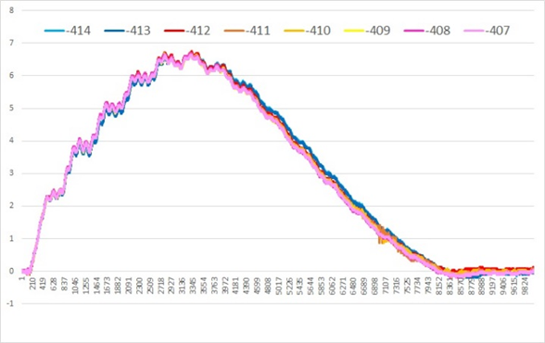
Breakdown(?) to be understood and suppress
RF power for LAS
RF Input
FC current pulse
Normal
RF reflected
RF transmitted
Abnormal
A few microsec
Normal pulse
Abnormal pulse
Trailing half was reduced, showing reduction of inductance.
RF power was reflected back to klystron and interrupting transmission through accelerator tube.

Slide 18
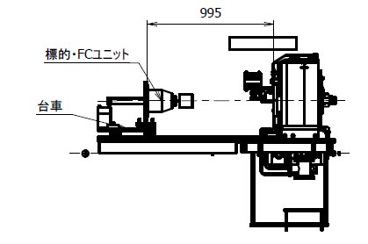
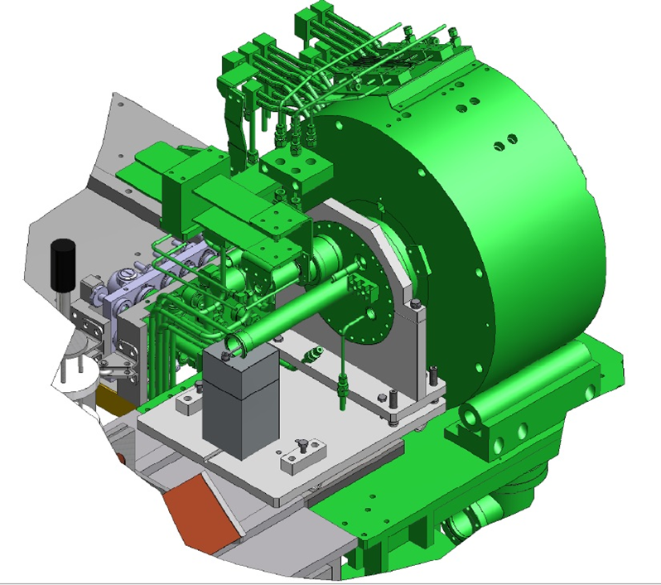
Further development on FC
FC chamber
TGT+FC
Replacement of TGT+FC is under consideration for phase-I.
Complete exchange mechanism of the TGT + FC + LAS may be in hand before Phase-II.

Slide 19
Positron at present and near future
Positron yield of 10% of drive electron was established.
Higher-charge drive electron makes more positrons.
High voltage cabling and other peripheries are approaching to their final ones.
Frequent gas burst is observed especially with solenoid magnetic field at more than 6kA current for FC.
Processing is a bit slow and we need to understand what is happening to overcome this phenomenon and operate at design current.
LAS (Large-aperture S-band) accelerator tubes are also subject to gas burst and sometimes with RF breakdown. More conditioning time is needed to reach the full accelerator field with SLED.
Exchange mechanism of target and FC was designed.
Exchange mechanism of fully replacing FC system is underway for final phase. This makes possible to replace any of the TGT/FC/LAS/Solenoid hard wares.

Slide 20
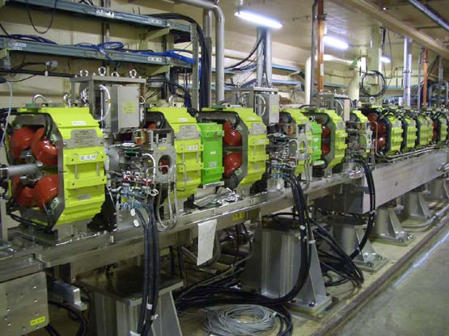
Collimation for phase-I
A set of three collimators were prepared for cutting beam tail for DR injection at the end of sector 1.
These can be used for cutting positron beam tail for Phase-I without DR.
Additional shield is being prepared.

Slide 21
Emittance issue for phase-II and beyond
Hard wares aligned on a girder by measuring positon by laser tracker
Girder are aligned by using laser PD referred to laser light passage
Hard ware alignment are to be smoothly improved by measuring with laser tracker
Beam evaluation and evaluation to be integrated in the alignment process
Suppression of emittance growth due to the floor movement

Slide 22
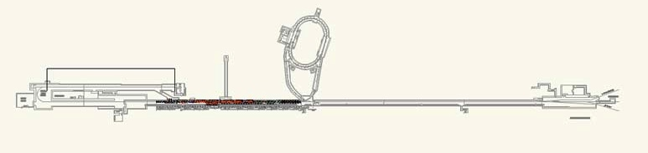
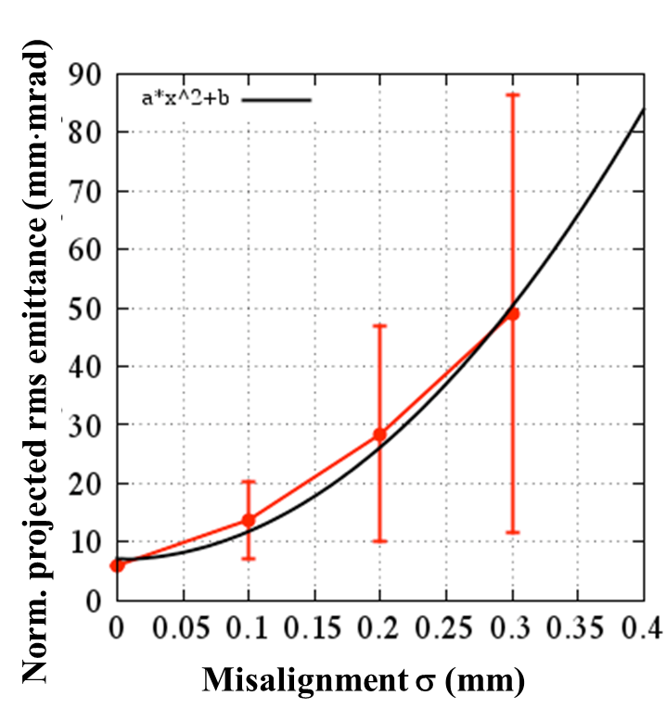
Alignment Requirement
120m
B
A
Rings
J-ARC
C
1
2
3
4
5
500m
  σ < 0.1 mm: βγε 20 mm·mrad is almost satisfied.
  σ > 0.1 mm: emittance preservation is required by some methods.
Requirement
Local σ < 0.1mm
Global σ < 0.3mm
H. Sugimoto

Slide 23
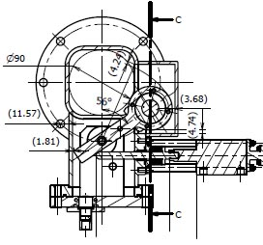
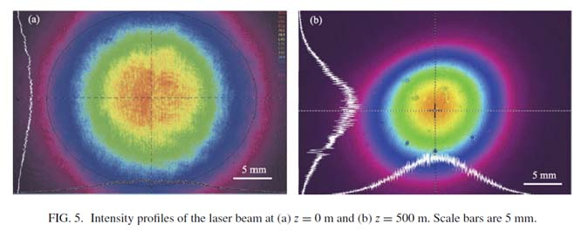
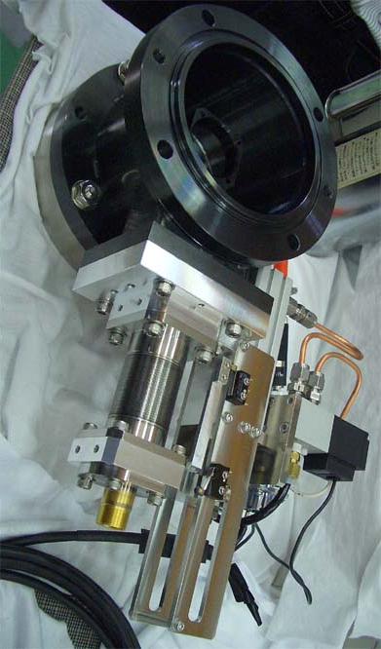
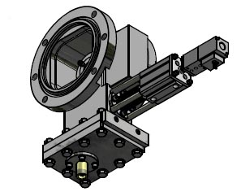
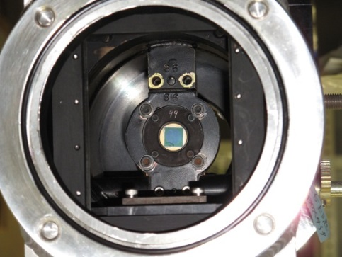
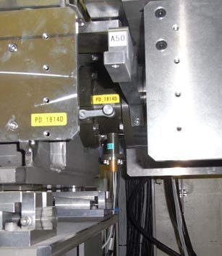
Laser PD system as a reference to align girders
500m laser line
4-segmented silicon PD (dia.=10mm)
Foresee more installation considering pendulum type and/or present type as candidate
Automatic ON/OFF
Linear type
2+8 installed now
Manual ON/OFF

Slide 24
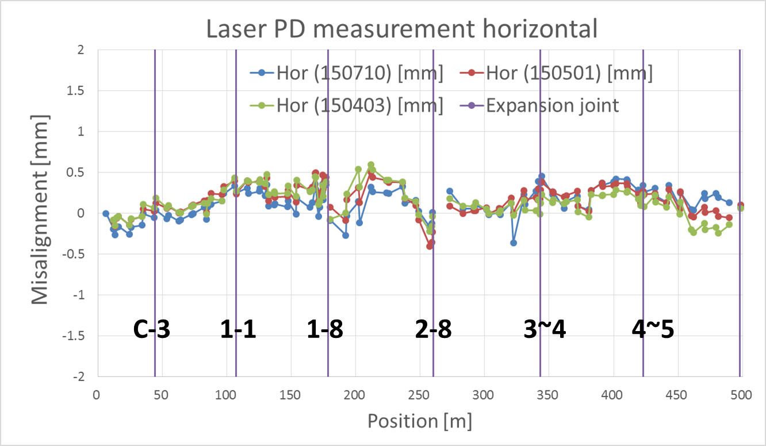
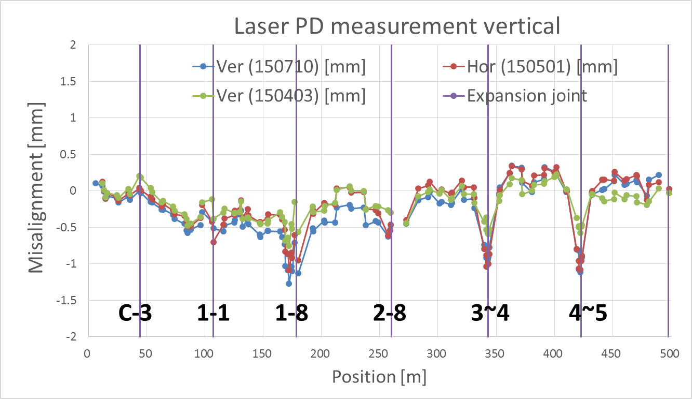
Laser PD measurement
Mostly aligned by a year ago, summer in 2014
Horizontal
Vertical
Ver.
PD_28_G6DA
PD in automatic measurement system are installed
two in autumn last year and eight in Summer this year
and more to be installed in this fiscal year
PD_28_REFUA

Slide 25
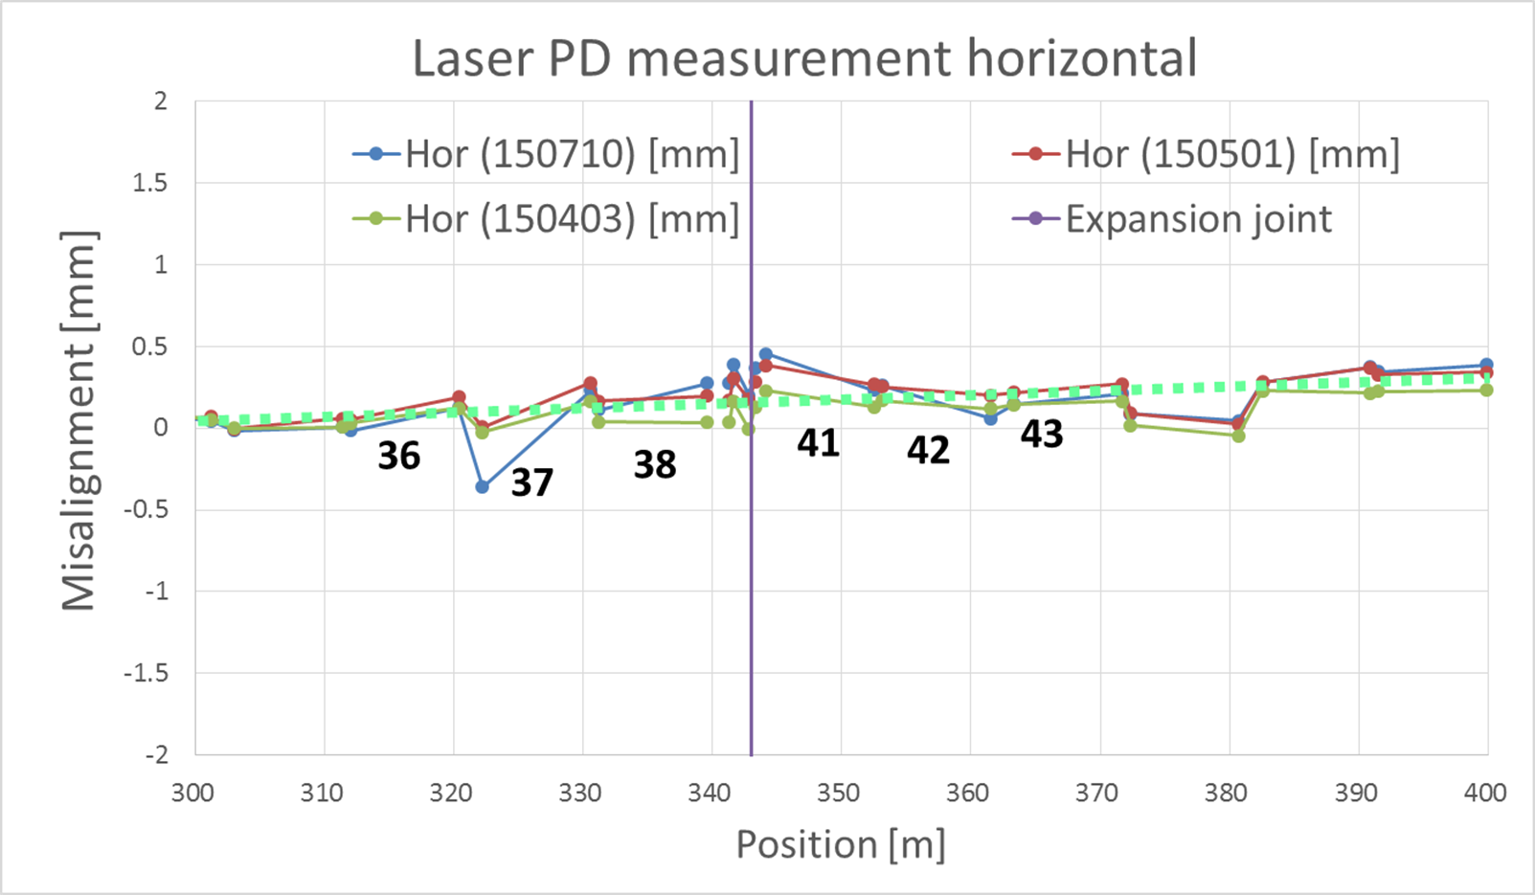
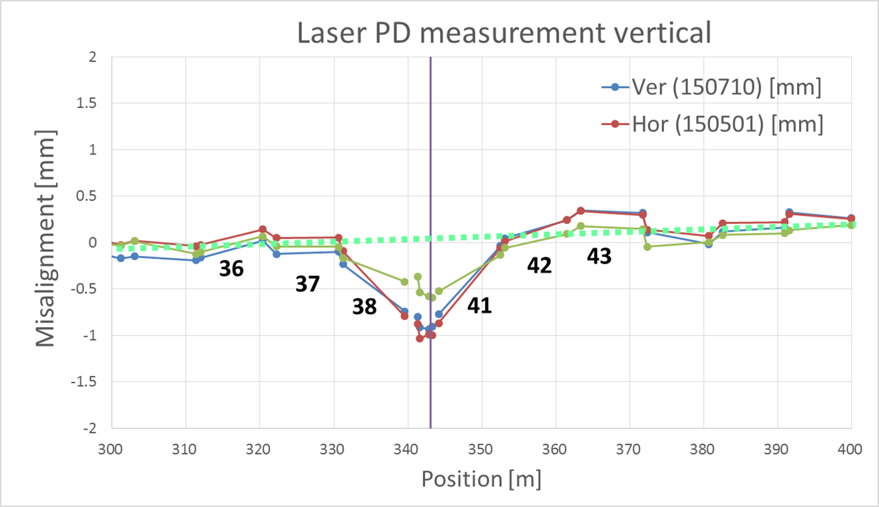
Laser PD more near expansion joint
Horizontal
Vertical
Ver. Same data
as left figure
Movement near joint is big.
Mover or some passive support structure to be developed.

Slide 26
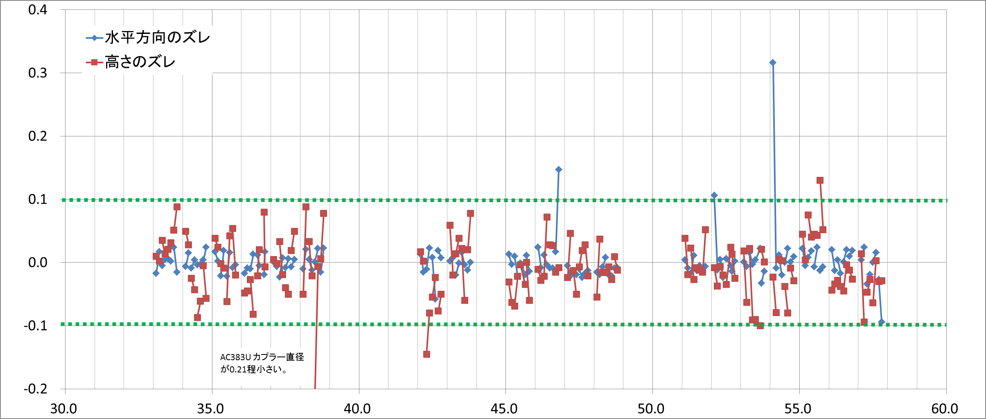
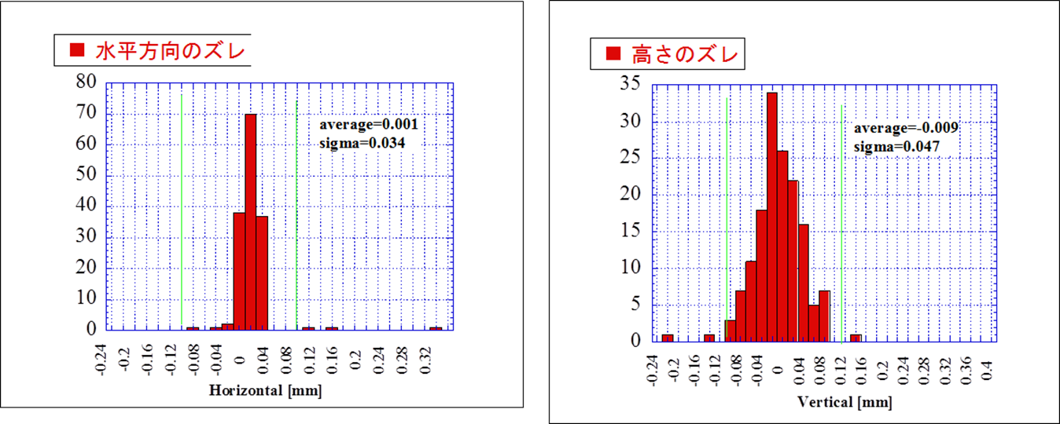
Hard ware initial alignment on a girders in sector 3 - 5
Horizontal
First round done to install/assign/measure.
From now on, we try to find a series of
alignment chances to improve smoothness.
the stability of this alignment should be confirmed.
Vertical
Horizontal
σ=34μm
Vertical
σ=47μm
2015/2/24
26

Slide 27
Floor configuration
B A
Gun
DR
BCS
ECS
PF
C 1 2 3 4 5
ECS
PF-AR
e+ target
HER
LER
Expansion joint
Laser PD continuous measurement devices
Half a year data in next page

Slide 28
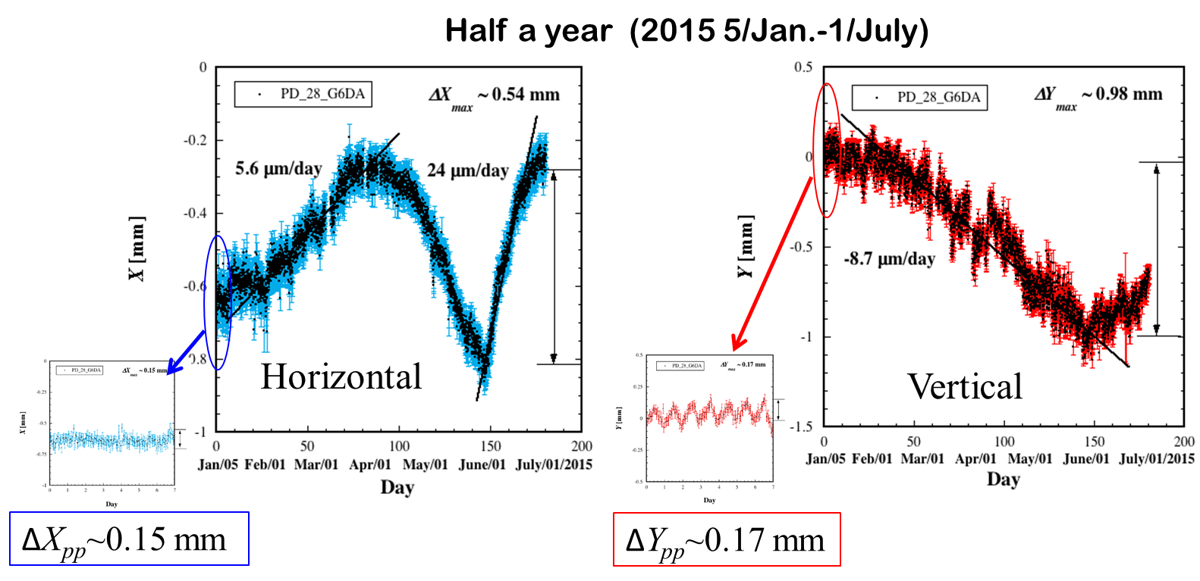
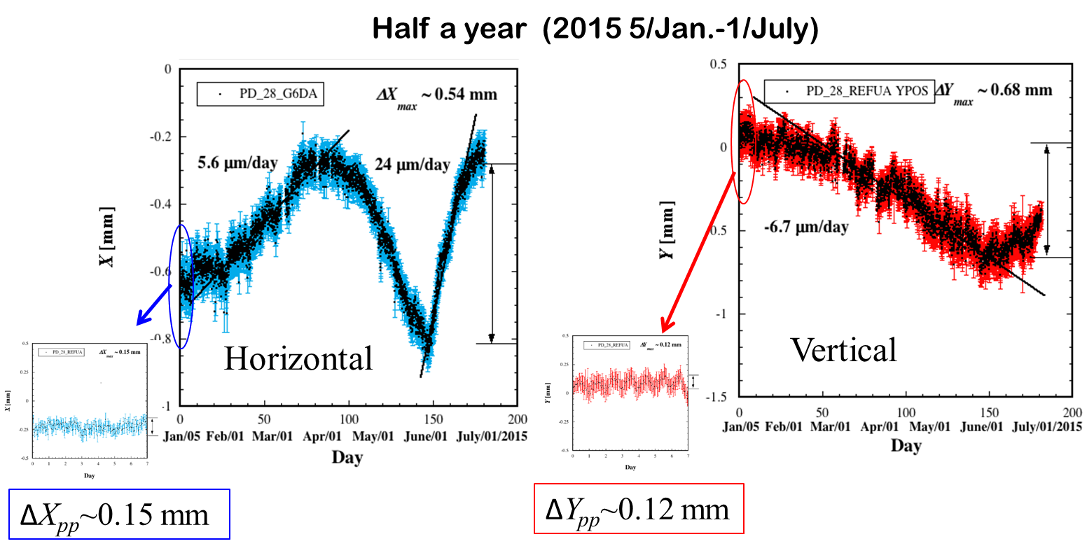
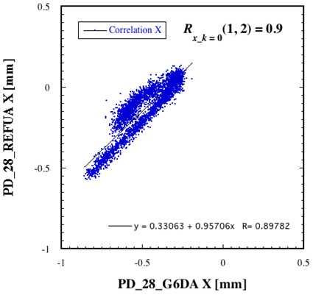
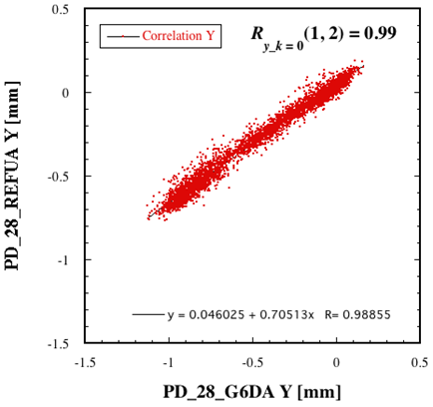
Movement in half a year
4.25 m
← Upstream PD_28_G6DA
PD_28_REFUA Downstream →
Correlation between these two positions.
Movement of 1mm order was observed in half a year.
Daily movement is of the order of +/- 0.15mm.
Positive correlation was observed.

Slide 29
Status and near future strategy
Monthly measurement of relevant PD’s are kept in best effort base for more than a year.
Continuous PD measurement at 10 points are in progress and acquire data over a year.
More automatic PD’s will be made and installed.
Movement at joint is underway to understand movement.
Beam study will be performed to acquire the feasibility of floor movement information by beam.
Feasibility of mover will be studied in mechanism, time, cost.
These efforts should be integrated to make a system before Phase-III, in two years from now.

Slide 30
Conclusion
Phase-I beam, both electrons and positrons, can be delivered in time in 2016.
  Thermionic gun, positron production, shield reinforcement, ….
Preparation for DR will be made by next summer and supply “low” emittance beam will be delivered in Phase-II from 2017.
  RF-gun, LTR/RTL, pulse magnet, …..
Floor movement should be understood and we develop a suppression / compensation scheme to meet Phase-III operation in 2018.
  Floor movement and emittance control, ultimate laser RF-gun, …

Slide 31

Mt. Tsukuba
Thank you
SuperKEKB
dual rings
PF-AR
PF
Injector
Linac

