Slide 1
LINAC Upgrade Status
Takako Miura / Kazuro Furukawa
(Accelerator Laboratory, KEK)
on behalf of Injector LINAC group

Slide 2
Injector LINAC
High-current and low-emittance injection beams are required for SuperKEKB. The LINAC has been upgraded for SuperKEKB, and beam commissioning has been performed during the upgrading.
LINAC Beam Parameters
 | for KEKB |  | for SuperKEKB
 | e+ | e- | e+ | e-
Energy | 3.5 GeV | 8.0 GeV | 4.0 GeV | 7.0 GeV
Bunch charge | Primary e-10nC →1 nC | 1 nC | Primary e-10nC → 4 nC | 5 nC
Norm.Emittance (γβε) | 2100 (mm⋅mrad) | 100 (mm⋅mrad) | 100/20 (Hor./Ver.) (mm⋅mrad) | 50/20 (Hor./Ver.) (mm⋅mrad)
Energy spread | 0.125% | 0.125% | 0.1% | 0.1%
Num. of Bunch / Pulse | 2 | 2 | 2 | 2
Repetition rate | 50 Hz |  | 50 Hz
Simultaneous top-up injection | 3 rings (KEKB e-/e+, PF) |  | 4 rings (SuperKEKB e-/e+, PF, PF-AR)

Slide 3
Schedule
SuperKEKB commissioning is divided into three stages. (phase1, phase2, phase3)
Calendar
2015
2016
2017
2018
Power restriction
in summer
Power restriction
in summer
Power restriction
in summer
Power restriction
in summer
Current plan on going
Phase 1
Phase 2
Phase 3
w/o QCS
w/o Belle II
QCS, Belle II install
w/ QCS
w/ Belle II (no VXD)
VXD install
w/ full Belle II
Vacuum Scrubbing
Basic machine tuning
L= 1×10³⁴cm⁻²s⁻¹
(KEKB design)
Add more RF
L= 8×10³⁵cm⁻²s⁻¹
Current=1A
Full Current
Injection Beam
low emittance
low emittance
1 nC/bunch
2 nC/bunch
4~5 nC/bunch
w/o DR
DR commissioning
w/ DR
w/ DR
no Top-up inj.
Top-up injection
Top-up injection

Slide 4
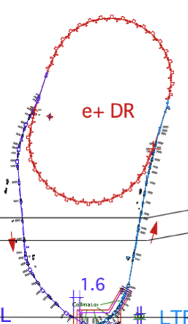
Major Upgrades of Injector LINAC
Photo-cathode RF gun system
Positron Damping Ring (DR)
< e- beam>
Low emittance (γε ≤ 20 mm⋅mrad)
high bunch charge ( ≥ 5nC)
Low emittance e+ beam
Alignment error tolerance
σ(local)=0.1mm
σ(global)=0.3mm
1.1 GeV e+
Damping Ring
circ. 136 m
Low emittance preservation
RF gun
Thermionic gun
(10nC primary e-)
1.5 GeV
3.5 GeV
10nC x 2 (prim. e-)
5nC x 2 (inj. e-)
BCS
ECS
PF
ECS
PF-AR
e+
target
chicane
HER
Pulsed Quads & Pulsed Steering Magnets
LER
Positron Capture Section
- Flux concentrator (FC)
- Large aperture S-band accel. Structures (LAS)
4 times higher e+ yield
Event Timing System and Pulsed Modules
Synchronization for 5-rings including DR
200 parameters are switched at 50Hz each mode
Optics at the downstream of DR is switched by using pulsed magnets

Slide 5
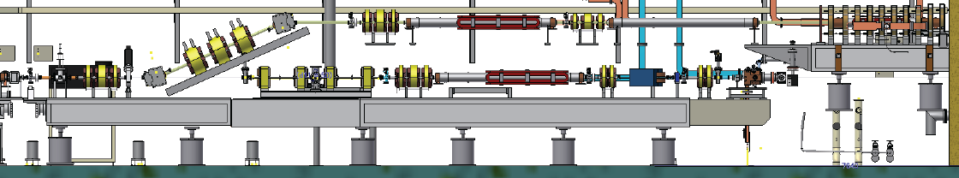
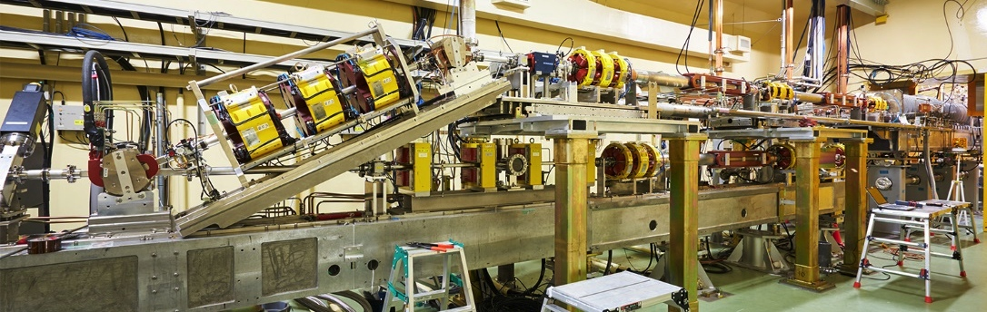
Layout of Electron Guns
Thermionic electron gun are located upstairs to produce ~10 nC primary electrons for positron production.
Photocathode RF gun for low emittance e- production is located on the straight line.
Thermionic gun (primary e- 10nC)
Merger line
Photocathode RF gun
Thermionic gun:
commissioning was started from June 2015.

Slide 6
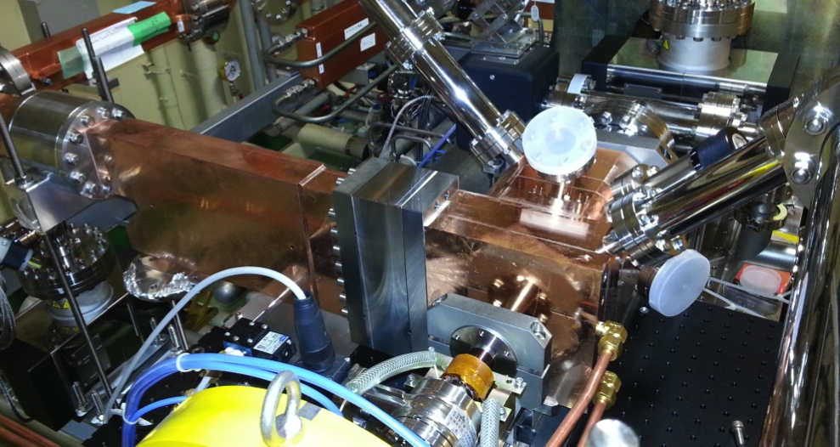
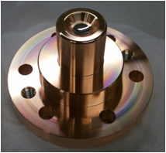
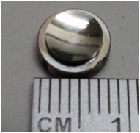
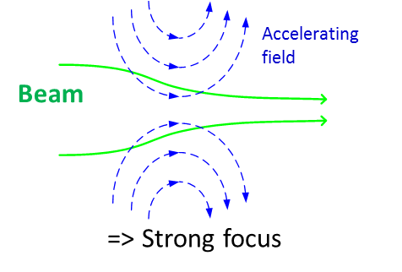
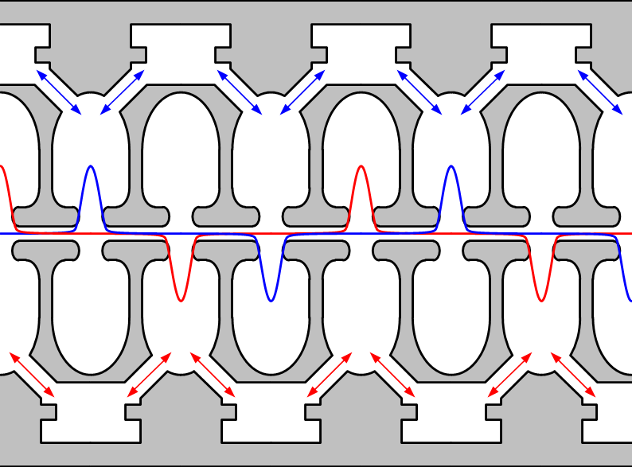
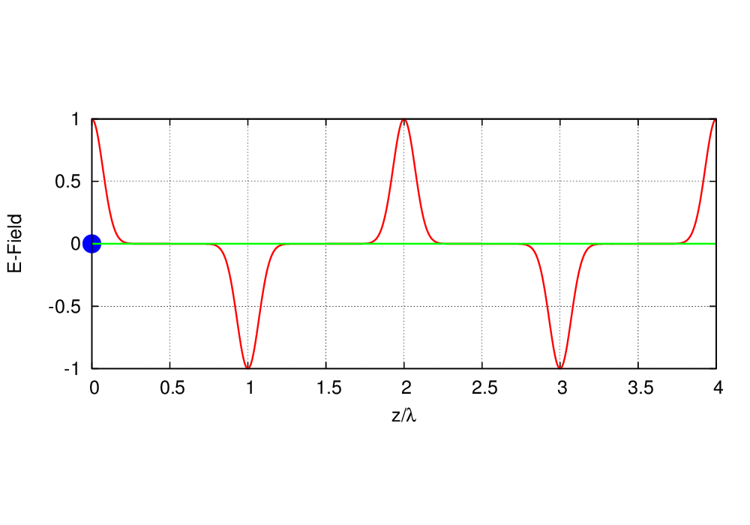
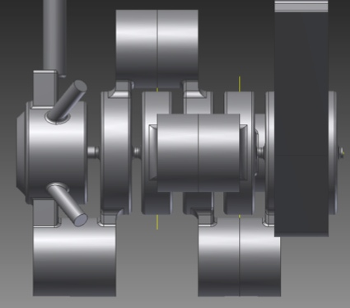
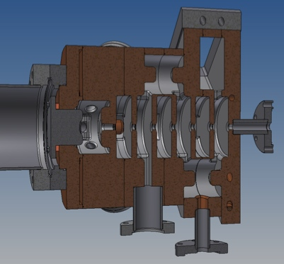
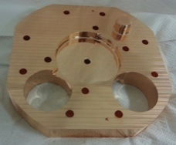
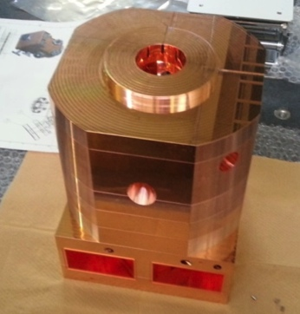
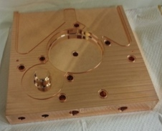
Quasi Traveling Wave Side Couple RF GUN
Quasi traveling wave (QTW) side couple RF gun
Strong focusing force using accelerating field
Installed in sept. 2013.
90 deg Hybrid
RF
0 deg.
Ir₅Ce
Cathode
beam
QE=1×10⁻⁴ @266nm
Long lifetime
90 deg.
Laser Port
Incident angle: 60deg to the cathode surface.
QTW type is adopted to make drift space short.
7 cell, 13.5 MeV@design
Emittance: 5.5 mm-mrad @5 nC (by simulation)
This RF gun can generate e- up to 10 nC
Drift space = no focus field
Beam
QTW is made by two standing waves with 90deg phase difference.
coupling cavities
T.Natsui, M.Yoshida
Notes:
At first, I want to introduce RF-GUN.
Quasi traveling wave side-couple RF Gun has been installed. RF power is fed by using hybrid
QTW is made by using 90deg phase different standing waves.
QTWS RF gun has strong focusing force using accelerating field. So, QTWS RF gun can accept high charge, up to 10 nC.
Cathode is here. Ir5Ce metal cathode has been employed. The quantum efficiency of this cathode is 1e-4, and lifetime is so long.
Here is laser port. (Laser incident angle is 60degree.)
As a laser system, broadband Yb:YAG is employed for longitudinal pulse shape manipulation.
2bunch and 25Hz system has been constructed. Final goal is 50 Hz. (Laser system is under development.)
It consists of fiber oscillator, pulse stretcher, pulse picker, thin-disk multi-pass amplifier, and two second harmonic generators.
Pulse is stretched here and 2bunch 25Hz pulses are picked up here,
and as final high gain amplifier, Yb:YAG thin disk multi-pass amplifiers are used.
(the laser pulse is stretched to ~20 ps by a transmission grating stretcher.
Pick up of 2bunch, 25Hz laser is performed here. Laser power is amplified by using thin-disk multi-pass amplifier.
In high power and high repetition rate operation, thin-disk heat issue was appeared.)

Slide 7
Yb:YAG/Nd:YAG Laser System for RF-Gun
Yb:YAG (1025-1070 nm) broad band →Pulse shape manipulation is possible.
Yb Oscilattor
Stretcher
Yb PCF
Amplifier
Yb:YAG thin-disk
Amplifier
SHG
100 fs
30 ps
0.2 nJ @ 1025-1070 nm
Transmission Grating Stretcher
@1064 nm
Yb-doped fiber oscillator
Yb-doped fiber pre amplifier
Yb-doped fiber amplifier
51.9 MHz
30 ps
@1035 nm
2 bunch, 25 Hz achieved
(limited by thermal effect)
Final goal is 50 Hz.
Synchronization system
EO Pulse picker
PCF Yb-doped fiber amplifier
Nd:YAG solid-state amplifier
25Hz
Double bunch
PCF: Photonic-crystal fiber
~ μJ
Yb:YAG thin-disk multi-pass amplifier
Yb:YAG thin-disk multi-pass amplifier
2856 MHz trigger
From Accelerator
PCF Yb-doped fiber amplifier
~0.8 mJ @ 258 nm
~5 mJ
X. Zhou, M. Yoshida, T. Natsui
RF GUN
SHG
SHG
SHG: Second harmonic generator
BBO

Slide 8
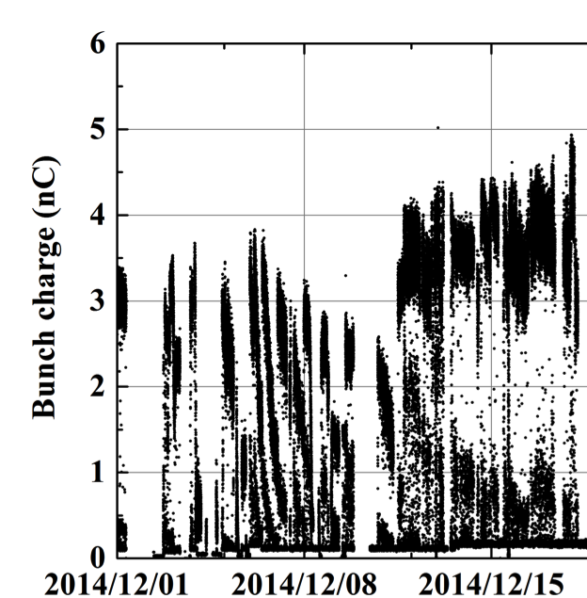
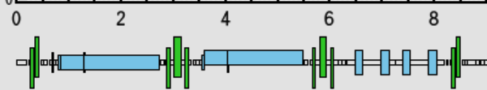
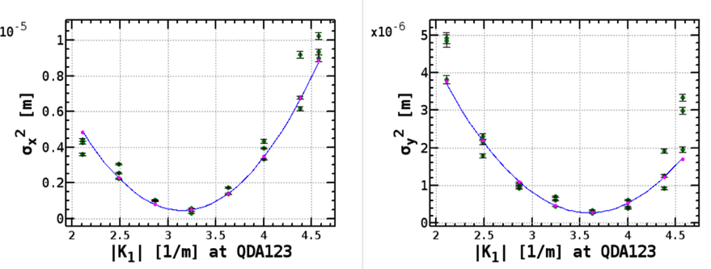
Beam Commissioning of RF Gun
Operation Condition
Target : 5nC
γε_{x}=50 mm⋅mrad, γε_{y}=20 mm⋅mrad @ LINAC end
γε_{x} , γε_{y} = 10 mm⋅mrad @ Gun
Laser: 2bunch, 25 Hz
RF gun acc. voltage: limited to 6.5 MV by breakdown (13.5 MV@design)
Bunch charge just after RF GUN (A1_C5)
Emittance measurement by Quad-scan
1 week
(m)
RF GUN
4nC/bunch
Screen monitor (t=30μm)
Bunch charge: 3nC@Screen
Sort for 3h
Beam size was measured shot by shot.
=> Position jitter is not included
γε_{x}=49.2 mm⋅mrad±10%
γε_{y}=26.2 mm⋅mrad±10%
(Y,M,D)
Archived 1/10s
Bunch charge stability depends on the laser stability.
Yb:YAG Thin-disk cooling by soldering Cu plate was Improved.
Measured emittances were higher than target values.
Higher horizontal emittance is due to laser incident angle.
R. Zhang, TUPWA071
Laser power increased and stability was also improving.
Need high acc. voltage of RF gun for small emittance

Slide 9
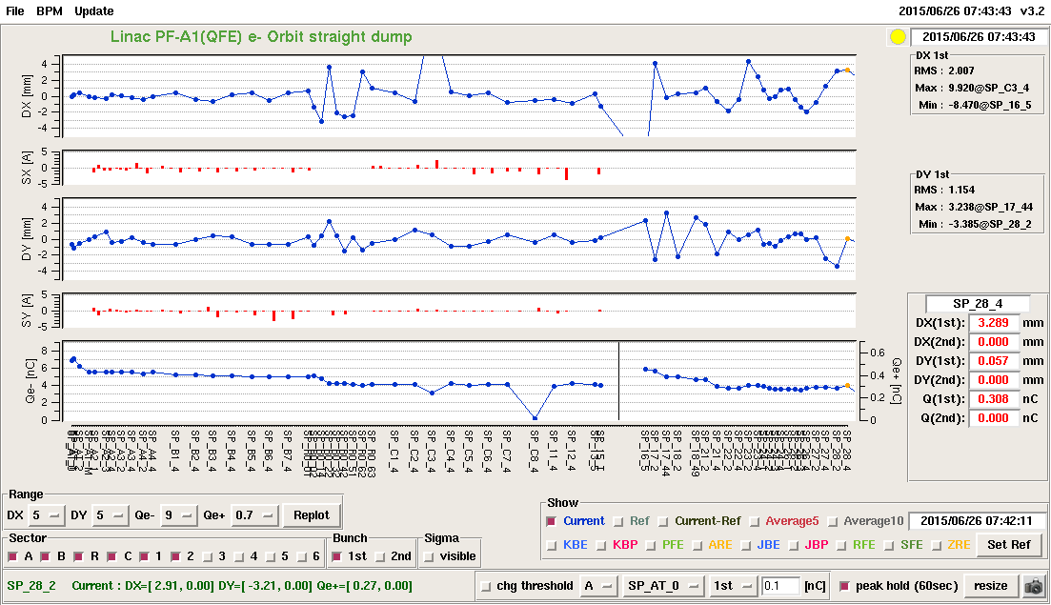
Beam Commissioning of Thermionic e- Gun
Linac A1(QFE) e-/e+ Orbit to LTR dump

Slide 10
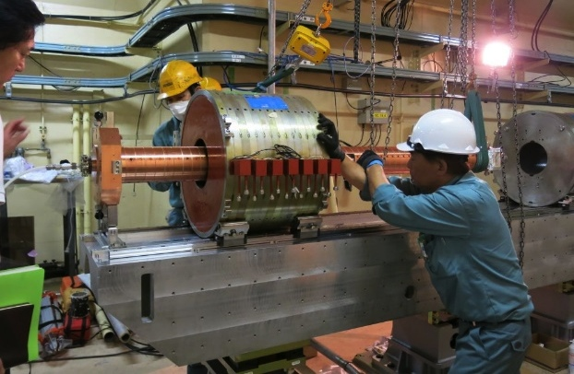
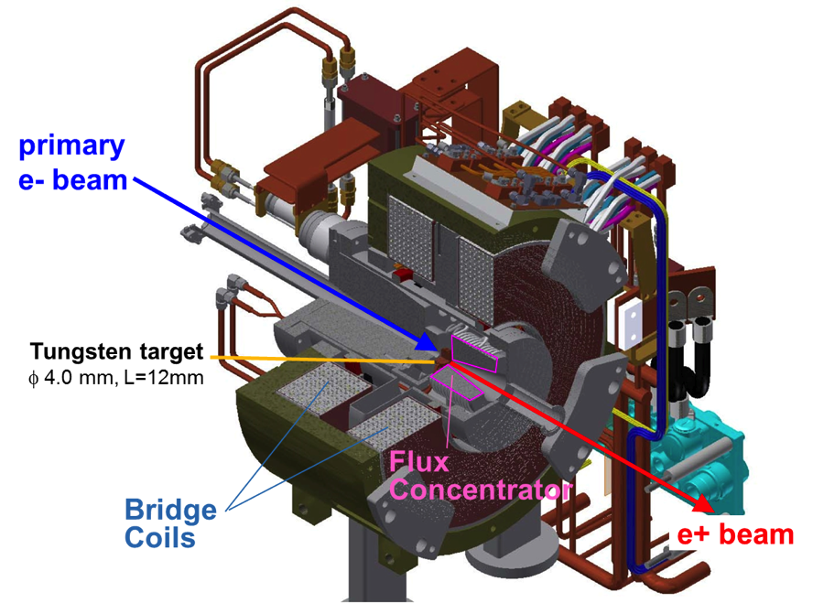
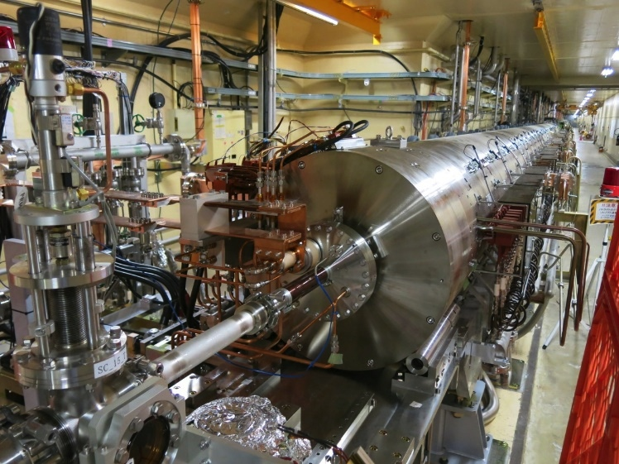
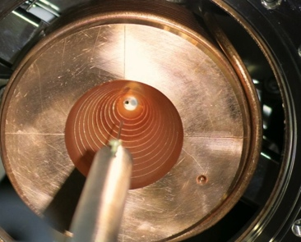
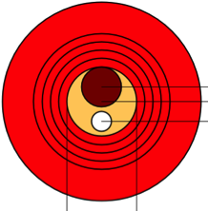
Positron Capture Section
0.5T DC solenoids : 15 m
T. Kamitani, L. Zang
LAS : Large aperture S-band
accel. Structures
Aperture φ20mm → φ 30mm
DC solenoid
FC : Flux concentrator
Large energy acceptance
Large transverse acceptance
LAS
Solenoid field at e+ production target
= 3.5T(FC)+1T(Bridge coil) = 4.5 T
FC viewed from downstream
LAS + DC solenoid (15m)
3.5T@12kA, 6μs (half sine)
FC/Target
e-
φ2.0 mm
Hole on-axis
Target
off-axis
May 2014 installed

Slide 11
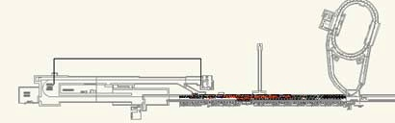
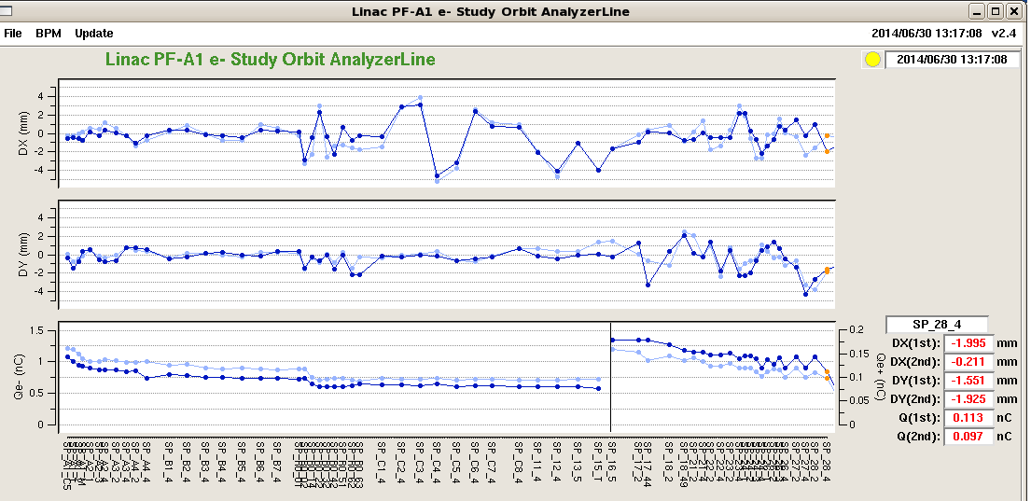
Positron beam commissioning @June 2014
 | Design | 6/2014
Flux Concentrator | 12 kA | 6.4 kA
Bridge Coil | 600 A | 600 A
DC Solenoids | 650 A | 370 A
Acc Field | 14, 12MV/m | 10, 12MV/m
T. Kamitani
B
A
e-
e+
Ye+ > 40 % is necessary at DR entrance.
C
1
2
orbit-X [mm]
Q(e+) = 0.18 nC
at capture section end
June 2014
Commissioning with
design parameters will be started
from Oct. 2015.
orbit-Y [mm]
Q(e+) = 0.12 nC
Primary e-
intensity at target
Q(e-) = 0.60 nC
Charge [nC]
So far, the commissioning data agrees the design well
Primary Electron
Positron
target
e+ yield (Ye+) = e+ charge (Qe+) / primary e- charge (Qe-)
Ye+@Jun.2014 = 30 % at capture section end, 20% at the end of Sector2 with limited ele/mag fields

Slide 12
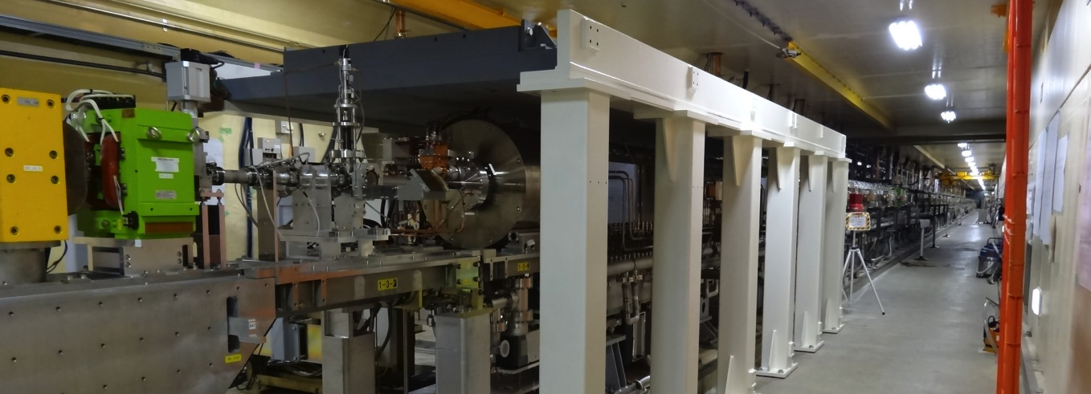
Radiation shield for higher beam current
#15 region
Iron shield
Gradual increase of beam current / shield and corresponding radiation license applications are planned

Slide 13
Summary
Steady progress towards first MR injection in JFY2015
Finished earthquake disaster recovery in JFY2014
Will make gradual improvements up to Phase-III
  Alignment: almost confident on the required precision (0.1-mm local, 0.3-mm global), need to maintain for longer term
  RF gun: following recommendations at review meetings with commercial devices and Nd-based lasers
  Thermionic gun: under commissioning
  Positron generator: waiting for license tests
Will balance between final beam quality and operation in phases
Will select optimized route depending on available resources
Thank you for your attention.

Slide 14

Mt. Tsukuba
Thank you
SuperKEKB
dual rings
PF-AR
PF
Injector
Linac

Slide 15
Back-up slides

Slide 16
Why need longitudinal pulse-shape manipulation?
Energy spread of 0.1% is required for SuperKEKB synchrotron injection.
15nC
20nC
5nC
10nC
t
Gaussian
Energy Spread
t
Square
5nC
10nC
15nC
5nC electron
20nC
Requirement
Pulse length
M. Yoshida

Slide 17
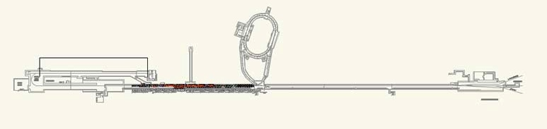
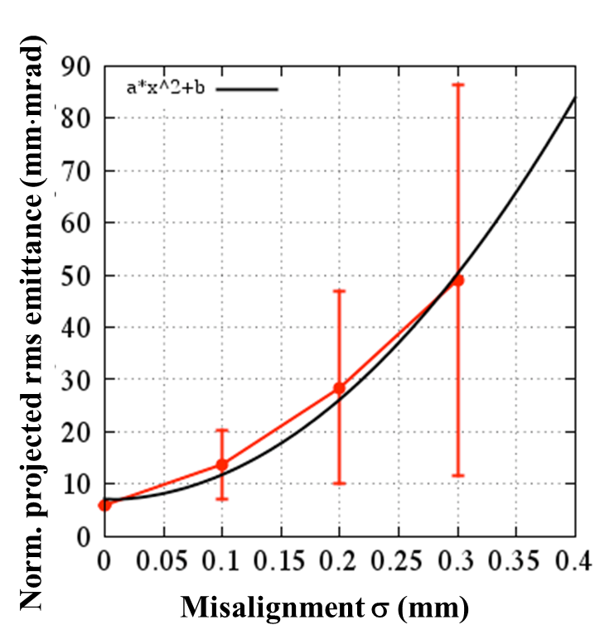
Alignment Requirement
120m
B
A
Rings
J-ARC
C
1
2
3
4
5
500m
  σ < 0.1 mm: βγε 20 mm·mrad is almost satisfied.
  σ > 0.1 mm: emittance preservation is required by some methods.
Requirement
Local σ < 0.1mm
Global σ < 0.3mm
H. Sugimoto

Slide 18
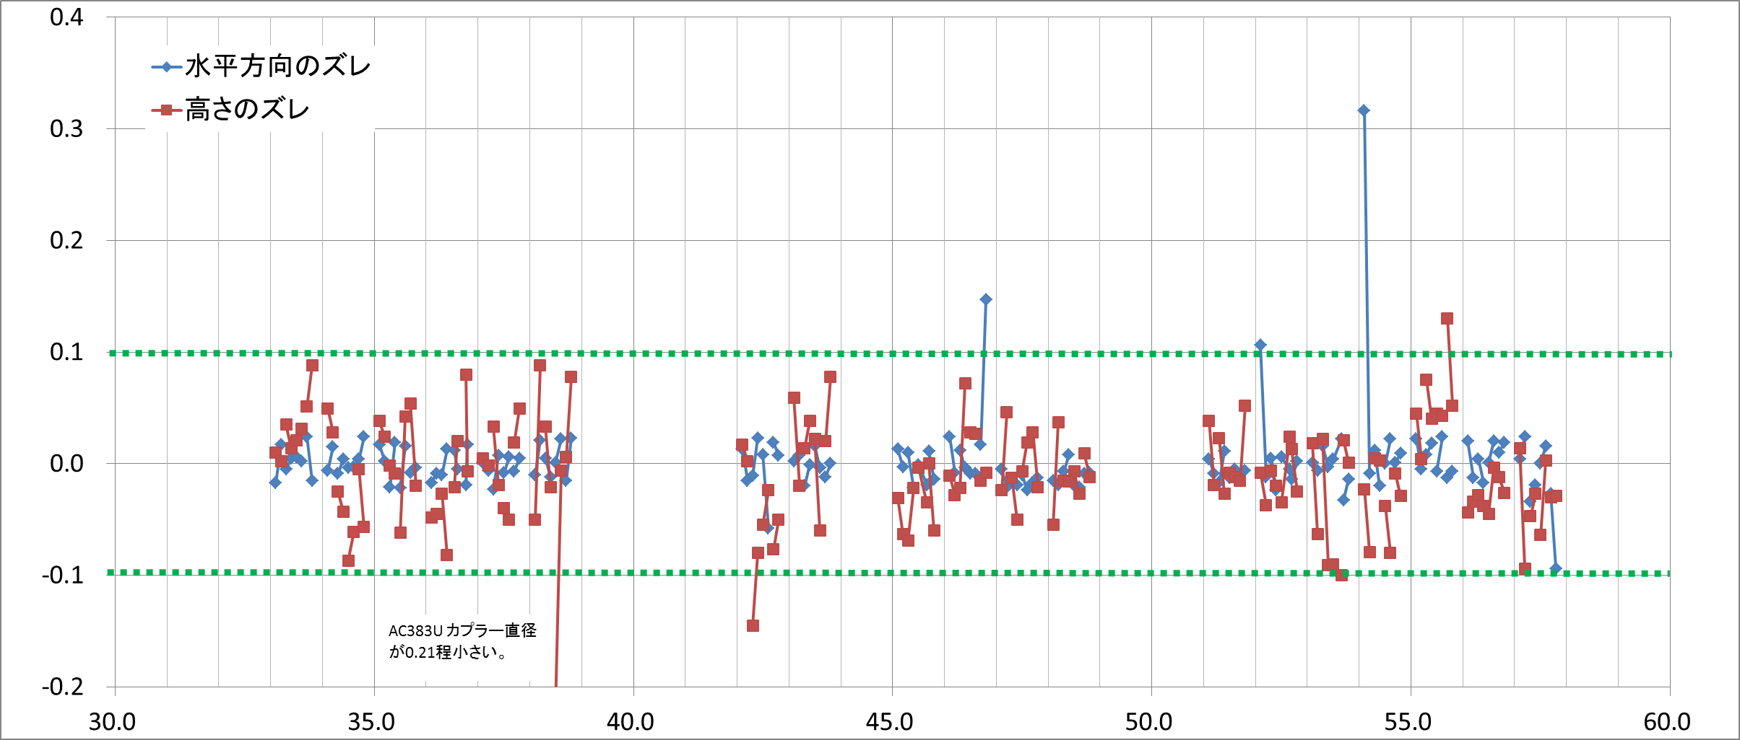
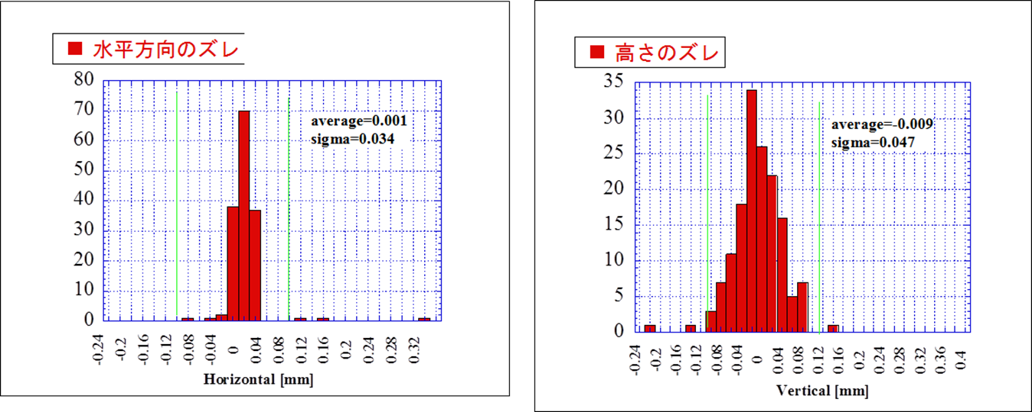
Hard ware alignment on a girders in sector 3 - 5
Horizontal
Vertical
Horizontal
σ=34μm
Vertical
σ=47μm
T. Higo
2015/2/24
KEK Review Higo
18

Slide 19
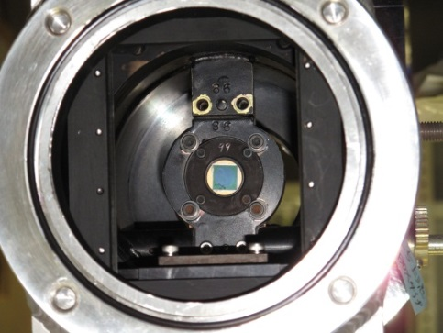
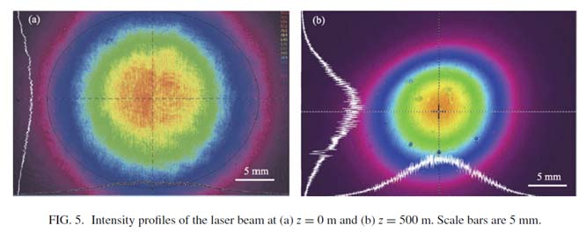
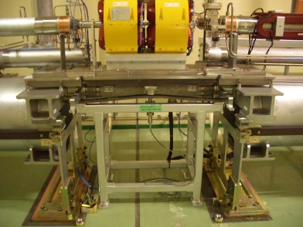
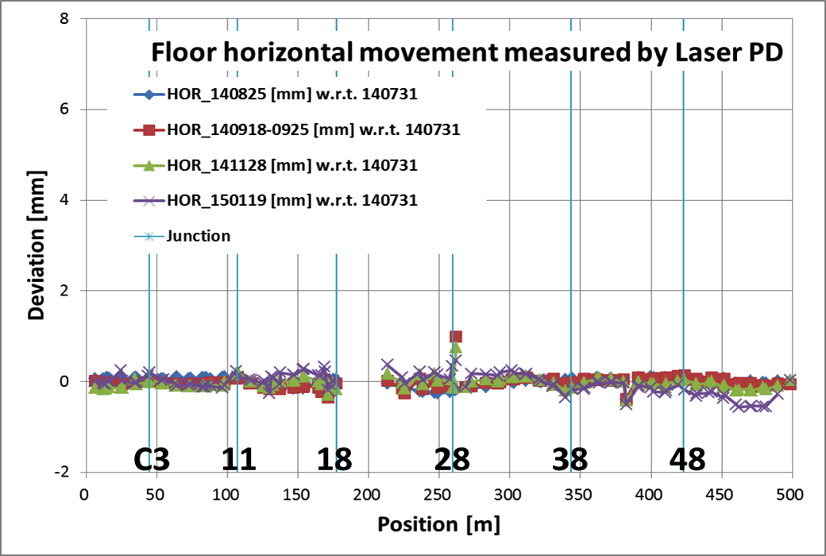
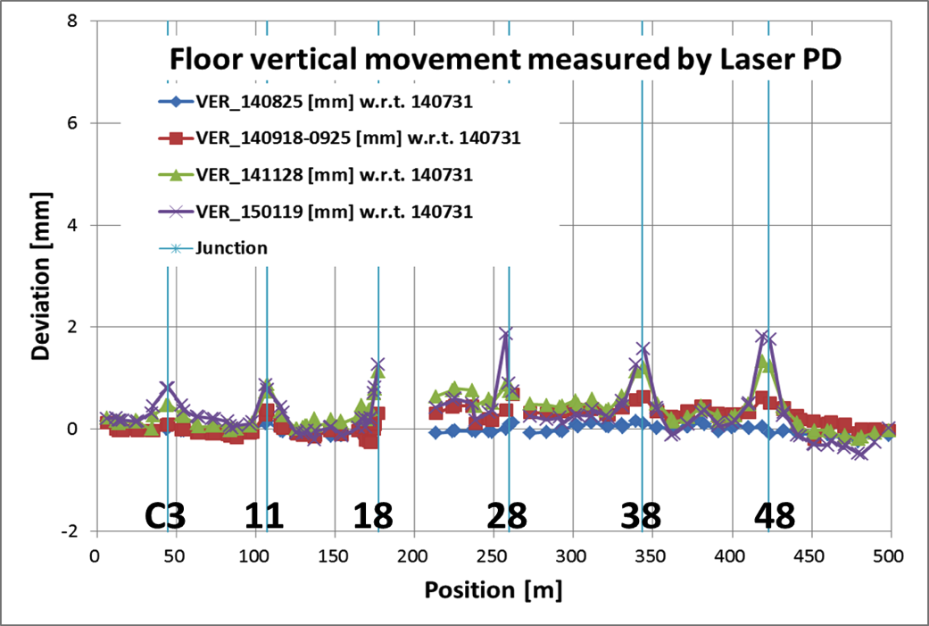
Floor Movement in a Half Year
straight laser of 500m + Position Detector (PD)
T. Suwada
At expansion joint in tunnel, large movement is observed.
4-segmented silicon PD (dia.=10mm)
T. Higo

Slide 20
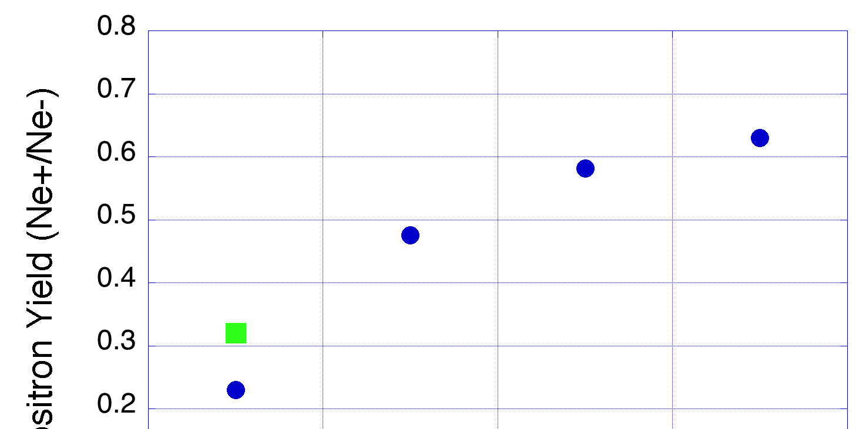
Expected e+ Yield improvement
T. Kamitani, F. Miyahara
At the entrance of LER, 4nC e+ is necessary for 10nC primary e- .
measurement
2014 June
simulation
Designed yield at capture section end
Ne+/Ne- @ capture section end
By raising
DC Solenoid field
FC field and
acceleration field,
2.7 times
Improvement expected.
2014-June
FC 6.4 kA
BC 600 A
DCS 370 A
Acc 10,12 MV/m
FC 6.4 kA
BC 600 A
DCS 650 A
Acc 10,12 MV/m
FC 12 kA
BC 600 A
DCS 650 A
Acc 10,12 MV/m
FC 12 kA
BC 600 A
DCS 650 A
Acc 14,12 MV/m
Start from Oct. 2015
Notes:
this axis is a ratio of number of positrons and primary electrons at the capture section end.
E+ beam commissioning will be started with these design parameters from this October.

Slide 21
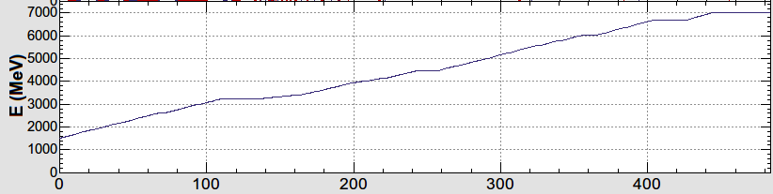
LINAC Beam Acceleration Scheme
e-/e+ beam with different bunch charge and energy are accelerated by 50 Hz repetition rate.
1.1 GeV
Damping Ring
circ. 136 m
Low emittance
RF gun
1.5 GeV
3.5 GeV
10nC x 2 (prim. e-)
5nC x 2 (inj. e-)
BCS
ECS
PF
3T
RF gun
PF-AR
ECS
e+ target &
LAS capture section
chicane
HER
LER
5 nC x2
HER: 7GeV e-
PF-AR: 6.5GeV e-
4.219 GeV
5nCx1
e-
LER: 4GeV e+
4 nCx2
e+
1.1 GeV
PF: 2.5 GeV e-
e+ target
0.1nCx1
1.5 GeV
e-/e+ compatible optics
Optics is changed for each pulse by using
pulsed quads (Doublet) & steering magnets

Slide 22
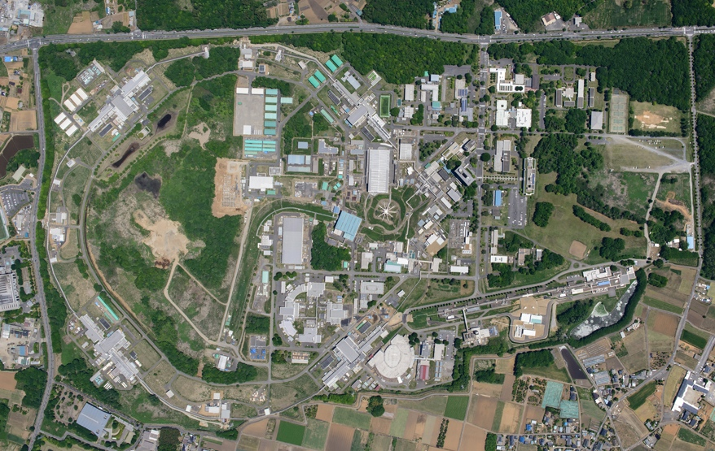
Injector LINAC
The upgrade construction toward SuperKEKB has been started from 2010.
High-current and low-emittance injection beams are required for SuperKEKB.
Upgrade of injector LINAC for SuperKEKB is in progress.
Belle II
e+
HER : e-
7 GeV, 2.6 A
e-
SuperKEKB
Circumference : ∼3 km
LER : e+
4 GeV, 3.6 A
LINAC Provides:
LER: 4 GeV e+ 4nC × 2
HER: 7 GeV e- 5nC × 2
PF: 2.5 GeV e- 0.3nC ×1
PF-AR: 6.5 GeV e- 5nC × 1
STF
Injector LINAC
∼600 m
PF-AR
PF
e+ Damping Ring newly constructed
LINAC is the injector for four storage rings (LER, HER, PF, and PF-AR).
The pulse by pulse beam mode switching in 50 Hz which is repetition rate of the LINAC is necessary for top-up injections into these four rings.
Notes:
The Injector LINAC should provide e+/e- beams to four storage rings (LER, HER of SuperKEKB, PF, and PF-AR)

Slide 23
Beam Lifetime
Y. Funakoshi
 | KEKB (design) |  | KEKB (operation) |  | SuperKEKB Design
 | LER | HER | LER | HER | LER | HER
Radiative Bhabha | 21.3h | 9.0h | 6.6h | 4.5h | 28min. | 20min.
Beam-gas | 45h^{a)} | 45h^{a)} |  |  | 24.5min.^{b)} | 46min. ^{b)}
Touschek | 10h | - |  |  | 10min. | 10min.
Total | 5.9h | 7.4h | ~2.2h | ~3.3h | 6min. ^{c)} | 6min. ^{c)}
Beam current | 2.6A | 1.1A | 1.6A | 1.1A | 3.6A | 2.6A
Loss Rate | 0.12mA/s | 0.04mA/s | 0.23mA/s | 0.11mA/s | 10mA/s | 7.2mA/s
a) Bremsstrahlung
b) Coulomb scattering, sensitive to collimator setting
c) w/o beam-beam effect
Revolution freq~100kHz
For compensation of the particle loss
4nC@25Hz
2.9nC@25Hz
Low emittance and high current injection beams are necessary.
injection rate are required.
LINAC is a key component of SuperKEKB.
Notes:
This is a Breakdown of the beam lifetime.
Radiative Bhabha life time becomes short depending on the Luminosity.
Touschek lifetime is very short because of small emittance and small dynamic aperture due to small betaY*.
(Dynamic aperture of SuperKEKB is extremely small than KEKB.)
KEKB lifetimes were a few hours, but SuperKEKB life time is 6 min. very short.
Loss rate becomes 10 mA/s or so. For compensation of the particle loss, higher injection rate than these values are required.
So, LINAC is upgraded for low emittance and high bunch charge injection to SuperKEKB.

Slide 24
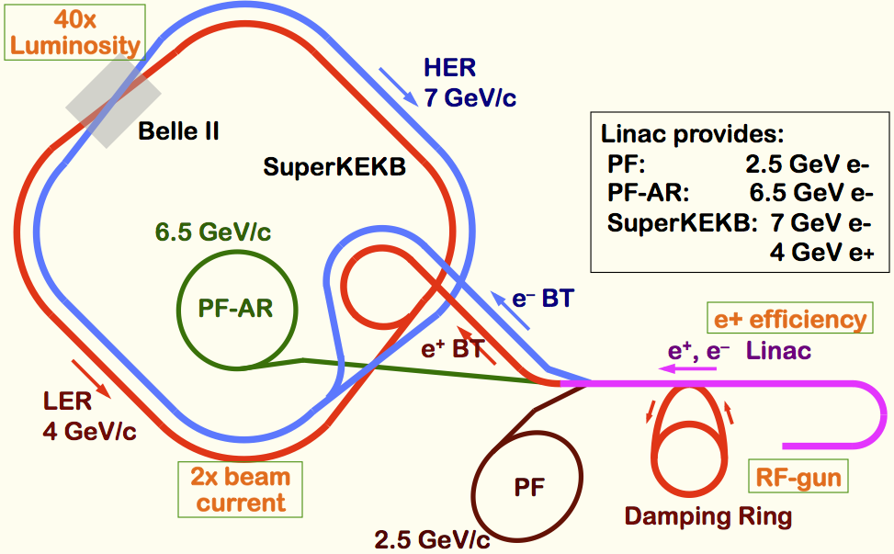
LINAC Beam Parameters
 | for KEKB |  | for SuperKEKB
 | e+ | e- | e+ | e-
Energy | 3.5 GeV | 8.0 GeV | 4.0 GeV | 7.0 GeV
Bunch charge | Primary e-10nC →1 nC | 1 nC | Primary e-10nC → 4 nC | 5 nC
Num. of Bunch / Pulse | 2 | 2 | 2 | 2
Norm.Emittance (γβε) | 2100 (mm⋅mrad) | 100 (mm⋅mrad) | 100/20 (Hor./Ver.) (mm⋅mrad) | 50/20 (Hor./Ver.) (mm⋅mrad)
Energy spread | 0.125% | 0.125% | 0.1% | 0.1%
Repetition rate | 50 Hz |  | 50 Hz
0.3nC ×1
5nC × 1
5nC × 2
4nC × 2
Beam modes are switched in pulse to pulse for 5-rings including Damping Ring (DR).
Notes:
Bunch charge increase 4 or 5 times higher than before.
For positron production, primary e- beam is the same 10 nC. So x4 higher e+ yield is necessary.
For high bunch charge 5nC, it is not easy to satisfy the low emittance.
5nC for e-, 4nC for e+ necessary.
2 bunches are accelerated in one rf pulse.
Linac is a injector of these four rings with different beam energy.

Slide 25
High charge and low emittance are required for SuperKEKB
 | for KEKB |  | for SuperKEKB
 | e+ | e- | e+ | e-
Energy (GeV) | 3.5 | 8.0 | 4.0 | 7.0
Bunch charge (nC) | 1 | 1 | 4 | 5
Norm.Emittance (γβε) (mm⋅mrad) | 2100 | 100 | 100 (H) / 20 (V) | 50 (H) / 20 (V)
Energy spread (%) | 0.125 | 0.125 | 0.1 | 0.1

