Slide 1
Present Status of
Injector Linac and Damping Ring
Kazuro Furukawa
for injector linac and damping ring, KEK

Slide 2
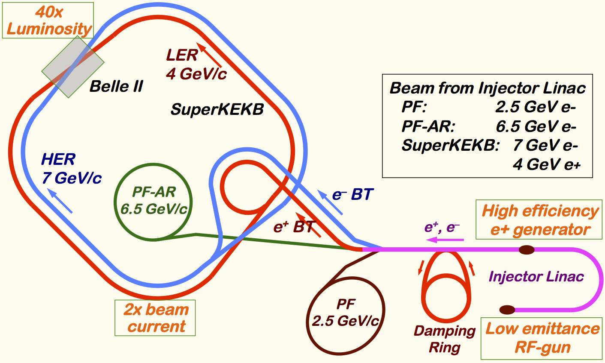
Mission of electron/positron Injector Complex in SuperKEKB
Linac upgrade overview
40-times higher Luminosity
  20-times higher collision rate with nano-beam scheme
    → Low-emittance even at first turn → Low-emittance beam from Injector
    → Shorter storage lifetime
  Twice larger storage beam → Higher beam current from Injector
Injector challenges
  Low emittance e-
    with high-charge RF-gun
  Low emittance e+
    with damping ring
  Higher e+ beam current
    with new capture section and BTs
  Emittance preservation
    with precise alignment & beam control
  4+1 ring simultaneous injection
Notes:
Higher Injection Beam Current
To Meet the larger stored beam current and shorter beam lifetime in the ring
4~8-times larger bunch current for electron and positron
Reconstruction of positron generator, etc
Lower-emittance Injection Beam
To meet nano-beam scheme in the ring
Positron with a damping ring
Electron with a photo-cathode RF gun
Emittance preservation by alignment and beam instrumentation
Quasi-simultaneous injections into 4 storage rings
SuperKEKB e–/e⁺ rings, and light sources of PF and PF-AR
Improvements to beam instrumentation, low-level RF, controls, timing, etc

Slide 3
Required injector beam parameters
Stage | KEKB (final) |  | Present Phase-I |  | SuperKEKB (final)
Beam | e+ | e– | e+ | e– | e+ | e–
Energy | 3.5 GeV | 8.0 GeV | 4.0 GeV | 7.0 GeV | 4.0 GeV | 7.0 GeV
Stored current | 1.6 A | 1.1 A | 1 A | 1 A | 3.6 A | 2.6 A
Life time | 150 min. | 200 min. | 100 min. | 100 min. | 6 min. | 6 min.
Bunch charge | Primary e-10nC → 1 nC | 1 nC | Primary e- 8nC → 0.4 nC | 1 nC | Primary e-10nC → 4 nC | 5 nC
Norm. Emittance (γβε) (μrad) | 2100 | 200 | 2400 | 150 | 100/20 (Hor./Ver.) | 50/20 (Hor./Ver.)
Energy spread | 0.125% | 0.125% | 0.5% | 0.5% | 0.1% | 0.1%
No. of Bunch / Pulse | 2 | 2 | 2 | 2 | 2 | 2
Repetition rate | 50 Hz |  | 25 / 50 Hz |  | 50 Hz
Simultaneous top-up injection (PPM) | 3 rings (KEKB e–/e+, PF) |  | No top-up |  | 4+1 rings (SuperKEKB e–/e+, DR, PF, PF-AR)

Slide 4
Progress
2010: Beam design and hardware developments
2011-2014: Recovery from earthquake, mainly because of soft-structure girder design
2012-: Linac construction and commissioning
2012-: Step-by-step acquirement of beam licenses
2016: Phase-1
2017: Damping ring commissioning, Phase-2
Continuous: Light source injections
…

Slide 5
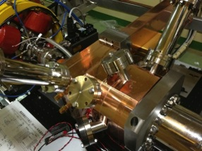
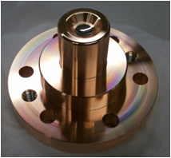
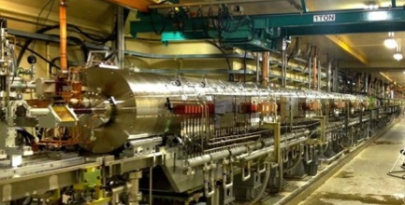
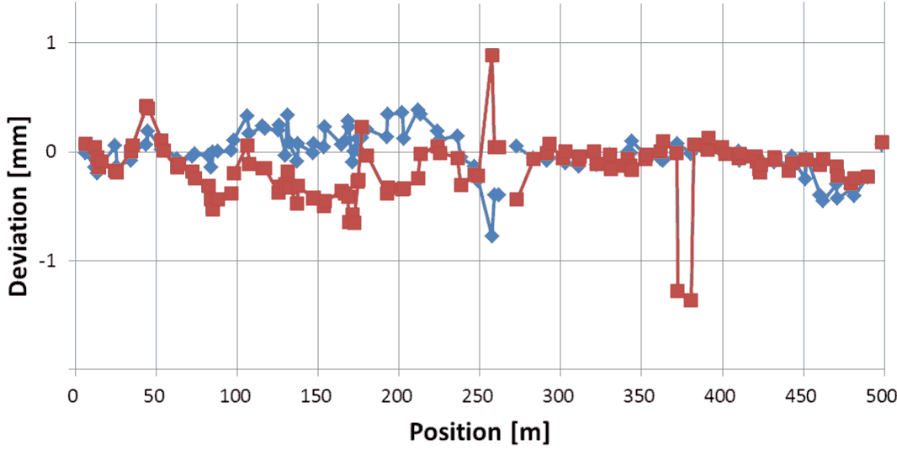
Linac Upgrade Progress towards SuperKEKB (1)
Linac Upgrade Overview
High-charge low-emittance RF gun development
  QTWSC cavity and Ir5Ce photo cathode
  developments
  Laser development is underway
Positron generator commissioning
  Good agreement with the simulation results
  Will solve discharge issues
Precise alignment for emittance preservation
  Recovering after large earthquake in 2011
  Reaching specification of 0.1~0.3mm
  Longer term stability should be solved
Utility upgrade during FY2014
  for electricity (+1.5MW) and cooling water (+1400L/min)
Quasi traveling wave
side couple cavity
Ir₅Ce
Cathode
Positron generator

Slide 6
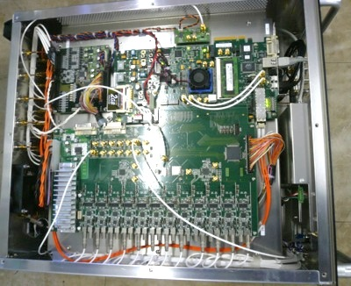
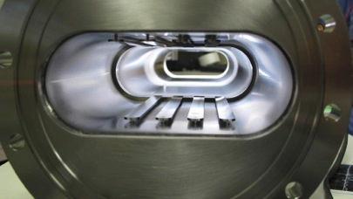
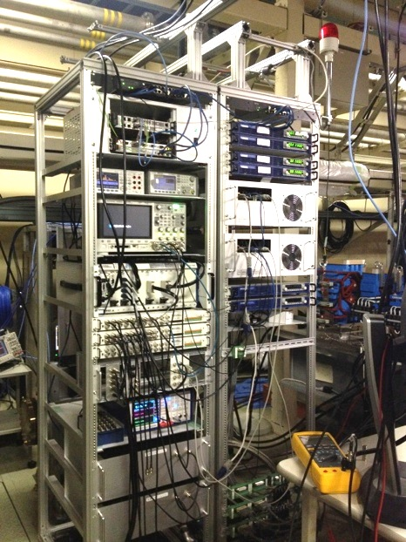
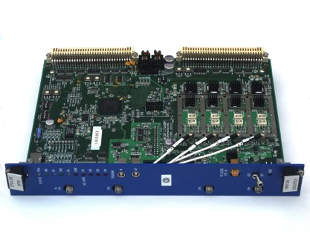
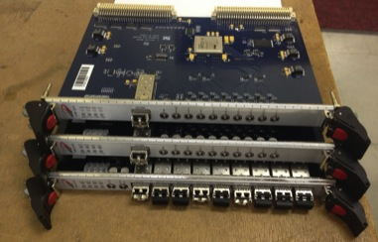
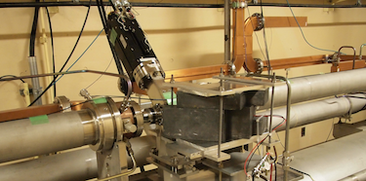
Linac Upgrade Progress towards SuperKEKB (2)
Linac Upgrade Overview
High-power microwave modulator upgrades
Low-level RF controls/monitor upgrades
  Pulse-to-pulse modulation (PPM) between 4+1 rings
  More spaces for increased number of devices
Beam instrumentation
  Large/small aperture beam position monitors (BPM)
  Precise/fast and synchronized BPM readout system
  Wire scanners and beam loss monitors
  Streak cameras
  (Deflectors, etc.)
Pulsed magnet developments
  ~3 bends, ~30 quads, ~40 steerings
  Even with energy recovery
Event-based control and timing system upgrades
  Combination of MRF & SINAP modules
  Essential for PPM operation
  Precise timing & synchronized controls
  Bucket selection at DR and MR
Pulse magnet tests
SINAP event modules
Beam wire scanner

Slide 7
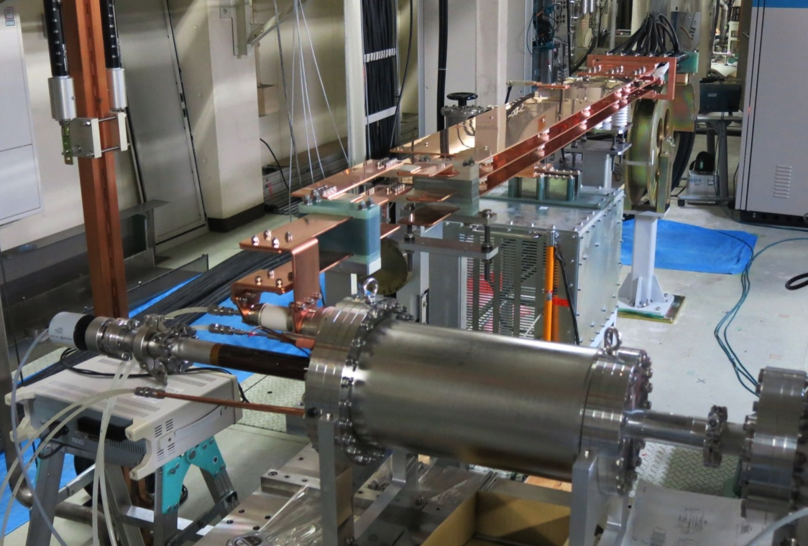
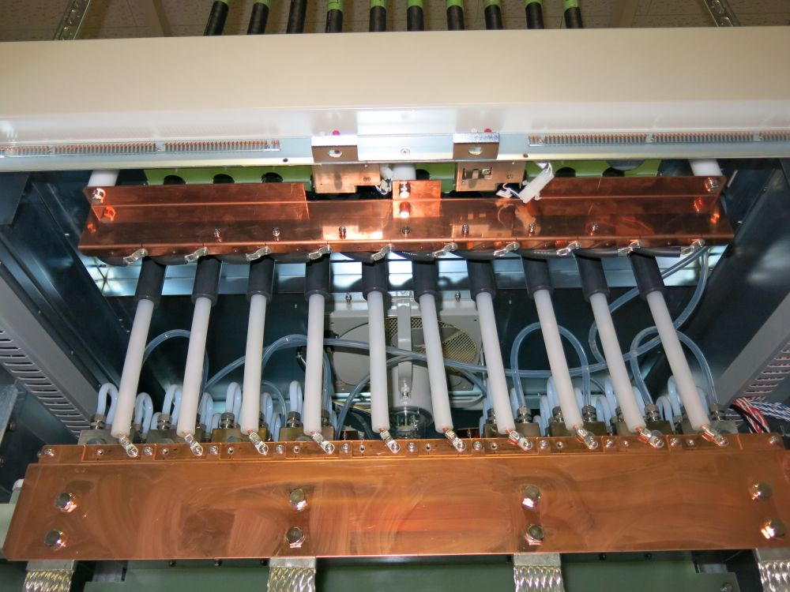
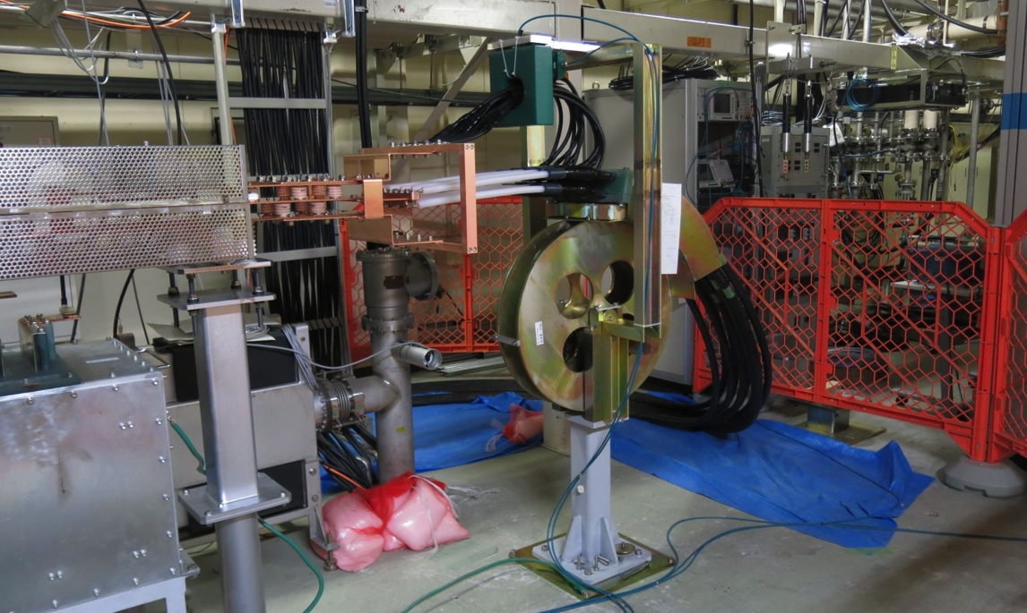
FC test stand (2015 July)
test operation performed with
  spare FC-base (#4)
  12-kA pulse modulator
  new coaxial cables
  new triplate feeder line
  snubber circuit
  but w/o bridge coils
full-spec (12 kA) operation for continuous 200 hours achieved with no serious breakdowns and problems
triplate
feeder line
snubber
circuit
FC-base (#4)
coaxial
cables
cable connection
inside modulator

Slide 8
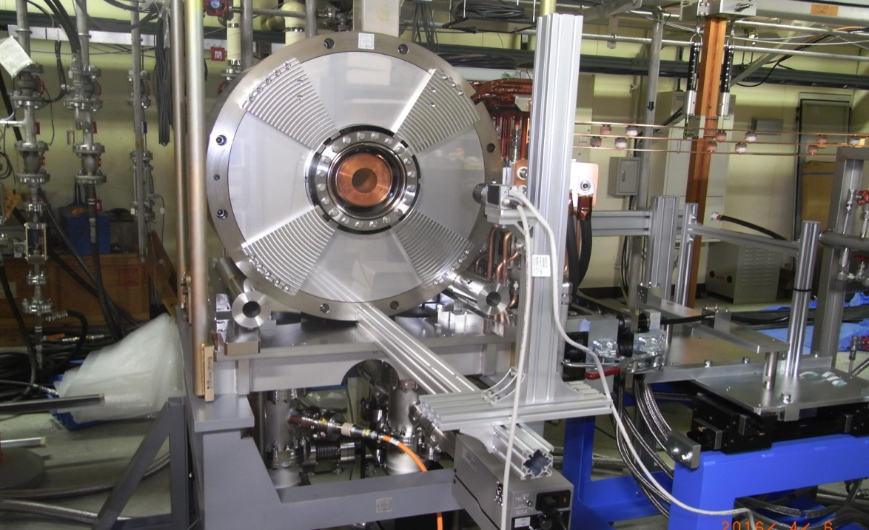
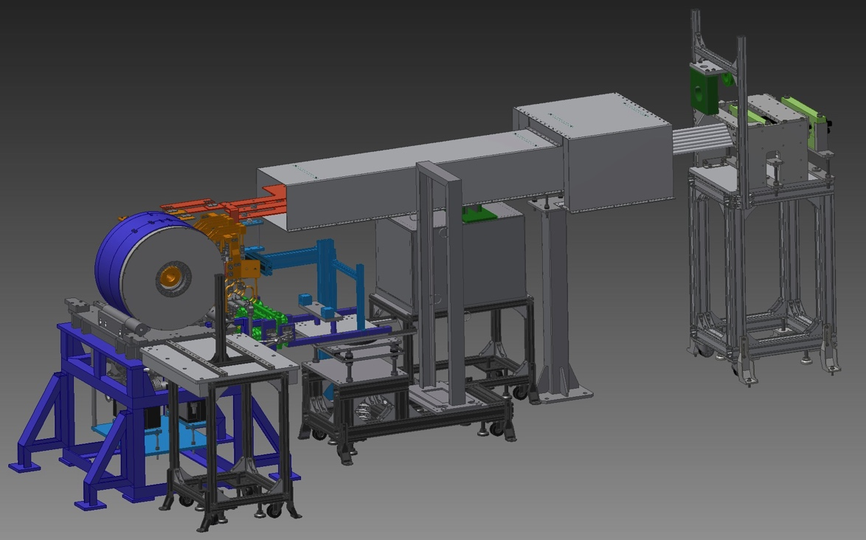
FC assembly #2 & test stand
Operation test with BC field is essential.
FC assembly #1 is radio-activated in the beam line.
Construct assembly #2 for operation with BC field at test stand.
Test-1: operation with FC-head #4
(not work-hardened model) to see what happens in the same situation as the damaged FC.
[2016 June, soon]
Test-2: operation with FC-head #5
(well work-hardened model) to check the operability at full current (12 kA) under the BC field.
[2016 August ~]

Slide 9
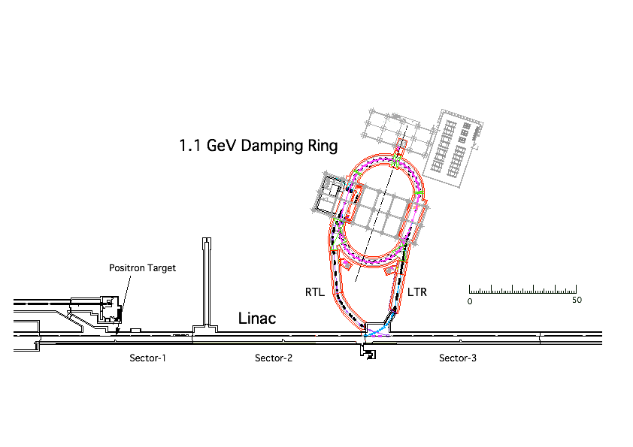
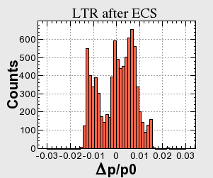
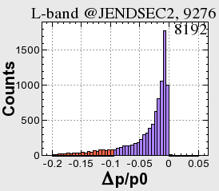
DR layout
Damping Ring System Layout
M. Kikuchi
±1.5%
Energy compression
±5%
Collimators in the arc
20% is cut at tail

Slide 10
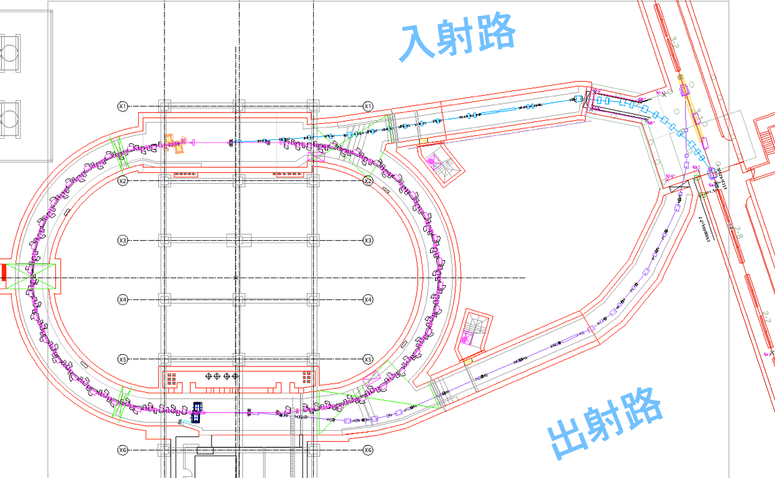
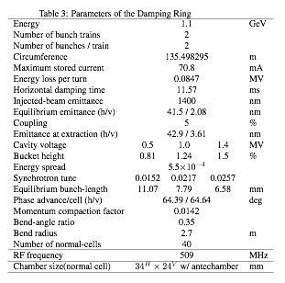
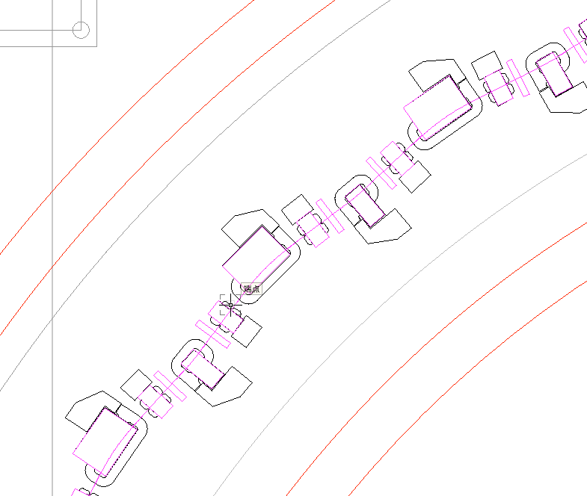
DR layout
Damping Ring Beam Parameters
M. Kikuchi
Linac
LTR
DR
RTL

Slide 11
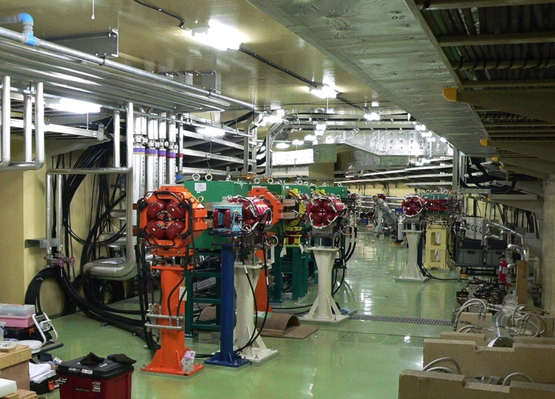
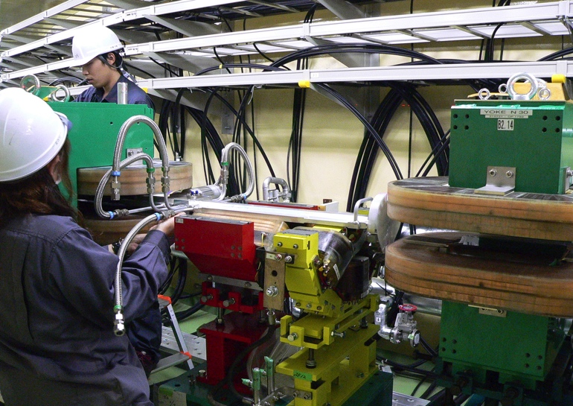
DR construction
Hardware Status
M. Kikuchi
LTR / RTL beam transport lines
  Magnet: Installation completed
  vac. chamber:
    installation, beam instrumentation in 2016 / 2017
DR
  Magnet: Installation completed (except for steerings in the straight)
  Vacuum chamber: installation is underway
Damping
Ring
Extraction
line
DR and the extraction line
Installation of vac. chambers
  Power supplies for the magnets:
    All delivered. Tuning will be done in 2017.
    Steering PS will be delivered in 2017.

Slide 12
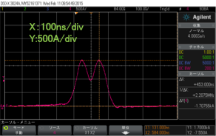
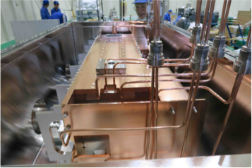
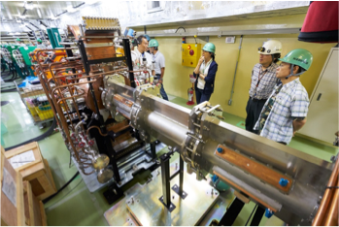
DR construction
  Beam instrumentation:
    Most of sensors, electronics and cables delivered.
    Cabling of BPM completed in FY2015.
M. Kikuchi
  Kicker system for injection/extraction:
    Magnets and the power supplies are delivered.
    Double half-sine pulse for the two bunches
    No ringing after pulse
Pulse shape of the kickers.
  Septum magnets for injection/extraction:
    Magnets and pulsers are delivered.
Septum magnet for injection.
  Two RF cavities were fabricated.
    installed in the tunnel in June 2016.

Slide 13
Bucket selection in Phase-2 with DR
DR timing
Without DR, simply wait up to 5120 x 96 ns ~ 490 μs
  96 ns : highest common frequency between linac – ring
With DR, in order to select arbitrary bucket in MR, have to wait up to ~4.5 ms, even if a bucket in DR was carefully selected
  Power supply can wait only 2 ms, one of only 2798 buckets in 5120 buckets can be selected, may have to change LLRF condition at latter half of linac every pulse
  Can be a big challenge in LLRF precision
e⁻ Gun
KEKB
ARC
Primary e– (3.5GeV, 10nC)
e⁺ BT (3.5GeV, 0.6nC)
e⁺ Target
96ns
>100ns
e⁺ DR (1.1 GeV, 4nC)
e⁻ Gun
>100ns
SuperKEKB
ARC
96ns
Primary e– (3.5GeV, 10nC)
e⁺ BT (KEKB: 4GeV, 4nC)
e⁺ Target

Slide 14
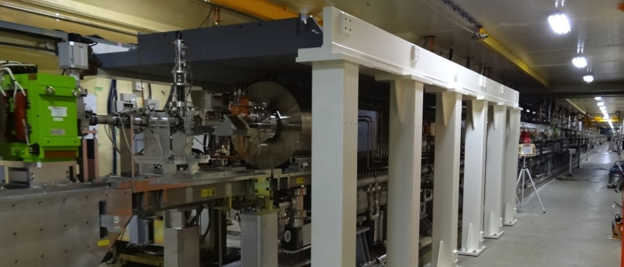
Beam Upgrade and Radiation Controls
Schedule
Step-by-step upgrade of beam limits
  Towards 5 nC per bunch in Phase-3
Beam license applications
  Fall 2013, 10 nA at #28 dump, 1250 nA at #A2 dump
  Spring 2014, New utility rooms, 50 nA at #61 linac-end dump
  Summer 2015, 200 nA at #15 positron target
  Spring 2016, 800 nA at #15 target
  Before Phase-3, 1250 nA at #15 target, 625 nA at #61 dump
Radiation shield additions …
  For Gun, 180deg-arc, Target, Electron stopper, Collimator, Damping-ring dump, Linac-end dump, 5 utility rooms, etc.
Even balancing with PF and PF-AR beam operations

Slide 15
SuperKEKB master schedule
・・・
JFY2010
JFY2011
JFY2012
JFY2013
JFY2014
JFY2015
JFY2016
JFY2017
・・・
Now (Jun, 2016)
KEKB operation
Dismantle KEKB
Phase 2 commissioning：
Low beta* tuning at IP
Collision tuning
Start physics data taking
SuperKEKB upgrade construction
Phase 3：
Physics run with full Belle II with VXD
Phase 1 commissioning goes
as expected even with RF-gun
Startup, conditioning, etc.
Large Earthquake
Mar.2011
SuperKEKB operation
Phase 1
Phase 2、3
Phase 1 commissioning：
Basic machine tuning
Low emittance beam tuning
Vacuum scrubbing
Started on Feb.1.2016.
DR
For ~10 years
Belle II install,
QCS install
DR commissioning starts prior to Phase 2
Akai, Mar.2016.

Slide 16
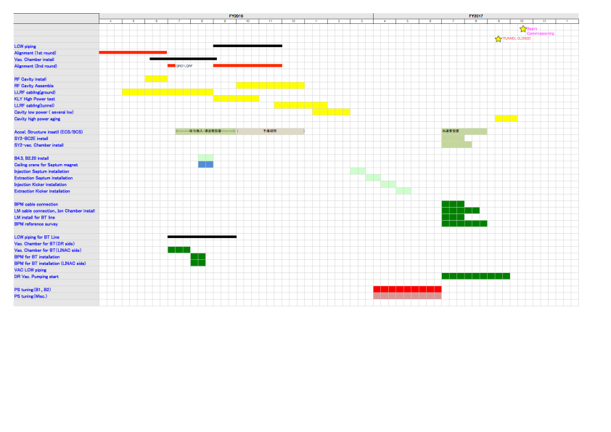
DR schedule
Construction Schedule
M. Kikuchi

Slide 17
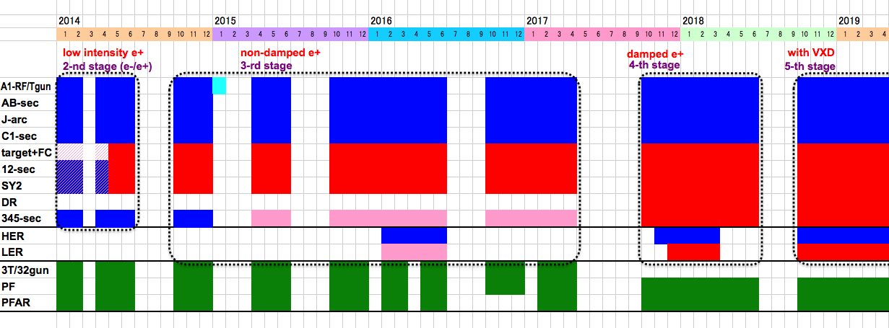
Linac Schedule Overview
Schedule
RF-Gun e- beam
commissioning
at A,B-sector
e- commiss.
at A,B,J,C,1
e+ commiss.
at 1,2 sector (FC, DCS, Qe- 50%)
e- commiss.
at 1,2,3,4,5 sector
Phase1: high emittance beam for vacuum scrub
Phase2,3: low emittance beam for collision
Time →
Location
↓
Beam
Licenses
in steps
Low Emittance Beams
4+1 Ring
Injections
DR
Commiss.
1 nC
Phase1
2 nC
Phase2
4 nC
Phase3
Without Top-up
Direct PF-AR BT
: Electron
non damped e+ commiss.
at 1,2, 3,4,5 sectors
e- commiss. at A→5 sectors
damped e+ commiss.
at 1→5 Qe+ = 1~4nC
e- commiss.
at A→5 Qe- = 1~5nC
Improved
RF gun
: Positron
: Low current electron

Slide 18
Subjects to Consider
Have to consider
too many subjects !
Phronesis needed (Greek: Practical wisdom, Ability to understand the Universal Truth)
Nov.

Slide 19
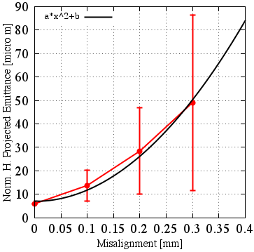
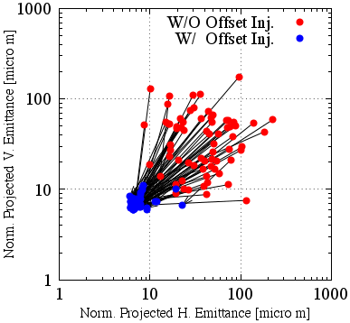
Emittance Preservation
Alignment
Offset injection may solve the issue
Orbit have to be maintained precisely
Mis-alignment should be <0.1mm locally, <0.3mm globally
Mis-alignment leads to Emittance blow-up
Orbit manipulation compensates it
100 samples
Sugimoto et al.

Slide 20
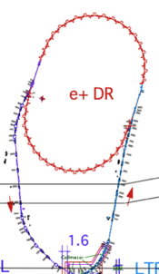
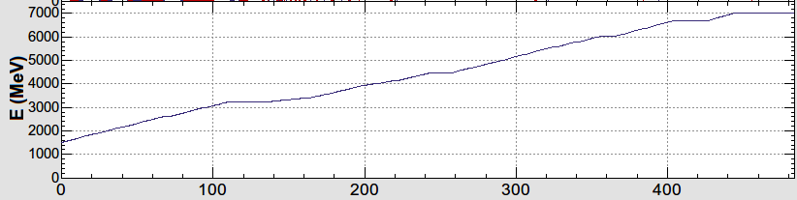
Injector Linac Energy Management
1.1 GeV
Damping Ring
circ. 136 m
e-/e+ beam with different bunch charge and energy are accelerated by 50 Hz repetition rate.
Low emittance
RF gun
1.5 GeV
3.5 GeV
10nC x 2 (prim. e-)
5nC x 2 (inj. e-)
BCS
ECS
PF
3T
RF gun
PF-AR
ECS
e+ target &
LAS capture section
chicane
HER
LER
5 nC x2
HER: 7GeV e-
PF-AR: 6.5GeV e-
4.219 GeV
5nCx1
e-
LER: 4GeV e+
4 nCx2
e+
1.1 GeV
PF: 2.5 GeV e-
e+ target
0.1nCx1
1.5 GeV
e-/e+ compatible optics
Optics is changed for each pulse by using
pulsed quads (Doublet) & steering magnets

Slide 21
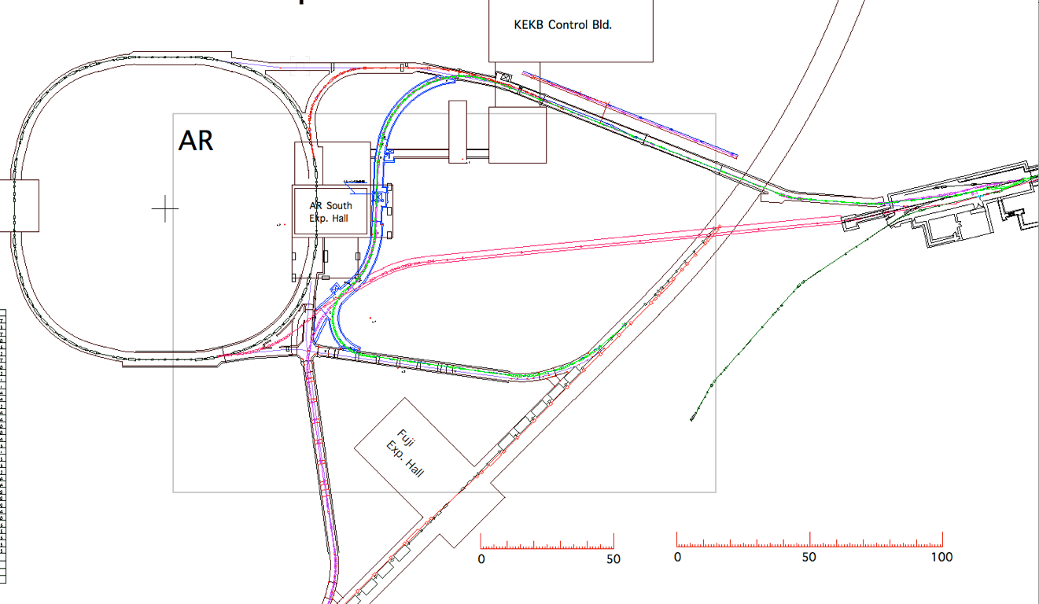
Spares

Slide 22
Pulse-to-pulse modulation
Event-based
Control System
Four PPM virtual accelerators
for SuperKEKB project
Based on
Dual-tier controls with
EPICS and event-system
Independent parameter sets
for each VA (20ms)
>200 parameters
for equipment controls
many more
for beam controls
maybe with additional PPM VA
of stealth beam
for measurement
Every
20 ms
F.B
e⁻ Gun
F.B
ARC
PF Injection
e– (2.5GeV, 0.2nC)
F.B
e⁻ Gun
Damping ring
SuperKEKB-LER Injection
F.B
ARC
e– (3.5GeV, 10nC)
F.B
e⁺ Target
e⁺ (4GeV, 4nC)
e⁻ Gun
ARC
SuperKEKB-HER Injection
F.B
F.B
e– (7GeV, 5nC)
e⁻ Gun
F.B
ARC
PF-AR Injection
e– (6.5GeV, 5nC)

Slide 23
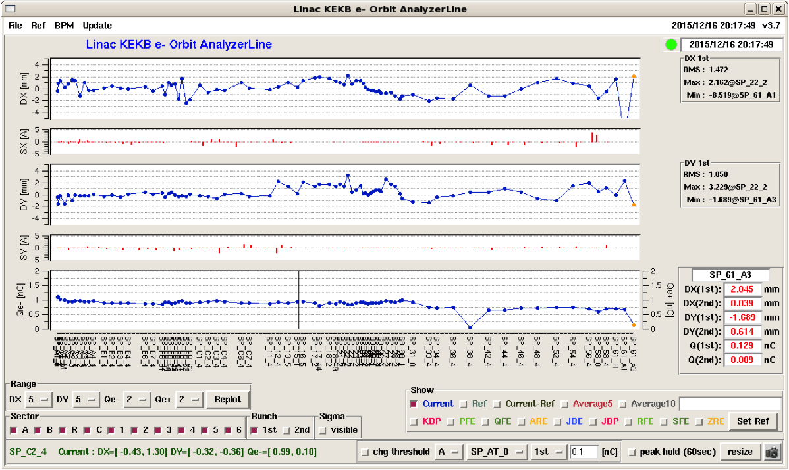
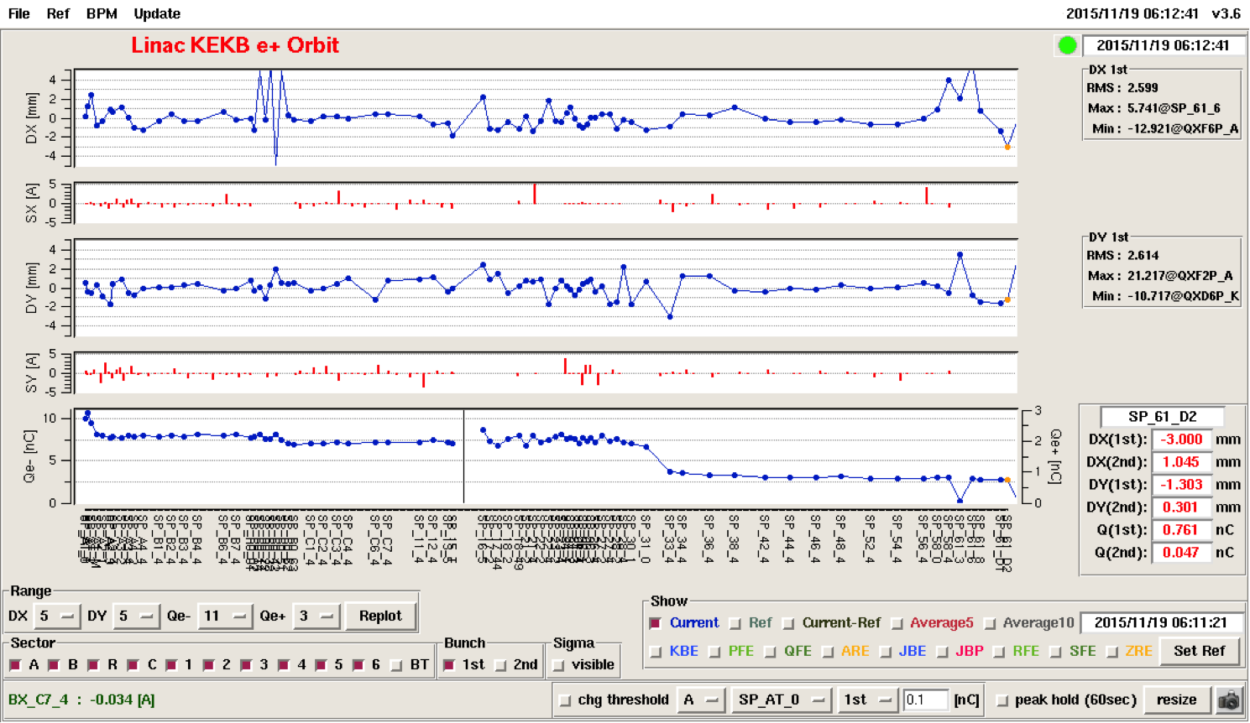
Injector Beam Commissioning for Phase-1
Electron beam
  Thermionic gun
  at the beginning
  1 nC per bunch
  2 bunches per pulse
  50 pulse per second
Positron beam
  Primary electron
  with 7-8 nC per bunch
  Positron of 0.7 nC
  at linac end
  without damping ring

Slide 24
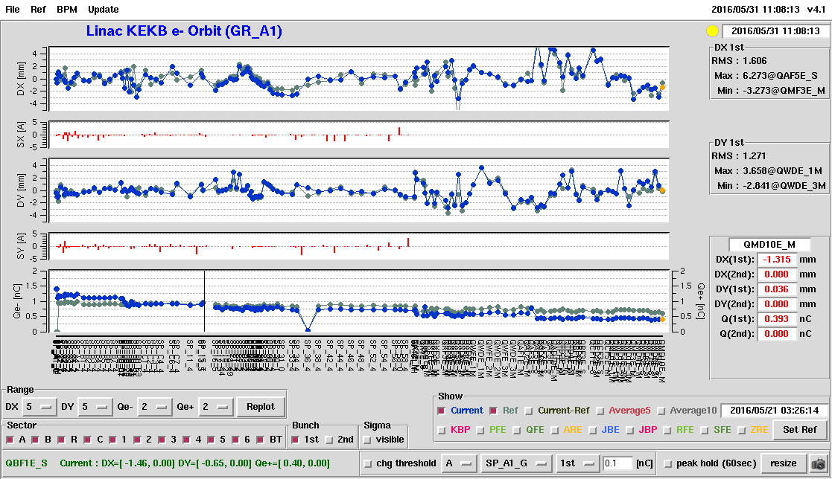
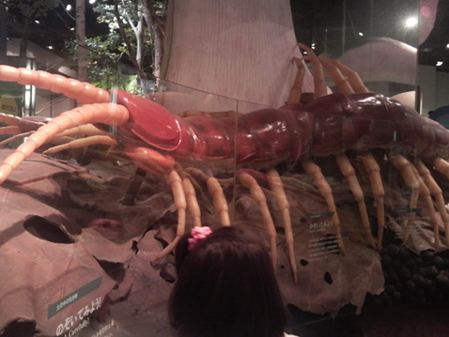
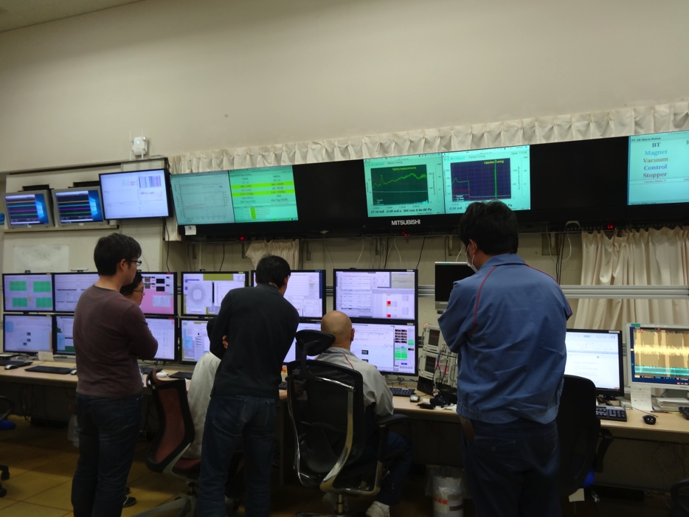
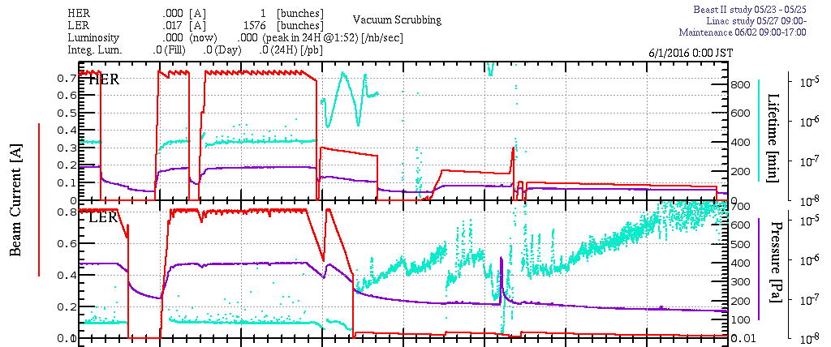
Progress: RF gun
Beam from RF gun
MR injection from RF gun during Phase-1 was recommended in the last gun review, and was planned for May 2016 since the last year
On May 31, even an unusual centipede (~15cm!!) managed to visit the operation room to celebrate the first injection into HER
Ibaraki Nature Museum

Slide 25
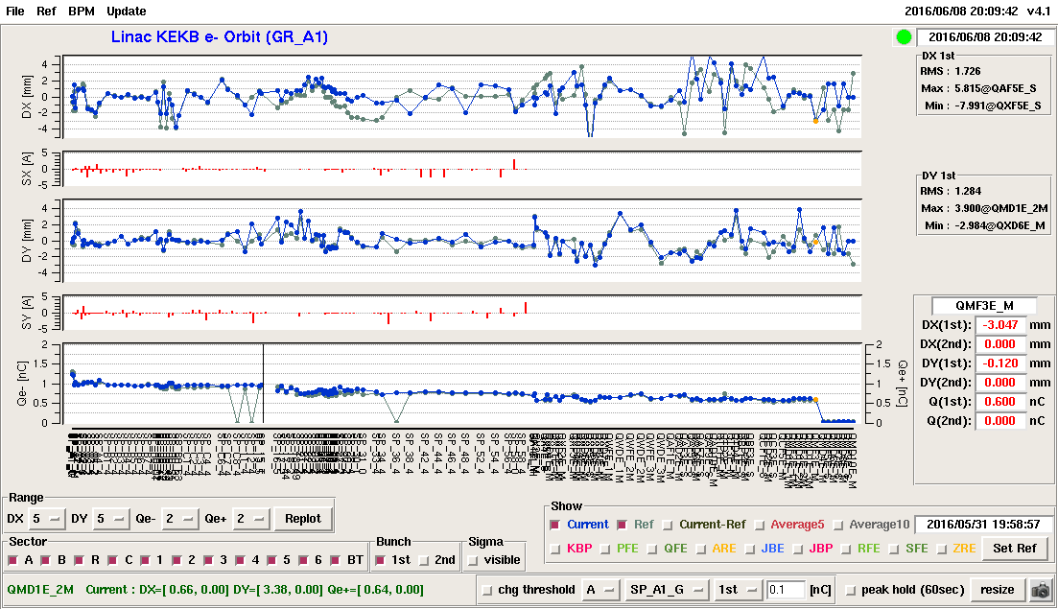
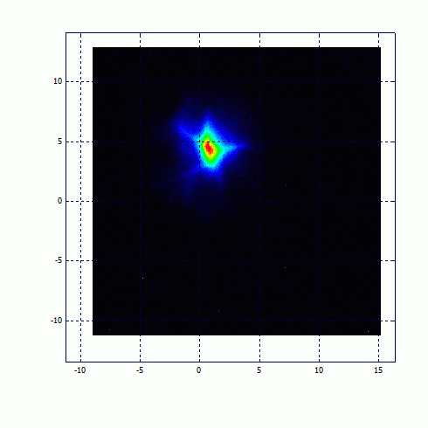
Beam from RF gun
Beam from RF gun
Successful Injection into MR for the first time, on May.31
And continuing the RF gun operation since Jun.8

Slide 26
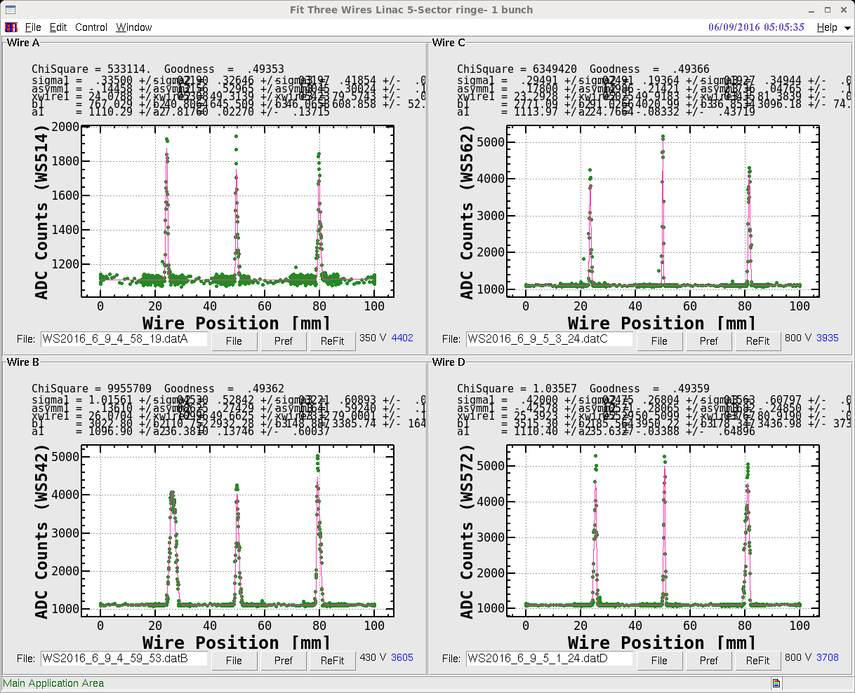
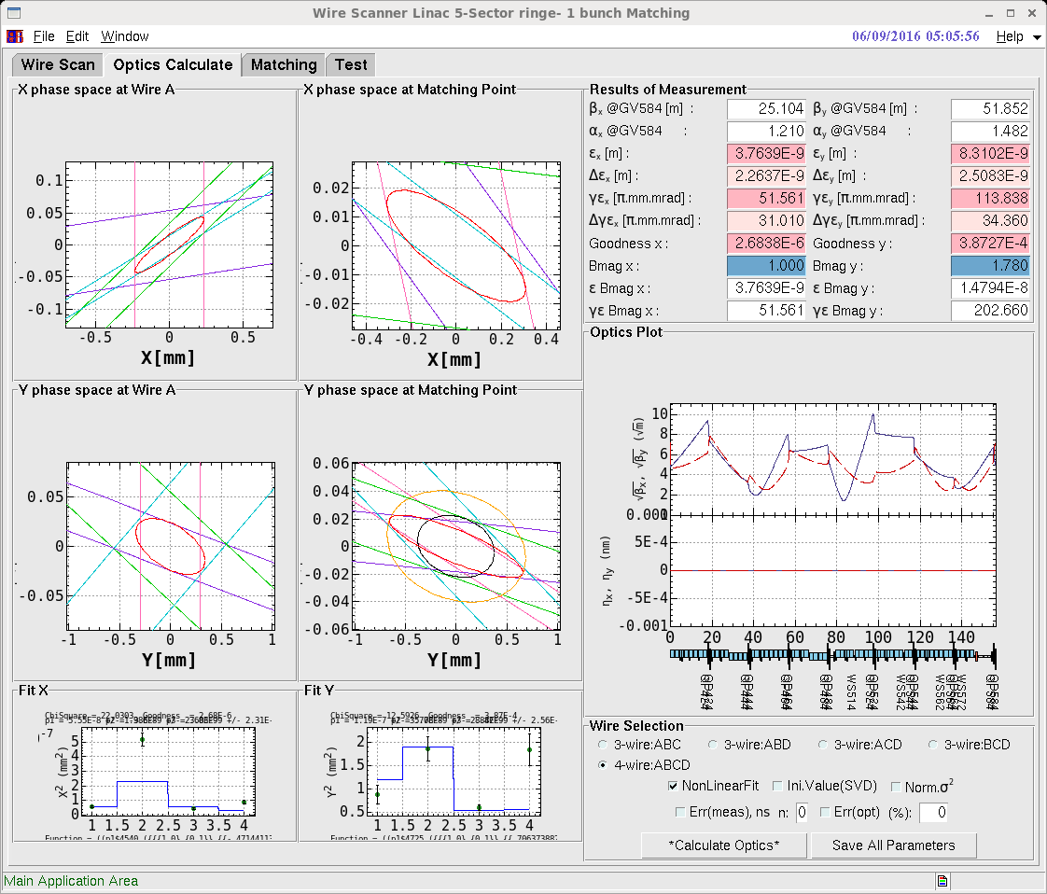
Wire Scanner Measurement
Beam from RF gun
Present beam: 1nC/bunch, 25Hz, 20mm.mrad at the gun,
30~200 mm.mrad at the linac end, ? Energy spread
Phase-2: 2nC/bunch, 50Hz, 20 mm.mrad at the linac end, 0.1% energy spread
Phase-3: 4-5nC/bunch
Much room to enjoy the improvements

Slide 27
Summary
Summary
Injection into SuperKEKB is another challenge with higher beam charge and lower transverse and longitudinal emittance
Steady progress towards designed injection beam in steps
  Alignment: almost confident on the required precision (0.1-mm local, 0.3-mm global), need to maintain for longer term
  Positron generator: another license test, need discharge analysis
  Thermionic gun: re-commissioned for primary electron for positron generation
  RF gun: successful HER injection, following recommendations at review meetings
  Need more radiation shield
  Need much construction left for 2017
Will balance between final beam quality and progressive operation
Will select optimized route depending on available resources
  Negotiation with light sources
  Commissioning and development in parallel (no other choices)

Slide 28
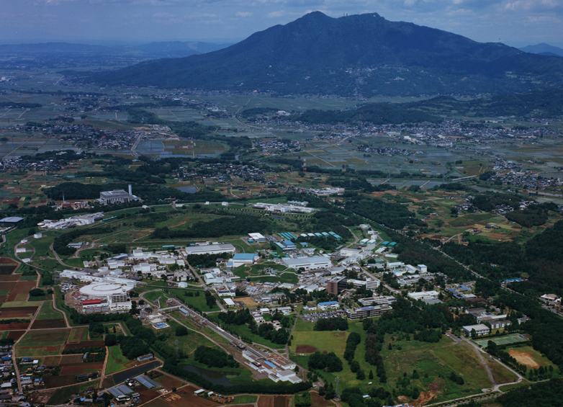
Mt. Tsukuba
Thank you
SuperKEKB
dual rings
PF-AR
PF
600m Injector
Linac

