Slide 1
Operation plans and Luminosity projections:
- near-term and middle-term -
Y. Suetsugu
Accelerator Laboratory, KEK

Slide 2
Contents
Some results of Phase-3 2019c run at a glance
  Details were covered by Ohnishi-san
Operation plans and luminosity projections
  Near term (~2020/June, ~2021/March=FY2020)
  Middle term (~2023/March=FY2022)
Summaries

Slide 3
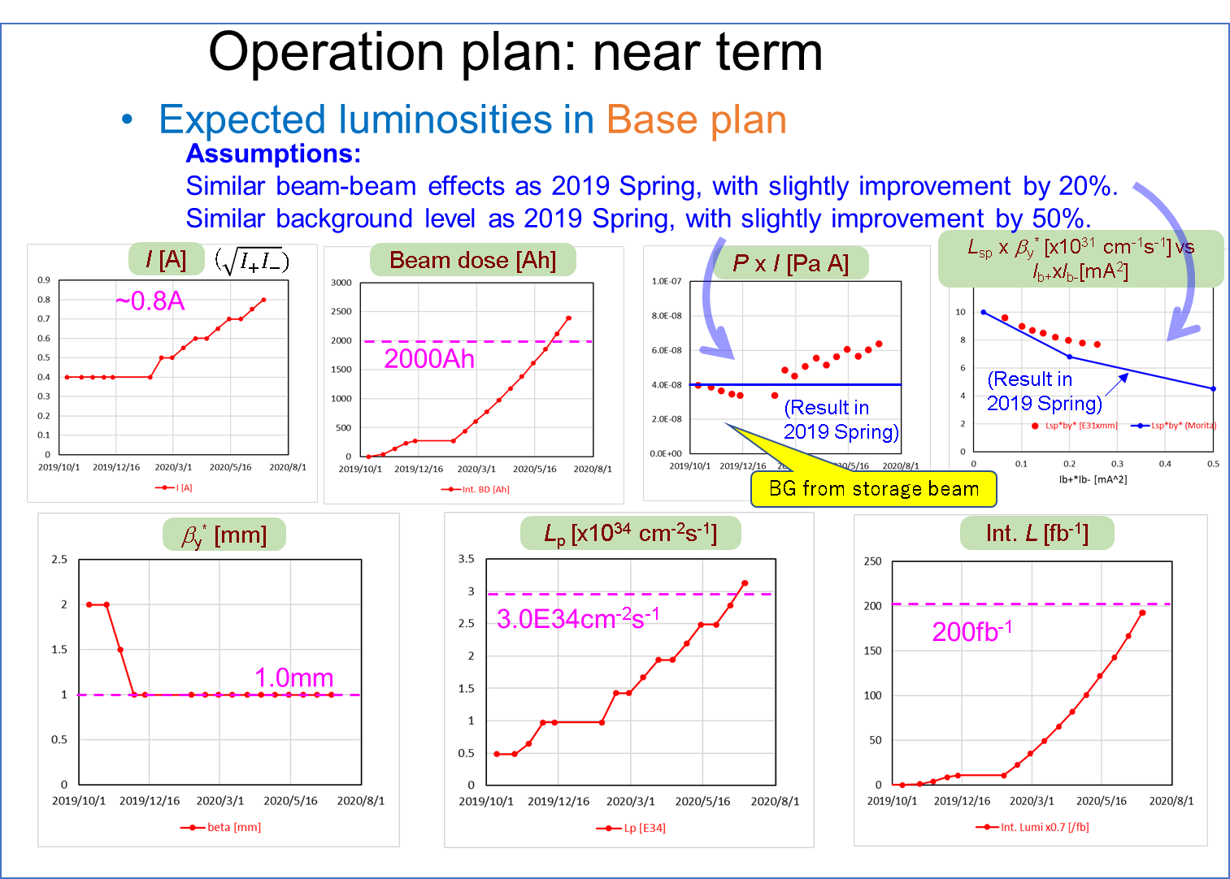
Some results of Phase-3 2019c run
Luminosity plan
presented in
2019/10/27 BPAC
● Cal, Assumption

Slide 4
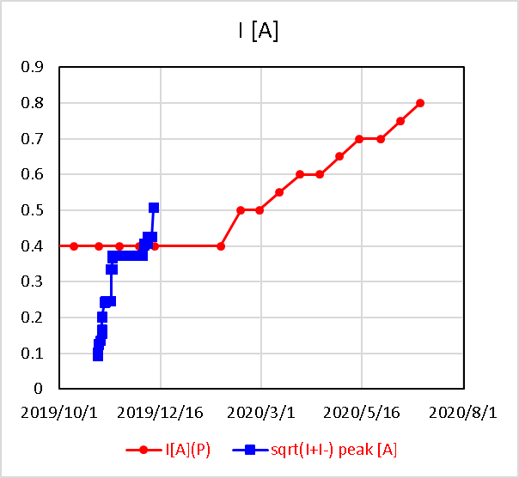
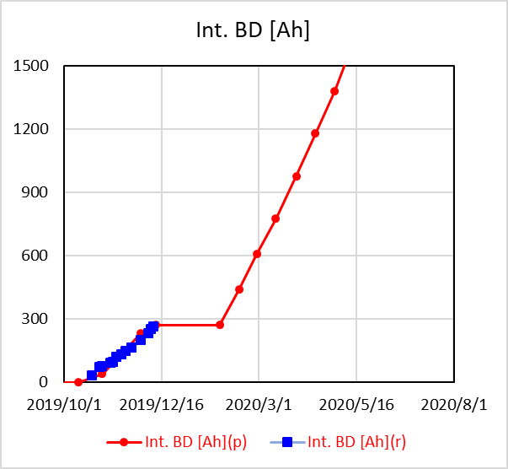
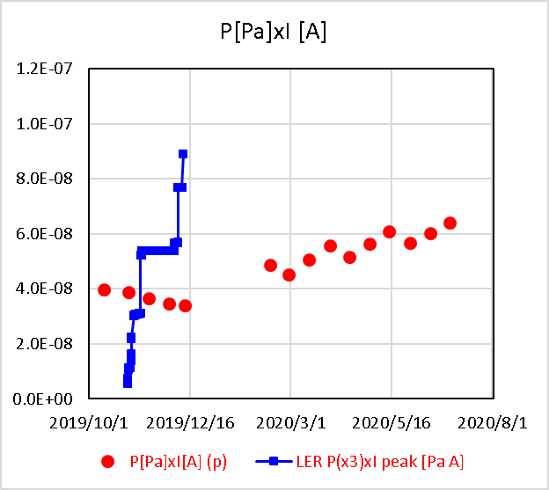
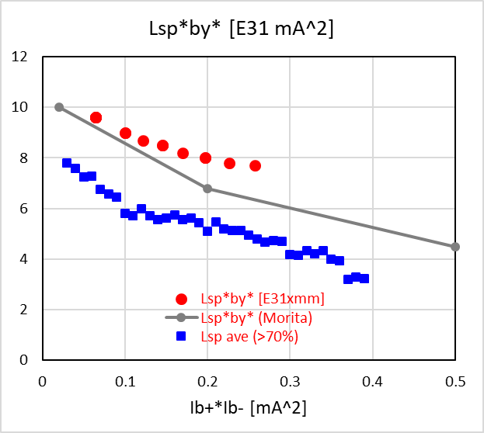
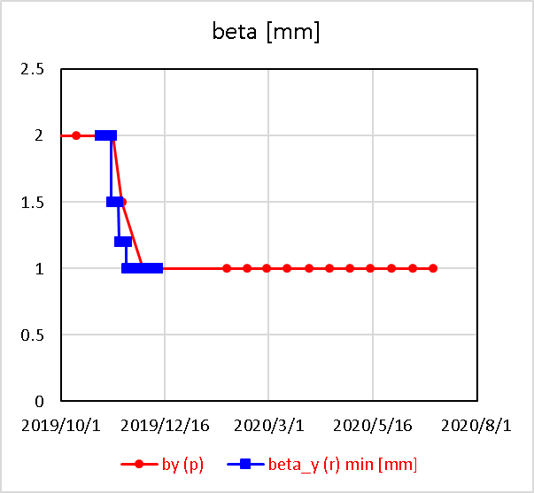
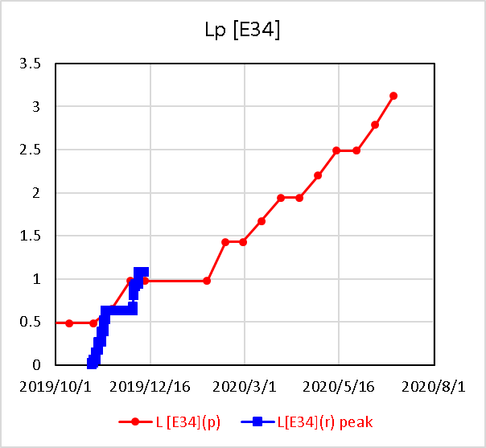
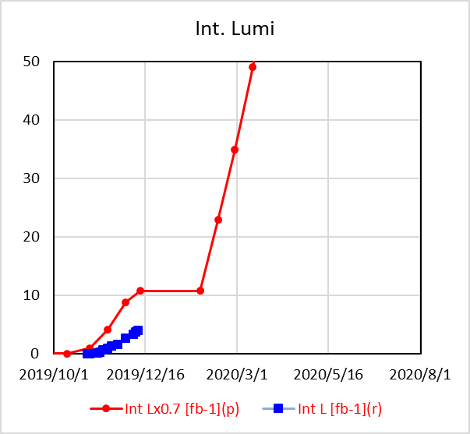
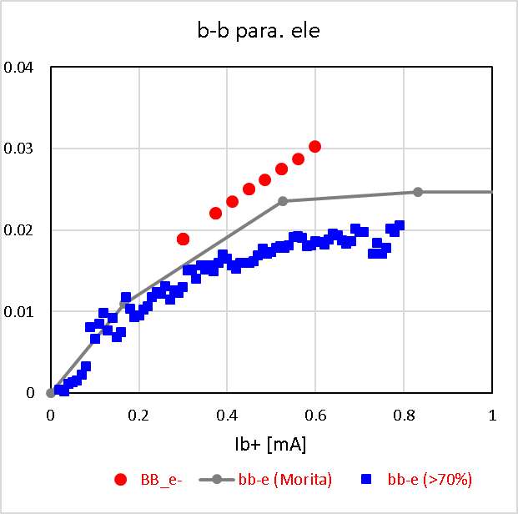

Some results of Phase-3 2019c run
● Cal., Assumption
■ Result in 2019c
P x I [Pa A]
BG from storage beam
L_{sp} x β_{y}* [x10³¹ cm⁻¹s⁻¹] vs I_{b+}xI_{b-}[mA²]
I [A]
($\sqrt{I_{+}I_{−}})$
Beam dose [Ah]
Belle HV on
~0.5A
(Result in
2019b)
~300Ah
(Result in
2019b)
Belle HV on
at β_{y}*=1mm
β_{y}* [mm]
L_{p} [x10³⁴ cm⁻²s⁻¹]
Int. L [fb⁻¹]
B-B param. (HER)
1.14E34cm⁻²s⁻¹
1mm
(Result in
2019b)
~4fb⁻¹

Slide 5
Some results of Phase-3 2019c run
● Cal., Assumption
■ Result in 2019c
P x I [Pa A]
BG from storage beam
L_{sp} x β_{y}* [x10³¹ cm⁻¹s⁻¹] vs I_{b+}xI_{b-}[mA²]
I [A]
($\sqrt{I_{+}I_{−}})$
Beam dose [Ah]
Belle HV on
~0.5A
(Result in
2019b)
~300Ah
(Result in
2019b)
Belle HV on
at β_{y}*=1mm
Beam currents | Beam dose | P x I (a measure of BG from storage beam) | L_{sp} x β_{y}* (a measure of BB effect)
Almost achieved | Achieved | Higher than expected | 70~80% of expectation
 |  | Collimator tuning Baking of collimators Vacuum scrubbing

Slide 6
Some results of Phase-3 2019c run
● Cal., Assumption
■ Result in 2019c
at β_{y}*=1mm
β_{y}* [mm]
L_{p} [x10³⁴ cm⁻²s⁻¹]
Int. L [fb⁻¹]
B-B param. (HER)
1.14E34cm⁻²s⁻¹
~0.02
1mm
(Result in
2019b)
~4fb⁻¹
β_{y}* | Luminosity | Integrated luminosity | Beam-Beam parameter (HER)
Achieved | Achieved | ~50 % | 70~80% of expectation
 |  | Low currents during phys. run Short time for phys. run | Need more study and tuning

Slide 7
Operation plans and luminosity projections
1. Near term-1 (~2020/June)
Here the luminosity projection was re-evaluated based on the 2019c result and operation plan.
(1) Base (conservative) plan
Assumptions:
1) 2020a run starts from 2020/3/2.
LER starts 2020/2/25 for vac. scrubbing and tuning.
2) 2020a and b runs are basically dedicated to physics run. (~100 days for physics run)
3) β_{y}* is kept at 1 mm.
Note: Details of the commissioning plan was reported by Ohnishi-san.

Slide 8
Operation plans and luminosity projections
1. Near term-1 (~2020/June)
Here the luminosity projection was re-evaluated based on the 2019c results.
(1) Base (conservative) plan
Assumptions:
1) 2020a run starts from 2020/3/2.
LER starts 2020/2/25 for vac. scrubbing and tuning.
2) 2020a and b runs are basically dedicated to physics run. (~100 days for physics run)
3) β_{y}* is kept at 1 mm.
4) BG from injection beams is improved. (stable injection, low emittance)
An essential point in the future commissioning!

Slide 9
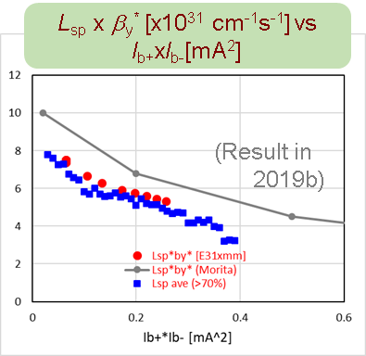
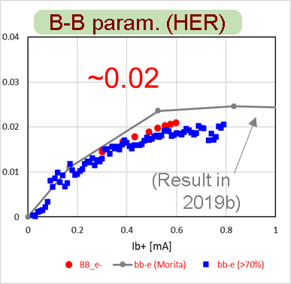
Operation plans and luminosity projections
1. Near term-1 (~2020/June)
Here the luminosity projection was re-evaluated based on the 2019c results.
(1) Base (conservative) plan
Assumptions:
1) 2020a run starts from 2020/3/2.
LER starts 2020/2/25 for vac. scrubbing and tuning.
2) 2020a and b runs are basically dedicated to physics run. (~100 days for physics run)
3) β_{y}* is kept at 1 mm.
4) BG from injection beams is improved. (stable injection, low emittance)
5) Using proven beam-beam effect in 2019c.

Slide 10
Operation plans and luminosity projections
1. Near term-1 (~2020/June)
Here the luminosity projection was re-evaluated based on the 2019c results.
(1) Base (conservative) plan
Assumptions:
1) 2020a run starts from 2020/3/2.
LER starts 2020/2/25 for vac. scrubbing and tuning.
2) 2020a and b runs are basically dedicated to physics run. (~100 days for physics run)
3) β_{y}* is kept at 1 mm.
4) BG from injection beams is improved. (stable injection, low emittance)
5) Using proven beam-beam effect in 2019c.
6) Similar background level (storage beam) as 2019c.
7) Expecting vacuum scrubbing of LER(Decrease in dP/dI is proportional to 1/BD). → Increase in beam currents.
8) Efficiency of integrated luminosity is 70% of peak luminosity.
9) 1576 bunches

Slide 11
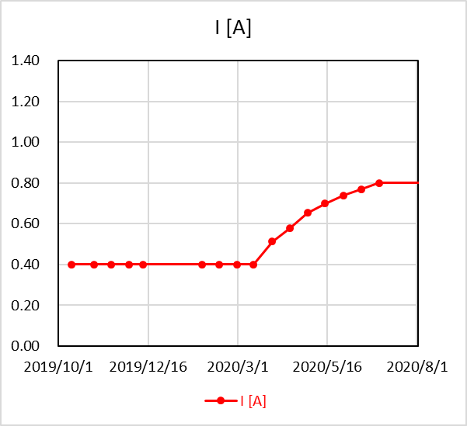
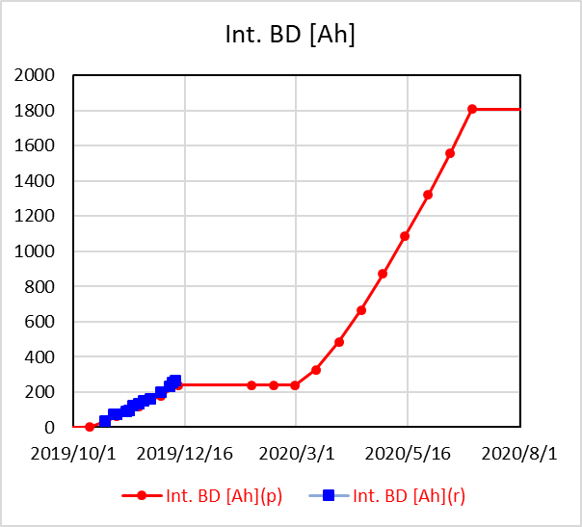
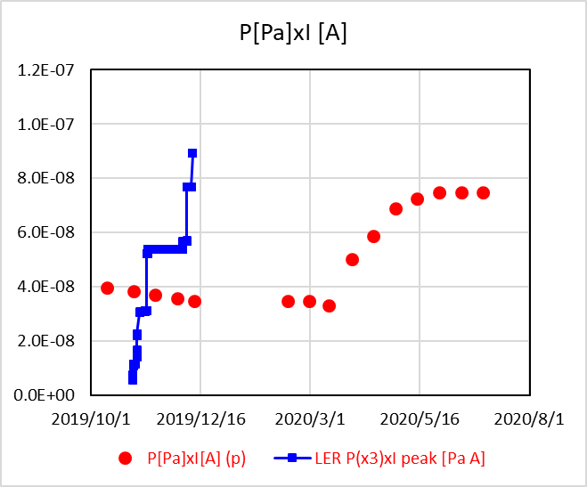
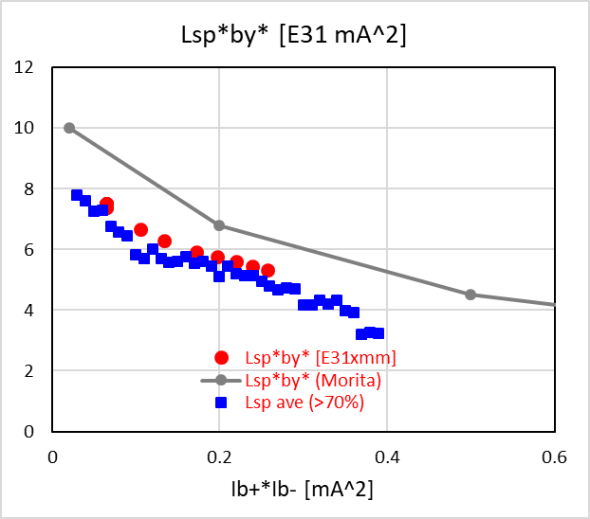
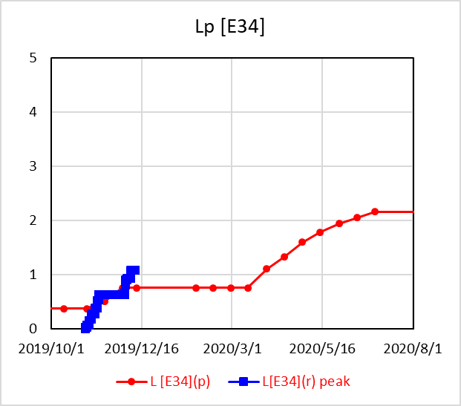
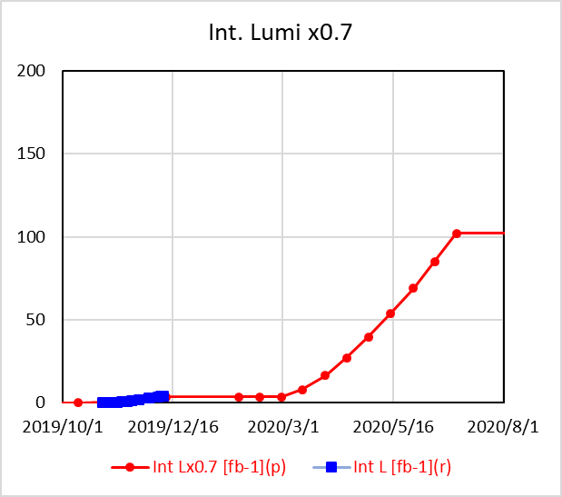
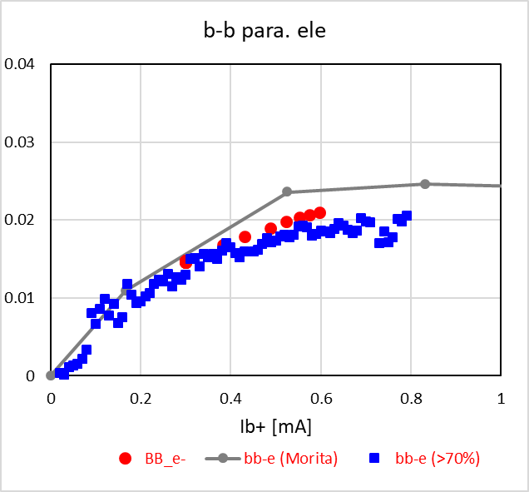

Operation plans and luminosity projections
1. Near term-1 (~2020/June)
(1) Base (conservative) plan
● Cal., Assumption
■ Result in 2019c
P x I [Pa A]
BG from storage beam
L_{sp} x β_{y}* [x10³¹ cm⁻¹s⁻¹] vs I_{b+}xI_{b-}[mA²]
I [A]
($\sqrt{I_{+}I_{−}})$
Beam dose [Ah]
~1.8 kAh
Belle HV on
~0.8A
(Result in
2019b)
Belle HV on
(Result in
2019c)
at β_{y}*=1mm
β_{y}* [mm]
L_{p} [x10³⁴ cm⁻²s⁻¹]
Int. L [fb⁻¹]
B-B param. (HER)
~0.02
2.2E34cm⁻²s⁻¹
~100 fb⁻¹
1mm
(Result in
2019b)

Slide 12
Operation plans and luminosity projections
1. Near term-1 (~2020/June)
Hardware improvements during winter shutdown and their expected effects
Additional V-type beam collimator
BG reduction
Increase in beam currents

Slide 13
Operation plans and luminosity projections
1. Near term-1 (~2020/June)
Hardware improvements during winter shutdown and their expected effects
Additional V-type beam collimator
BG reduction
Replacement and activation of RF-gun cathode
Establishment of 2-bunch injections
Increase in beam currents

Slide 14
Operation plans and luminosity projections
1. Near term-1 (~2020/June)
Hardware improvements during winter shutdown and their expected effects
Additional V-type beam collimator
BG reduction
Replacement and activation of RF-gun cathode
Establishment of 2-bunch injections
Increase in beam currents
Beam-beam parameter improvement
(Beam Tail ↓, BG ↓, Currents ↑, → Lumi. ↑)
Preparation of Crab waist scheme
Improvements in BG, optics and beam dynamics issues are also expected by machine studies during beam operation.

Slide 15
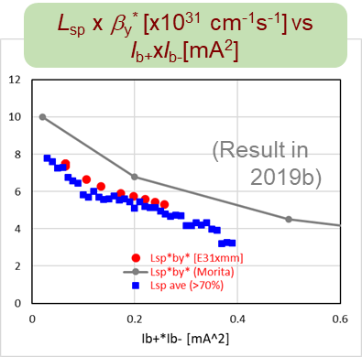
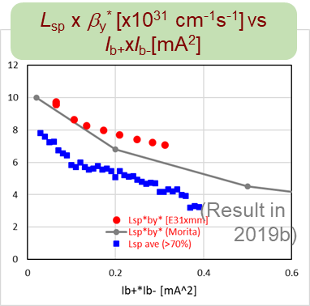
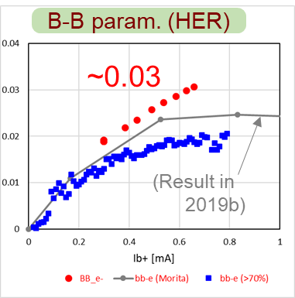
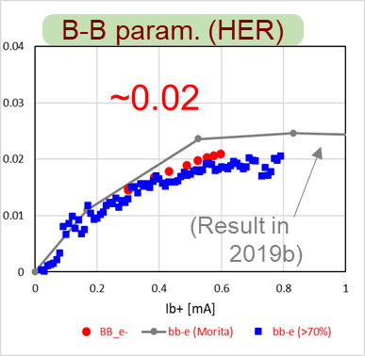
Operation plans and luminosity projections
1. Near term-1 (~2020/June)
(2) Possible (expected) plan
Assumptions:
1) 2020a run starts from 2020/3/2.
LER starts 2020/2/25 for vac. scrubbing and tuning.
2) 2020a and b runs are basically dedicated to physics run. (100 days for physics run)
3) β_{y}* is kept at 1 mm.
4) BG from injection beams is improved. (stable injection, low emittance)
5) Similar beam-beam effect as 2019c, but still expecting some improvement by 30~50%.

Slide 16
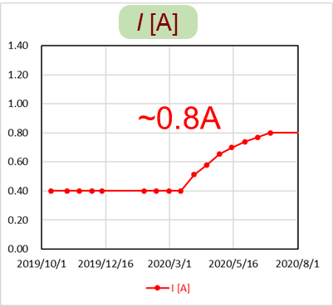
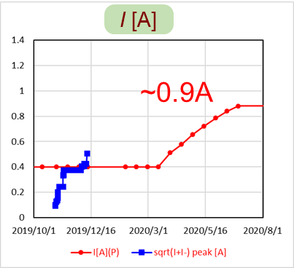
Operation plans and luminosity projections
1. Near term-1 (~2020/June)
(2) Possible (expected) plan
Assumptions:
1) 2020a run starts from 2020/3/2.
LER starts 2020/2/25 for vac. scrubbing and tuning.
2) 2020a and b runs are basically dedicated to physics run. (100 days for physics run)
3) β_{y}* is kept at 1 mm.
4) BG from injection beams is improved. (stable injection, low emittance)
5) Similar beam-beam effect as 2019c, but still expecting some improvement by 30~50%.
6) Similar background level (storage beam) as 2019c.
7) Expecting vacuum scrubbing of LER(Decrease in dP/dI is proportional to 1/BD). → Further increase in beam currents.
8) Efficiency of integrated luminosity is 70% of peak luminosity.
9) 1576 bunches

Slide 17
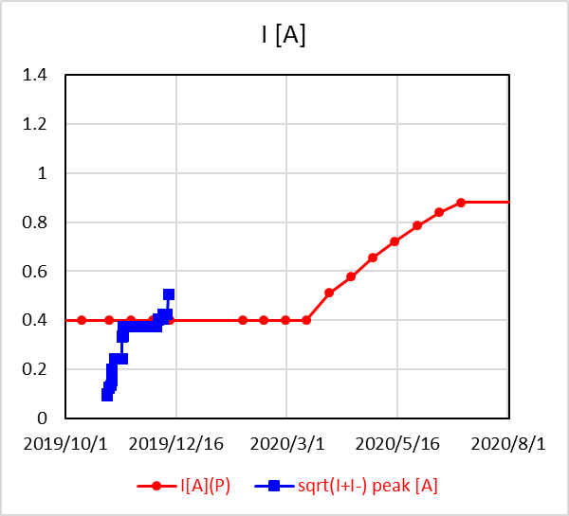
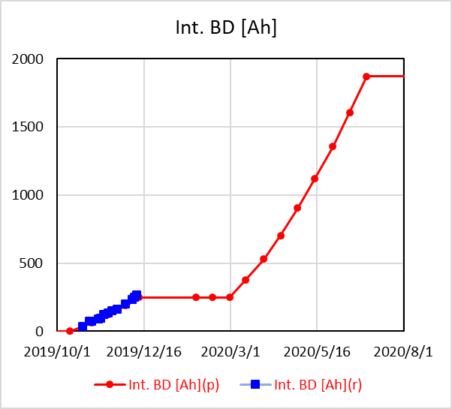
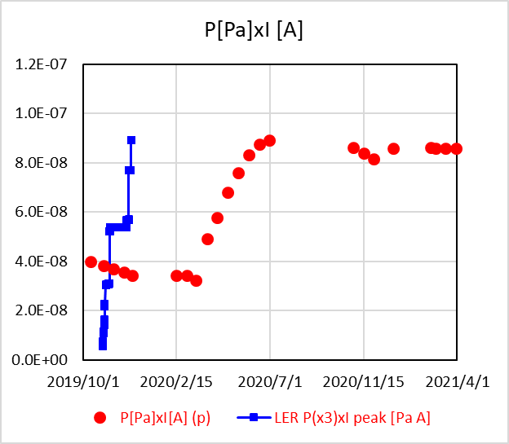
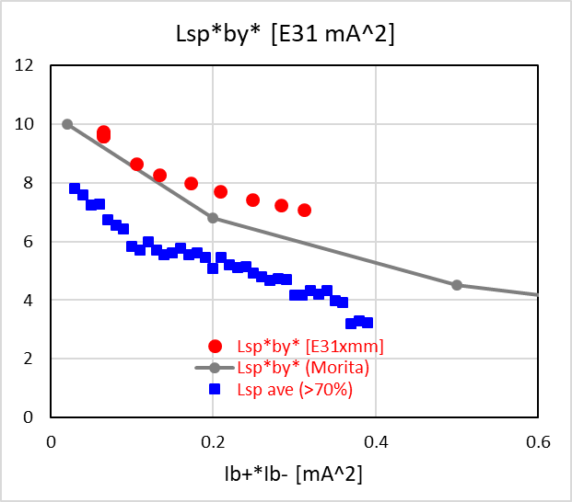
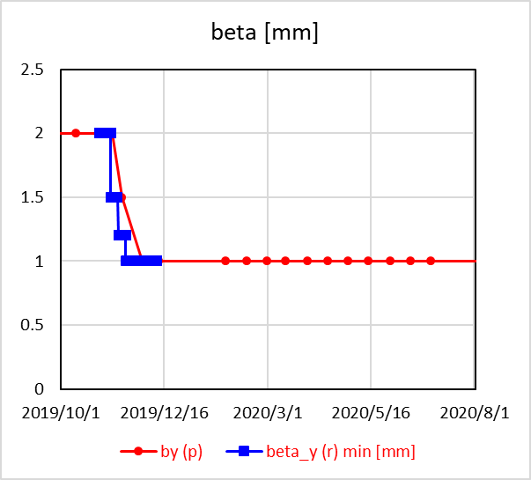
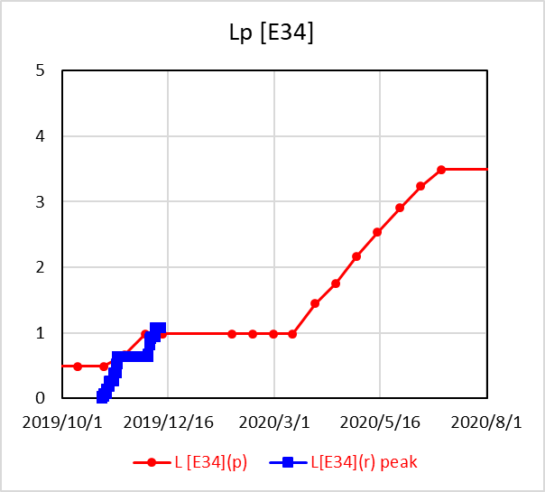
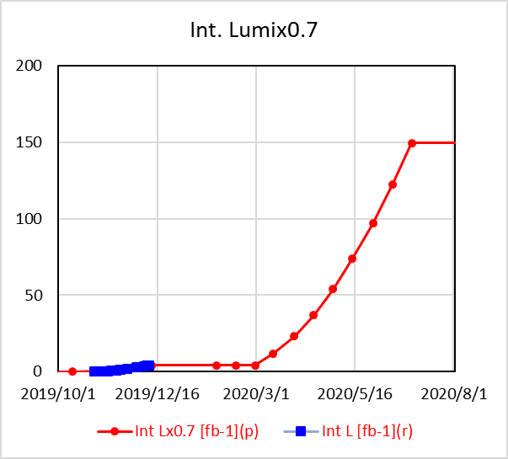
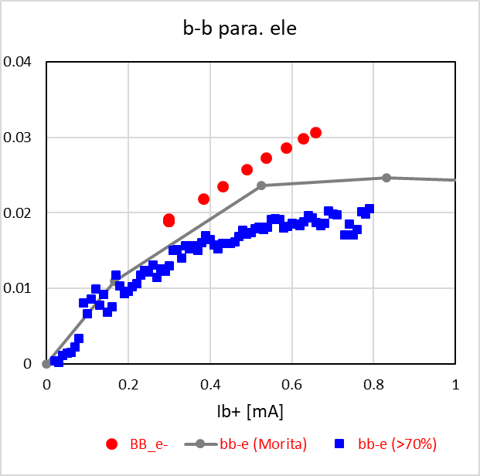
Operation plans and luminosity projections
1. Near term-1 (~2020/June)
(2) Possible (expected) plan
● Cal., Assumption
■ Result in 2019c
P x I [Pa A]
BG from storage beam
L_{sp} x β_{y}* [x10³¹ cm⁻¹s⁻¹] vs I_{b+}xI_{b-}[mA²]
I [A]
($\sqrt{I_{+}I_{−}})$
Beam dose [Ah]
~1.8 kAh
~0.9A
(Result in
2019c)
(Result in
2019b)
Belle HV on
at β_{y}*=1mm
β_{y}* [mm]
L_{p} [x10³⁴ cm⁻²s⁻¹]
Int. L [fb⁻¹]
B-B param. (HER)
3.5E34cm⁻²s⁻¹
~150 fb⁻¹
~0.03
1mm
(Result in
2019b)

Slide 18
Operation plans and luminosity projections
1. Near term-1 (~2020/June)
Interim summary
 | Until 2020/7/1
 | Int. L [fb⁻¹] | L_{p} [E34] | I_{max} [A] | β_{y}* [mm]
Base (conservative) plan | 100 | 2.2 | 0.8 | 1
Possible (expected) plan | 150 | 3.5 | 0.9 | 1

Slide 19
Operation plans and luminosity projections
1. Near term-2 (~2021/March=FY2020)
Operation plan
FY2020 Budget for SuperKEKB project
As reported by Ushiroda-san
Assuming the average unit cost of electricity to be kept, we can operate for 5.4 months with FY2020 project budget alone.
We aim to add 1.1 months (= 6.5 months in total)
(cost cut here and there, hope for world peace and stable electricity cost, and extra budget from DG).
Here we considered two cases;
(1) Case N1: 6.5 months operation in FY2020
(2) Case N2: 5.4 months operation in FY2020

Slide 20
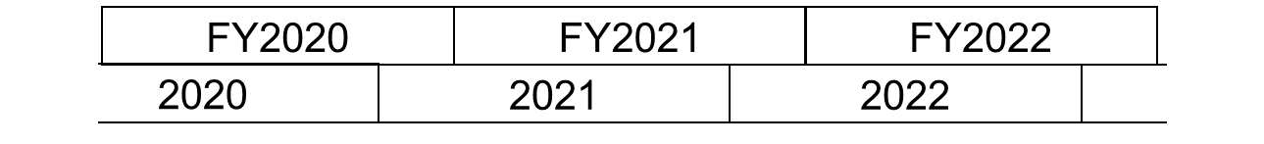
Operation plans and luminosity projections
1. Near term-2 (~2021/March=FY2020)
Assumptions:
1) 6.5 months operation.
4/1~7/1 (3 mo), 10/13~12/25 (~2.4 mo), 2/22~3/31 (~1.1 mo)
5.4 months operation.
4/1~7/1 (3 mo), 10/13~12/25 (~2.4 mo)
Case N1
(6.5mo)
Case N2
(5.4mo)
2021
2021
3 mo
2.4 mo
1.1 mo
3 mo
2.4 mo
b
c
a
b
c

Slide 21
Operation plans and luminosity projections
1. Near term-2 (~2021/March=FY2020)
Assumptions:
1) 6.5 months operation.
4/1~7/1 (3 mo), 10/13~12/25 (~2.4 mo), 2/22~3/31 (~1.1 mo)
5,4 months operation.
4/1~7/1 (3 mo), 10/13~12/25 (~2.4 mo)
2) 2020c is dedicated to squeeze β_{y}*. (as in the case of 2019c)
β_{y}* = 1.0 mm → 0.7 mm → 0.5 mm in 1 month
2021a is dedicated to physics run (Case N1)
Case N1
(6.5mo)
Case N2
(5.4mo)
2021
2021
3 mo
2.4 mo
1.1 mo
3 mo
2.4 mo
b
c
a
b
c
β_{y}*->0.5mm
β_{y}*->0.5mm
Pysics run

Slide 22
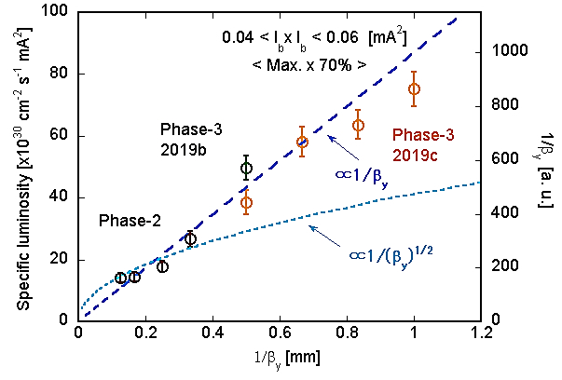
Operation plans and luminosity projections
1. Near term-2 (~2021/March=FY2020)
Assumptions:
1) 6.5 months operation.
4/1~7/1 (3 mo), 10/13~12/25 (~2.4 mo), 2/22~3/31 (~1.1 mo)
5,4 months operation.
4/1~7/1 (3 mo), 10/13~12/25 (~2.4 mo)
2) 2020c is dedicated to squeeze β_{y}*. (as in the case of 2019c)
β_{y}* = 1.0 mm → 0.7 mm → 0.5 mm in 1 month
2021a is dedicated to physics run (Case N1)
3) Specific luminosity at low bunch currents is proportional to 1/ β_{y}*.
Specific luminosity vs 1/β_{y}*
Result until 2019c

Slide 23
Operation plans and luminosity projections
1. Near term-2 (~2021/March=FY2020)
Assumptions:
1) 6.5 months operation.
4/1~7/1 (3 mo), 10/13~12/25 (~2.4 mo), 2/22~3/31 (~1.1 mo)
5,4 months operation.
4/1~7/1 (3 mo), 10/13~12/25 (~2.4 mo)
2) 2020c is dedicated to squeeze β_{y}*. (as in the case of 2019c)
β_{y}* = 1.0 mm → 0.7 mm → 0.5 mm in 1 month
2021a is dedicated to physics run (Case N1)
3) Specific luminosity at low bunch currents is proportional to 1/ β_{y}*.
4) Beam background is independent of β_{y}* .
Also a key point in the future commissioning!

Slide 24
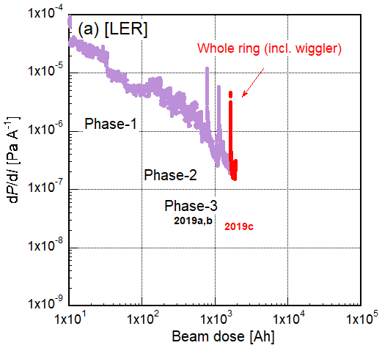
Operation plans and luminosity projections
1. Near term-2 (~2021/March=FY2020)
Assumptions:
1) 6.5 months operation.
4/1~7/1 (3 mo), 10/13~12/25 (~2.4 mo), 2/22~3/31 (~1.1 mo)
5,4 months operation.
4/1~7/1 (3 mo), 10/13~12/25 (~2.4 mo)
2) 2020c is dedicated to squeeze β_{y}*. (as in the case of 2019c)
β_{y}* = 1.0 mm → 0.7 mm → 0.5 mm in 1 month
2021a is dedicated to physics run (Case N1)
3) Specific luminosity at low bunch currents is proportional to 1/ β_{y}*.
4) Beam background is independent of β_{y}* .
5) Expecting steady vacuum scrubbing of
LER.
6) Efficiency of integrated luminosity
is 70% of peak luminosity.
7) 1576 bunches
dP/dI of LER

Slide 25
Operation plans and luminosity projections
1. Near term-2 (~2021/March=FY2020)
Hardware improvements during 2020 summer shutdown and their possible effects
Additional V-type beam collimator
BG reduction
Increase in beam currents

Slide 26
Operation plans and luminosity projections
1. Near term-2 (~2021/March=FY2020)
Hardware improvements during 2020 summer shutdown and their possible effects
Additional V-type beam collimator
BG reduction
50Hz injection from Linac
e⁺ charge increase
(FC power up)
Increase in beam currents
Improvements in BG, optics and beam dynamics issues are also expected by machine studies during beam operation.

Slide 27
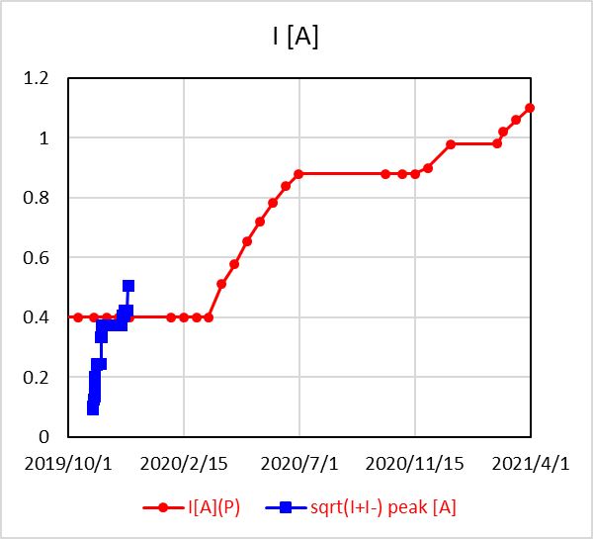
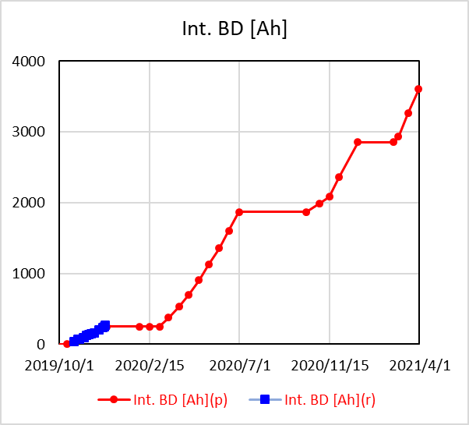
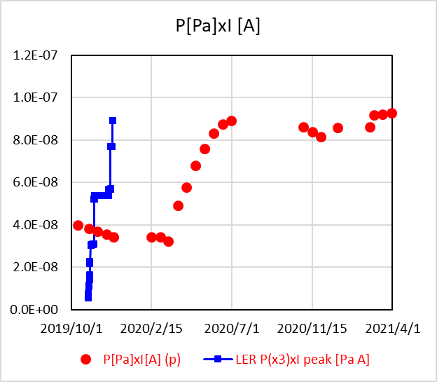
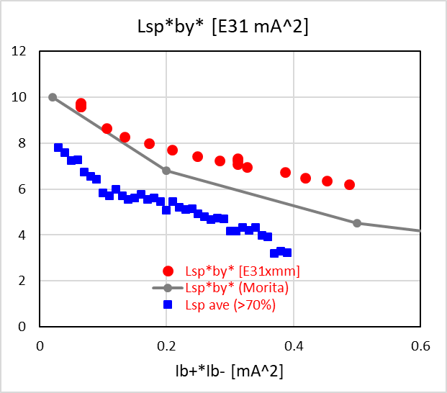
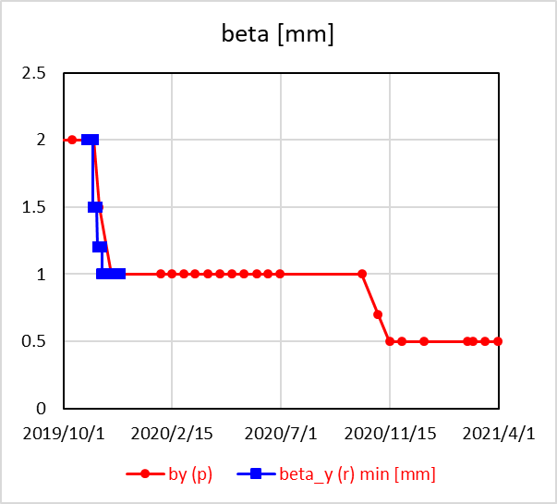
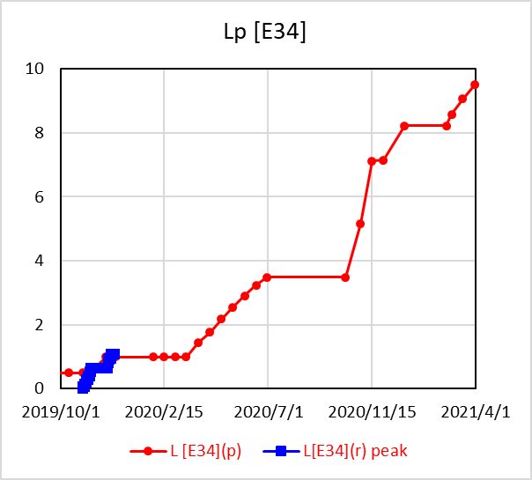
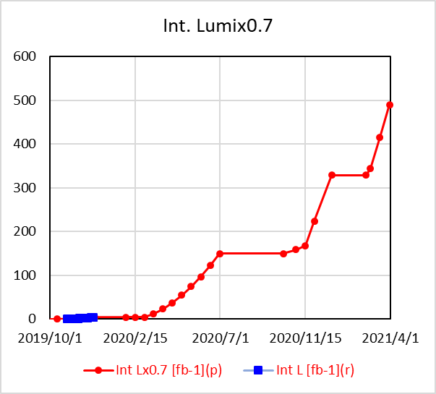
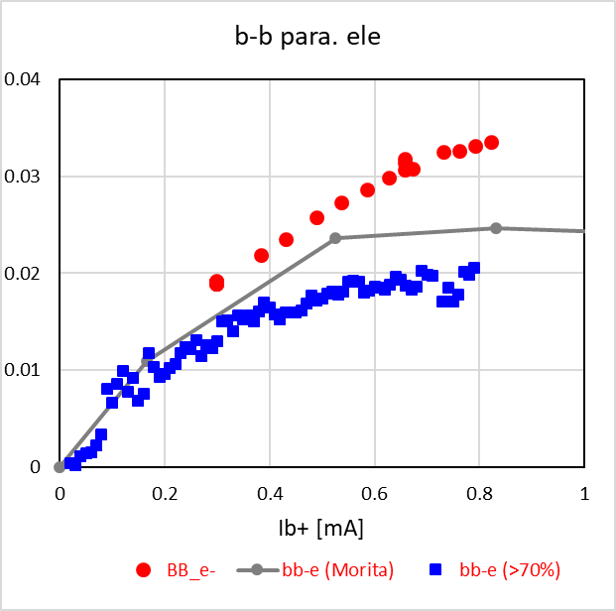
Operation plans and luminosity projections
1. Near term-2 (~2021/March=FY2020)
● Cal., Assumption
■ Result in 2019c
(1) Case N1: 6.5 months operation
P x I [Pa A]
BG from storage beam
L_{sp} x β_{y}* [x10³¹ cm⁻¹s⁻¹] vs I_{b+}xI_{b-}[mA²]
I [A]
($\sqrt{I_{+}I_{−}})$
Beam dose [Ah]
~1.1A
~3.7 kAh
(Result in
2019c)
(Result in
2019b)
at β_{y}*=1mm
β_{y}* [mm]
L_{p} [x10³⁴ cm⁻²s⁻¹]
Int. L [fb⁻¹]
B-B param. (HER)
~9.5E34cm⁻²s⁻¹
~500 fb⁻¹
~0.034
0.5 mm
(Result in
2019b)

Slide 28

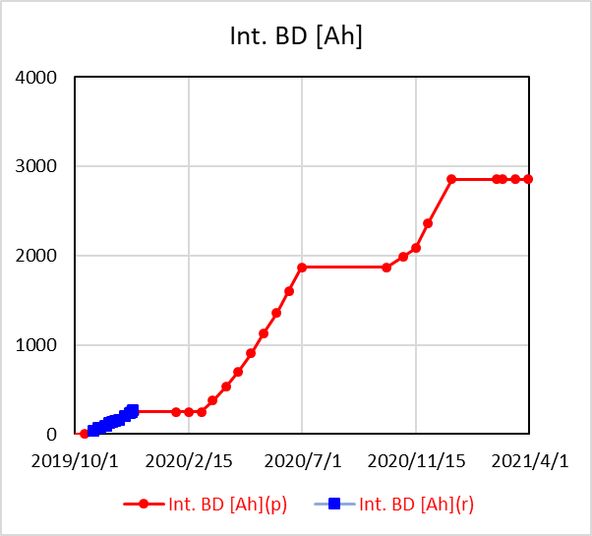
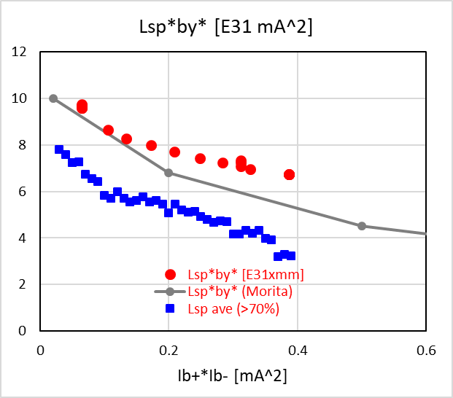
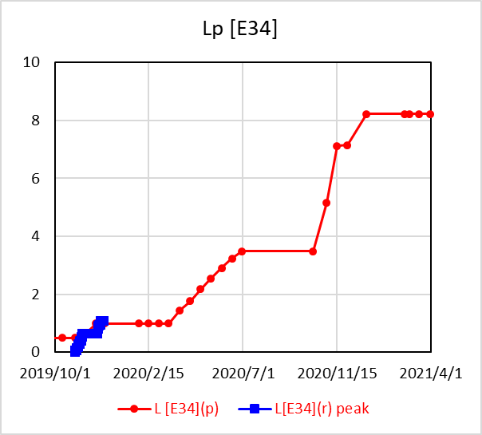
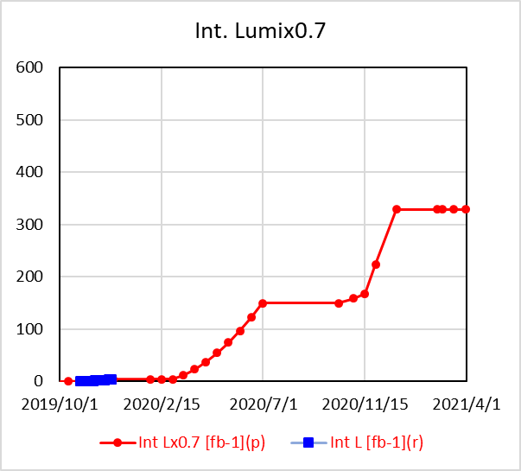
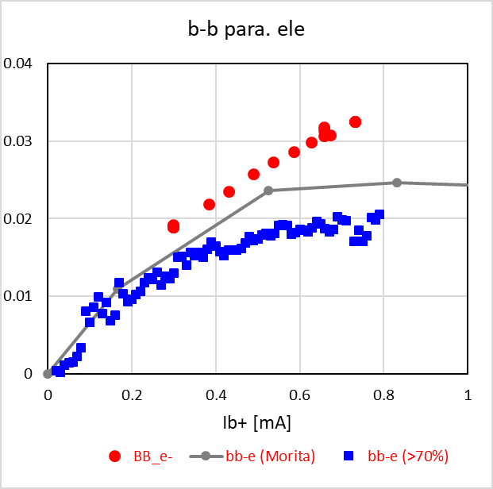
Operation plans and luminosity projections
1. Near term-2 (~2021/March=FY2020)
● Cal., Assumption
■ Result in 2019c
(2) Case N2: 5.4 months operation
P x I [Pa A]
BG from storage beam
L_{sp} x β_{y}* [x10³¹ cm⁻¹s⁻¹] vs I_{b+}xI_{b-}[mA²]
I [A]
($\sqrt{I_{+}I_{−}})$
Beam dose [Ah]
~1 A
~2.8 kAh
(Result in
2019c)
(Result in
2019b)
at β_{y}*=1mm
β_{y}* [mm]
L_{p} [x10³⁴ cm⁻²s⁻¹]
Int. L [fb⁻¹]
B-B param. (HER)
~8.1E34cm⁻²s⁻¹
~320 fb⁻¹
~0.032
0.5 mm
(Result in
2019b)

Slide 29
Operation plans and luminosity projections
1. Near term-2 (~2021/March=FY2020)
Interim summary
 | Until 2020/7/1 |  |  |  | Until 2021/3/31
 | Int. L [fb⁻¹] | L_{p} [E34] | I_{max} [A] | β_{y}* [mm] | Int. L [fb⁻¹] | L_{p} [E34] | I_{max} [A] | β_{y}* [mm]
Base (conservative) plan | 100 | 2.2 | 0.8 | 1
Possible (expected) plan | 150 | 3.5 | 0.9 | 1
Case N1: 6.5 months operation | 150 | 3.5 | 0.9 | 1 | 500 | 9.5 | 1.1 | 0.5
Case N2: 5.4 months operation | 150 | 3.5 | 0.9 | 1 | 320 | 8.1 | 1 | 0.5

Slide 30
Operation plans and luminosity projections
2. Middle term (~2023/March=~FY2022)
Operation plans
Here we considered three cases:
Case M1
(6.5mo)
(6mo)
(5mo)
2023
3 mo
2.4 mo
4.1 mo
3 mo
3 mo
2 mo
PXD exc. 9 mo
b
c
a
b
c
c
a
(2) Case M2
(5.4mo)
(5mo)
(7mo)
2023
3 mo
2.4 mo
3 mo
5 mo
2 mo
2 mo
PXD exc. 9 mo
b
c
c
a
b
c
a
(3) Case M3
(5.4mo)
(6mo)
(5mo)
2023
3 mo
2.4 mo
3 mo
3 mo
3 mo
2 mo
PXD exc. 9 mo
b
c
b
c
c
a

Slide 31
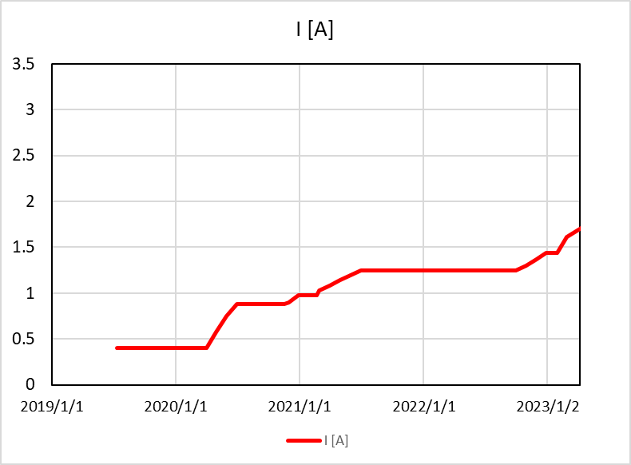
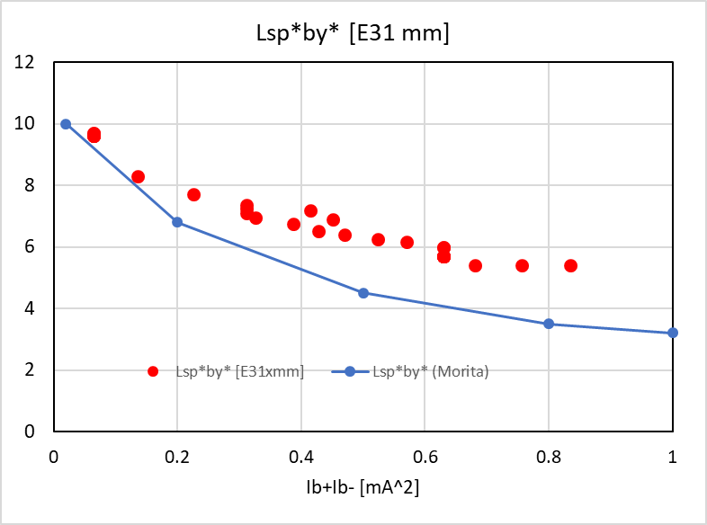

Operation plans and luminosity projections
2. Middle term (~2023/March=~FY2022)
Assumptions:
1) We basically aim 7 months operation/year (~2022).
(more operation budget and further cost down!)
2) 2021c is dedicated to squeeze β_{y}*. (as in the case of 2020c)
β_{y}* = 0.5 mm → 0.4 mm → 0.3 mm (Still Specific Lumi. ∝ 1/β_{y}*)
3) Bunch number is increased to from 1576 to 2500 from 2023a.
4) Further improvement in BG, beam-beam effect and so on.
5) Other assumptions are the same as before.
For Case 1 (typical)
I [A]
L_{sp} x β_{y}* [x10³¹ cm⁻¹s⁻¹] vs I_{b+}xI_{b-}[mA²]
B-B param. (HER)
~1.7 A
(~12 kAh)
~0.04
(Result in
2019b)

Slide 32



Operation plans and luminosity projections
2. Middle term (~2023/March=~FY2022)
(1) Case M1
(2) Case M2
~2.6E35cm⁻²s⁻¹
~2.5E35cm⁻²s⁻¹
~3.4 ab⁻¹
~3.4 ab⁻¹
Case M1 and M2
  Lp and Int. L are finally almost the same, but the difference around 2021 is large.
(3) Case M3
~2.4E35cm⁻²s⁻¹
~2.7 ab⁻¹

Slide 33
Operation plans and luminosity projections
2. Middle term (~2023/March=~FY2022)
(1) Case M1
(2) Case M2
~2.6E35cm⁻²s⁻¹
~2.5E35cm⁻²s⁻¹
~3.4 ab⁻¹
~3.4 ab⁻¹
Case M1 and M2
  Lp and Int. L are finally almost the same, but the difference around 2021 is large.
Case M1 and M3
  Lp and Int. L of M3 are lower than those in M1 due to short run time (low beam currents).
(3) Case M3
~2.4E35cm⁻²s⁻¹
~2.7 ab⁻¹

Slide 34
Operation plans and luminosity projections
2. Middle term (~2023/March=~FY2022)
Interim summary
 | Until 2022/3/1 |  |  |  | Until 2023/3/31
 | Int. L [ab⁻¹] | L_{p} [E34] | I_{max} [A] | β_{y}* [mm] | Int. L [ab⁻¹] | L_{p} [E34] | I_{max} [A] | β_{y}* [mm]
Case M1: FY2020 6.5 months PXD exc. 2022 | 1.5 | 19 | 1.3 | 0.3 | 3.4 | 26 | 1.7 | 0.3
Case M2: FY2020 5.4 months PXD exc. 2021 | 0.6 | 16 | 1.1 | 0.3 | 3.4 | 25 | 1.6 | 0.3
Case M3: FY2020 5.4 months PXD exc. 2022 | 1.2 | 17 | 1.2 | 0.3 | 2.7 | 24 | 1.6 | 0.3

Slide 35
Summaries
Operation plans and luminosity projections were re-evaluated based on the recent results
Near term plans
~100 fb⁻¹(conservative) ~ ~150 fb⁻¹ (expected) by 2020/June
~500 fb⁻¹(6.5 mo.) ~ ~320 fb⁻¹ (5.4 mo.) by 2021/March (expected)
Middle term plan
~2.7 ~ ~3.4 ab⁻¹ by 2023/March (expected)
Depend on the operation plan.
Long term plan (~2029)
Under consideration
It might be nothing to say that these luminosity projections include lots of (expected) assumptions.
We are now struggling to solve various challenges step by step and to provide higher luminosities.
Now we have to recognize again that securing sufficient operation time is an essential issue as a factory machine.
We greatly appreciate your continued support.

Slide 36
Thank you for your attention.

