Slide 1
Progress of Injector Linac
Kazuro Furukawa
for Injector Linac

Slide 2
入射器の復習
今期の運転
Alignment
陽電子発生装置
RF 電子銃
Commissioning
Phase-1 定常運転

Slide 3
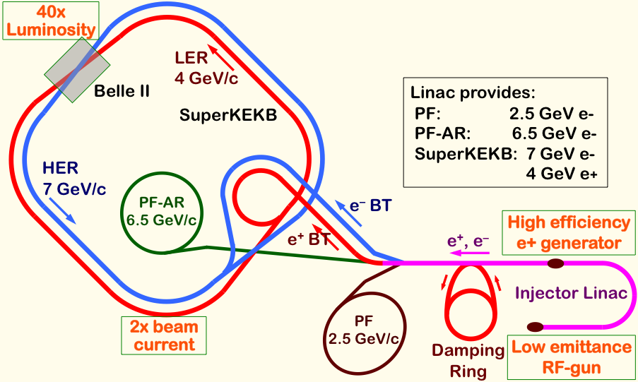
Mission of electron/positron Injector in SuperKEKB
Linac Overview
40-times higher Luminosity
  Twice larger storage beam → Higher beam current at Linac
  20-times higher collision rate with nano-beam scheme
    → Low-emittance even at first turn → Low-emittance beam from Linac
    → Shorter storage lifetime → Higher Linac beam current
Linac challenges
  Low emittance e-
    with high-charge RF-gun
  Low emittance e+
    with damping ring
  Higher e+ beam current
    with new capture section
  Emittance preservation
    with precise beam control
  4+1 ring simultaneous injection
Notes:
Higher Injection Beam Current
To Meet the larger stored beam current and shorter beam lifetime in the ring
4~8-times larger bunch current for electron and positron
Reconstruction of positron generator, etc
Lower-emittance Injection Beam
To meet nano-beam scheme in the ring
Positron with a damping ring
Electron with a photo-cathode RF gun
Emittance preservation by alignment and beam instrumentation
Quasi-simultaneous injections into 4 storage rings
SuperKEKB e–/e⁺ rings, and light sources of PF and PF-AR
Improvements to beam instrumentation, low-level RF, controls, timing, etc

Slide 4
電子ビームパラメタ
Linac Overview
 | SuperKEKB | KEKB
エネルギー (GeV) | 7.0 | 8.0
HER蓄積電流値 (A) | 2.6 | 1.1
HERビーム寿命 (min.) | 6 | 200
最大ビーム繰り返し (Hz) | 50 | 50
最大バンチ数 (rfパルス当たり) | 2 | 2
エミッタンス (mm⋅mrad) | 50/20 (Hor./Ver.) | 100
バンチ電荷量 (nC) | 5 | 1
エネルギー広がり (%) | 0.1 | 0.05
バンチ長 σz (mm) | 1.3 | 1.3
ダンピングリング | n/a | n/a
同時トップアップ入射 | 4 rings (SuperKEKB e-/e+, PF, PF-AR) | 3 rings (KEKB e-/e+, PF)

Slide 5
陽電子ビームパラメタ
Linac Overview
 | SuperKEKB | KEKB
エネルギー (GeV) | 4 | 3.5
LER蓄積電流値 (A) | 3.6 | 1.6
LERビーム寿命 (min.) | 6 | 133
最大ビーム繰り返し (Hz) | 50 | 50
最大バンチ数 (rfパルス当たり) | 2 | 2
エミッタンス (mm⋅mrad) | 100/20 (Hor./Ver.) | 2100
バンチ電荷量 (nC) | 4 | 1
エネルギー広がり (%) | 0.1 | 0.125
バンチ長 σz (mm) | 0.7 | 2.6
ダンピングリング | 〇 | n/a
同時トップアップ入射 | 4 rings (SuperKEKB e-/e+, PF, PF-AR) | 3 rings (KEKB e-/e+, PF)

Slide 6
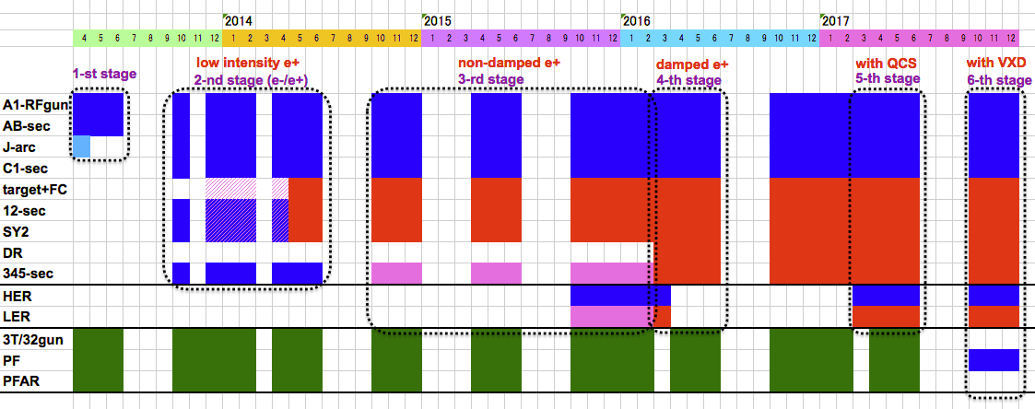
Linac Schedule Overview (tentative A)
Schedule
RF-Gun e- beam
commissioning
at A,B-sector
e- commiss.
at A,B,J,C,1
e+ commiss.
at 1,2 sector (FC, DCS, Qe- 50%)
e- commiss.
at 1,2,3,4,5 sector
Phase1: high emittance beam for vacuum scrub
Phase2,3: low emittance beam for collision
Time →
Location
↓
1 nC
Phase1
2 nC
Phase2
4 nC
Phase3
: Electron
non damped e+ commiss.
at 1,2, 3,4,5 sectors
e- commiss. at A→5 sectors
damped e+ commiss.
at 1→5 Qe+ = 1~4nC
e- commiss.
at A→5 Qe- = 1~5nC
PF-AR e-
commiss.
: Positron
: Low current electron

Slide 7
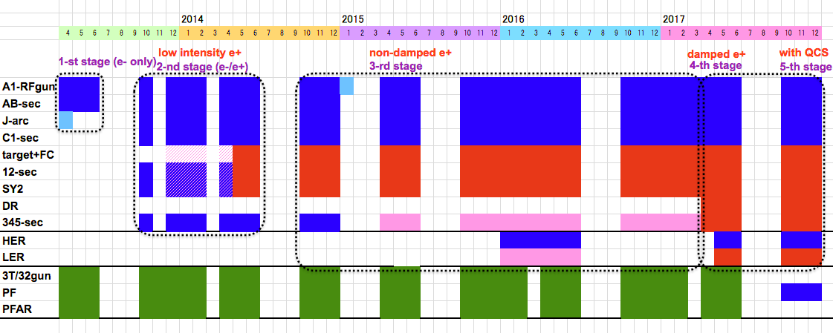
Linac Schedule Overview (tentative B)
Schedule
RF-Gun e- beam
commissioning
at A,B-sector
e- commiss.
at A,B,J,C,1
e+ commiss.
at 1,2 sector (FC, DCS, Qe- 50%)
e- commiss.
at 1,2,3,4,5 sector
Phase1: high emittance beam for vacuum scrub
Phase2,3: low emittance beam for collision
Time →
Location
↓
1 nC
Phase1
2 nC
Phase2
: Electron
non damped e+ commiss.
at 1,2, 3,4,5 sectors
e- commiss. at A→5 sectors
damped e+ commiss.
at 1→5 Qe+ = 1~4nC
e- commiss.
at A→5 Qe- = 1~5nC
: Positron
: Low current electron

Slide 8
Operation Status
Operation
FY2014 の運転
  運転時間: 3900 hours (FY2013 -27%)
    PF/PF-AR Injection (and Commissioning for SuperKEKB)
    Apr.11 – Apr.25
    May.7 – Jul.1
    Sep.24 – Dec.26
    5 days in Jan, Feb
  故障 (FY2013 0.43%)
    偏向電磁石コイル発熱 (May)
    マイクロ波パルス電源デスパイカー発熱 (May)
    フラックスコンセントレータ電源側ケーブル発熱 (Dec)
    マイクロ波パルス電源トランス端末発熱 (Dec)

Slide 9
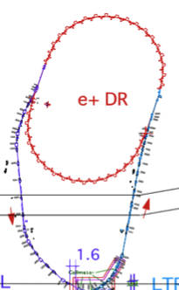
Facility for Electric Power and Cooling Water
Utility
Linac needs electricity and cooling water extensions, especially for positron generator upgrade
Separate building construction in FY2013 not to impact PF/PF-AR
Facility extensions performed during summer 2014
SuperKEKB injector
50 Hz (e+ or e-)
pulse-by-pulse
mode switching
low emittance
RF gun
1.1 GeV
Damping Ring
circ. 136 m
PF
AR
6.5 GeV e-
2.5 GeV e-
0.1nC x 1
Bunch
Compressor
LER
3.5 GeV
10nC x 2 (prim. e-)
5nC x 2 (inj. e-)
Energy-spread
Compression System
S-band
linac
4.0 GeV e+
4nC x 2
3T
RF gun
HER
ECS
e+ target &
LAS capture section
7.0 GeV e-
5nC x 2
[1] Sector 1,2
Electricity and cooling water addition for new positron generator
+920 kVA, +900 L/min
[2] Sector 2,3
Electricity addition for new damping ring
+310 kVA
[3] Sector 5
Electricity and cooling water addition for energy compression, beam diag., injection beamlines
+300 kVA, +460L/min

Slide 10
Alignment
Alignment
High-precision alignment was not necessary in PF and KEKB injections, and it was much damaged by earthquake in 2011.
Instead of flexible-structure girder before earthquake, rigid-structure was adopted with jack-volts and fixed supports.
Reflector pedestals are developed and mounted onto quad magnets and accelerating cavities for laser-tracker measurement.
Iterative measurement and adjustment with 500-m straight laser and position sensors should enable 0.3-mm global alignment.
Laser tracker should enable 0.1-mm measurement within 10-m girder unit.
Displacement gauges, hydrostatic leveling, inclinometer are also employed.
Remote measurement system and girder mover system will be necessary for longer term, and are under development.

Slide 11
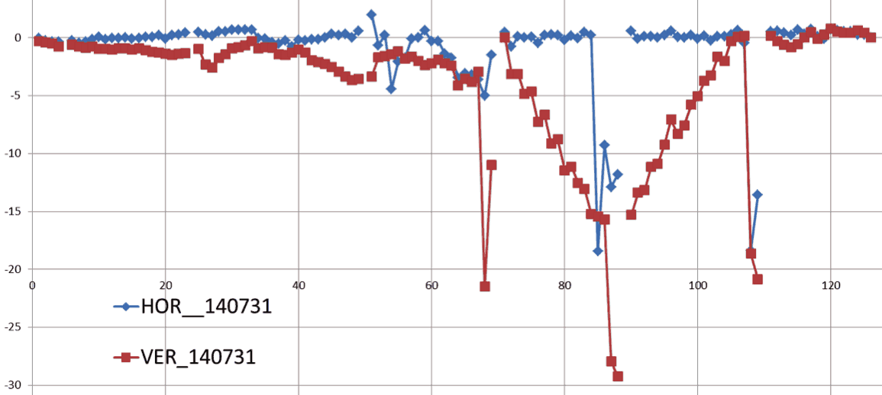
Alignment progress in 2014
Alignment
For the first time at 3-5 sectors
Horizontal axis: sensor number from sector C, 1-4, to sector 5
(~80 m/sector)
Vertical axis: voltage (~displacement at 0.25~0.5mm/mV)
Some girders were not yet upgraded
Moved up to 3 mm not to break vaccuum
Displacement / mV
Sector C
Sector 5

Slide 12
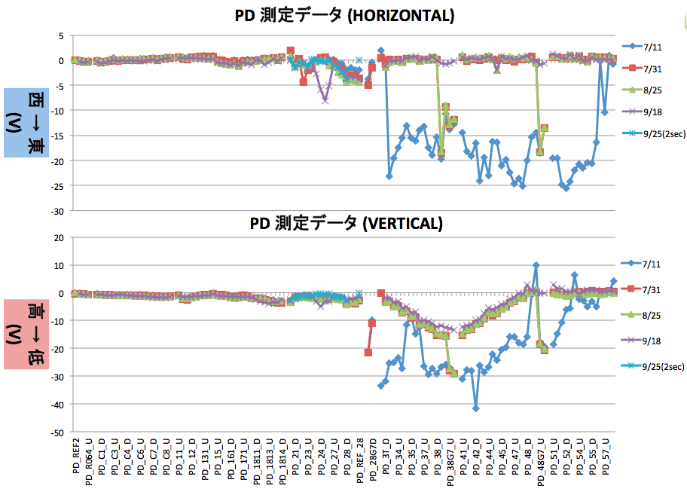
Alignment progress in 2014
Alignment
Higo et al.
For the first time after earthquake at downstream sectors
Several measurements during summer
Measurement reproducibility was confirmed up to ~0.2 mm
While there existed
several conflicting
measurements,
consistent scheme
has been established
Movement of tunnel
by several 10’s of
micrometer was
observed (→ mover)
Further work necessary
in 2015, for alignment
and girder replacement
~5mm
~10mm

Slide 13
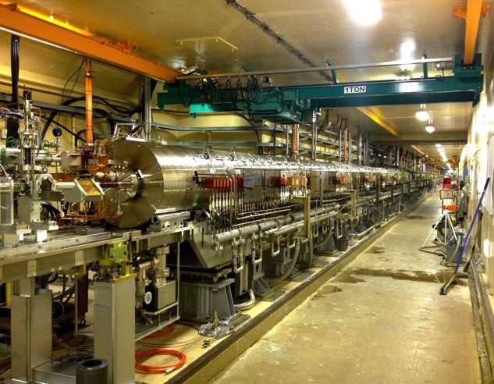
Positron Generation
Positron Enhancement
4-times more positron is required at SuperKEKB than KEKB
  Safety measure was taken after cable fire during the test of Flux Concentrator (FC)
  New components in
  100-m capture section
  were tested in steps
  High voltage tests in
  tunnel in April
  Beam tests with electron
  in May

Slide 14
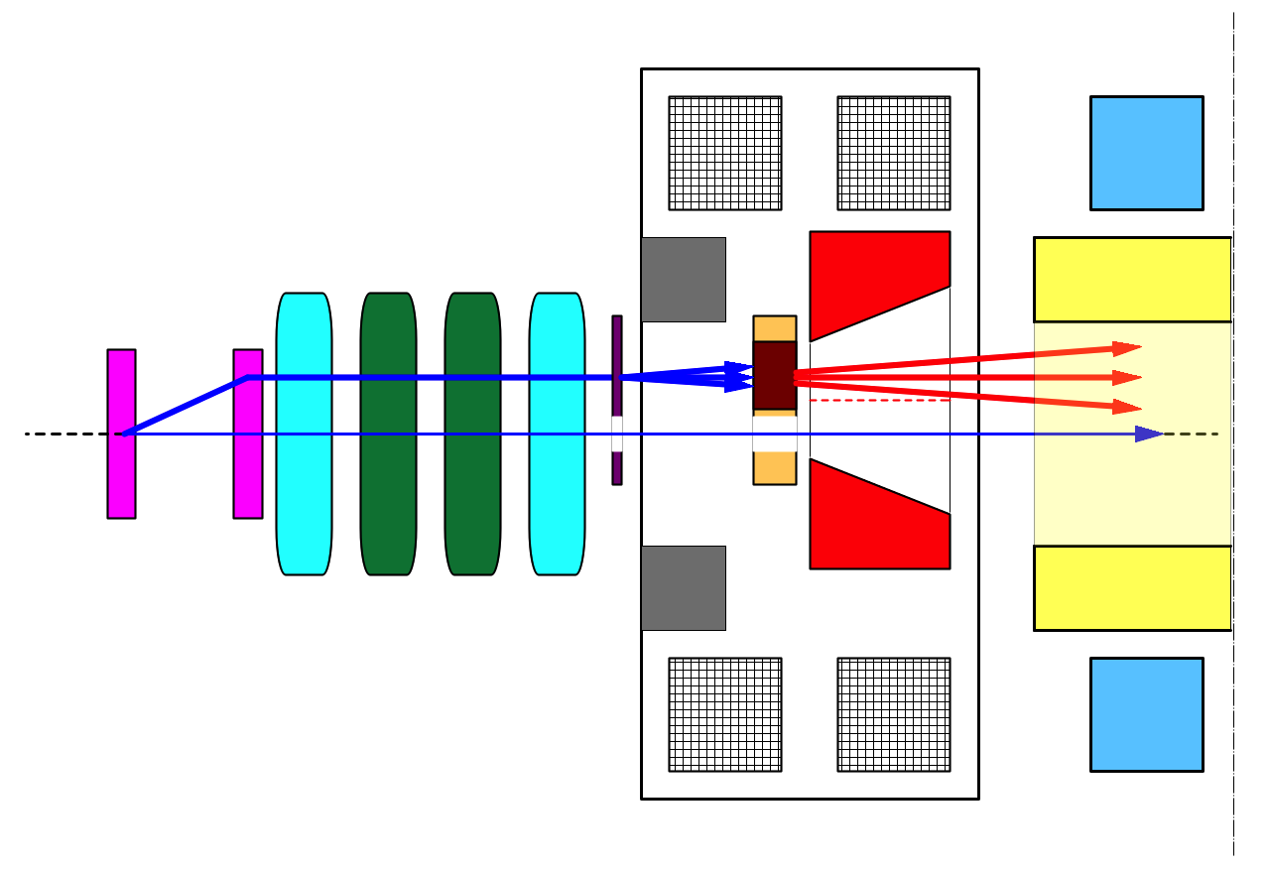
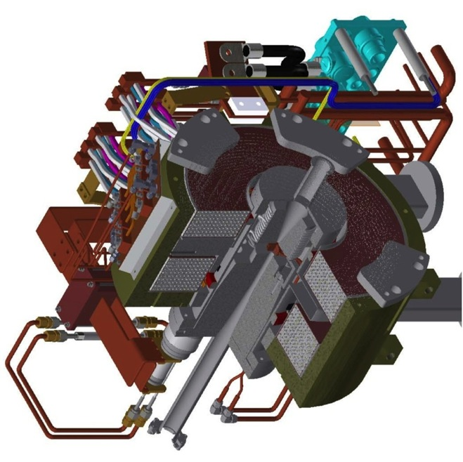
Positron generation for SuperKEKB
Positron Enhancement
bridge coils
solenoid
side view
primary
e- beam
10 nC
primary e-
DC QM
spoiler
LAS Accel.
structure
target
e+
positron
production
Target
beam
hole
5 nC injection e-
Flux
Concentrator
pulsed ST
pulsed QM
Flux
Concentrator
Bridge
Coils
e+ beam
New positron capture section after target with
Flux concentrator (FC) and large-aperture S-band structure (LAS)
Satellite bunch (beam loss) elimination with velocity bunching
Pinhole (2mm) for electrons beside target (3.5mm)
Beam spoiler for target protection

Slide 15
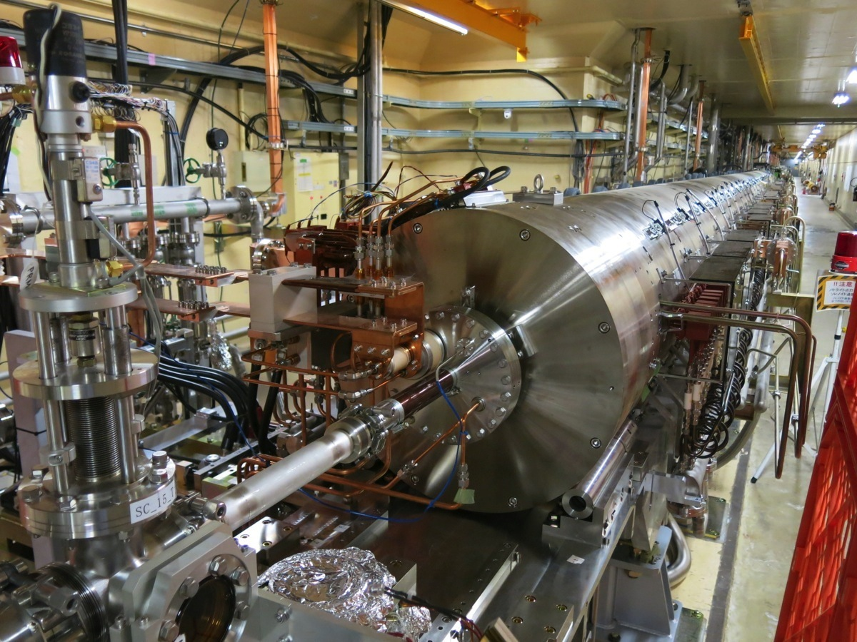
陽電子捕獲部@Linacトンネル
Positron Enhancement
T.Kamitani
この中にFC、標的
ブリッジコイルが
収められている。
DCソレノイド
電子ビーム
2014年4月に陽電子捕獲部
をビームラインの設置し、
5月より陽電子のコミッショニング
を開始した。

Slide 16
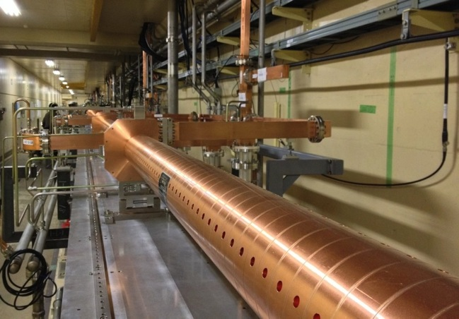
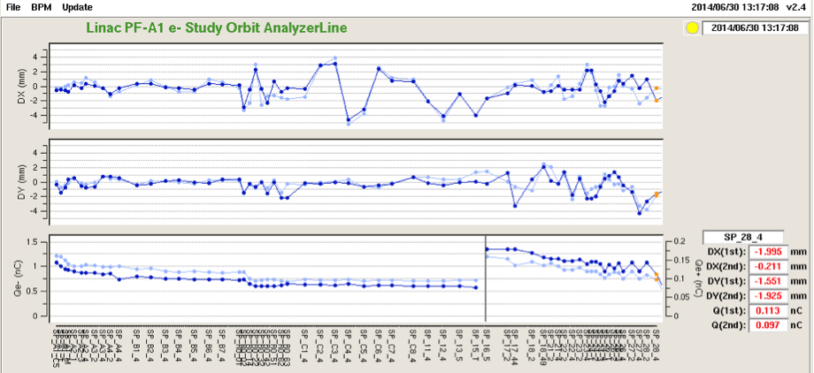
Positron from New Positron Capture Section
Positron Enhancement
Generated positron ~0.1nC was
transferred to the entrance of
damping ring
With higher magnetic and electric
field, 4-nC positron will be
generated
Target shield
(40cm x 6m long)
will be finalized
Alignment will be
improved
3mm → 0.1mm
Flux concentrator and
following solenoid/quad
Large aperture S-band structure
before solenoid & quad installation
400 m
Beam position
Horizontal
Vertical
~0.1 nC
Beam charge
Primary Electron
Positron
W target

Slide 17
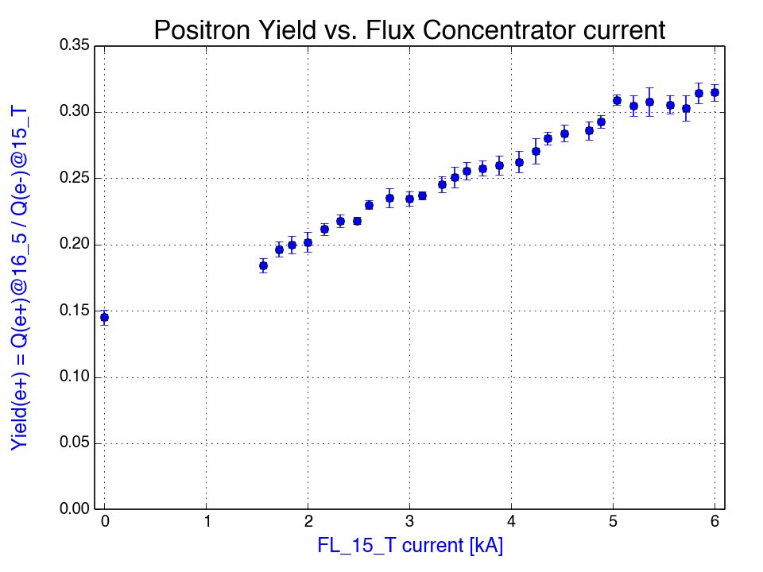
(1) FC current
Positron Enhancement
T.Kamitani
6kAより大きな電流値でもまだ
saturationせずに順調に伸びていくと
期待される
新型電源では12kAまで上がる予定。
伝送路の inductance も下げる予定。
FC currentがzeroでも
ある程度のyieldがある
FCでの実電流値は1.07倍
plot上の6kA => 6.42 kA
CT測定値

Slide 18
Positron Generation
Positron Enhancement
T.Kamitani
Installation of positron generator for SuperKEKB in April 2014
(Beamline construction since summer 2013)
(positron target, spoiler, Flux Concentrator, bridge coils, LAS structures [x6], DC solenoids [16+13],
e+/e- separator, quads [>90])
Commissioning of positron beam, observation of the first positron after reconstruction for SuperKEKB, further improvements expected
Oct.~Dec.2014 : Linac commissioning
Jan.~Mar.2015 : Construction Apr.~Jun. : Linac commissioning
Jul.~Sep.2015 : Construction Oct (?) : LER injection
 | Primary e- [nC] | Positron [nC] | Efficiency | Parameters
June 2014 | 0.6 | 0.12 | 20% | FC 6.4kA, Solenoids 370A, LAS capture field 10 MV/m
Specification (at SY2) | 10.0 | 5.0 | 50% | FC 12kA, Solenoids 650A, LAS capture field 14 MV/m
DR injection (2017?) |  | 4.0 | 40% | Energy spread acceptance 0.5%
x17
x42
x2.5

Slide 19
陽電子生成装置遮蔽体
Positron Enhancement
1-5 陽電子ターゲット下流の加速器上空に鉄を主体としたシールドを設置する．
遮蔽体の全体図
S. Matsumoto

Slide 20
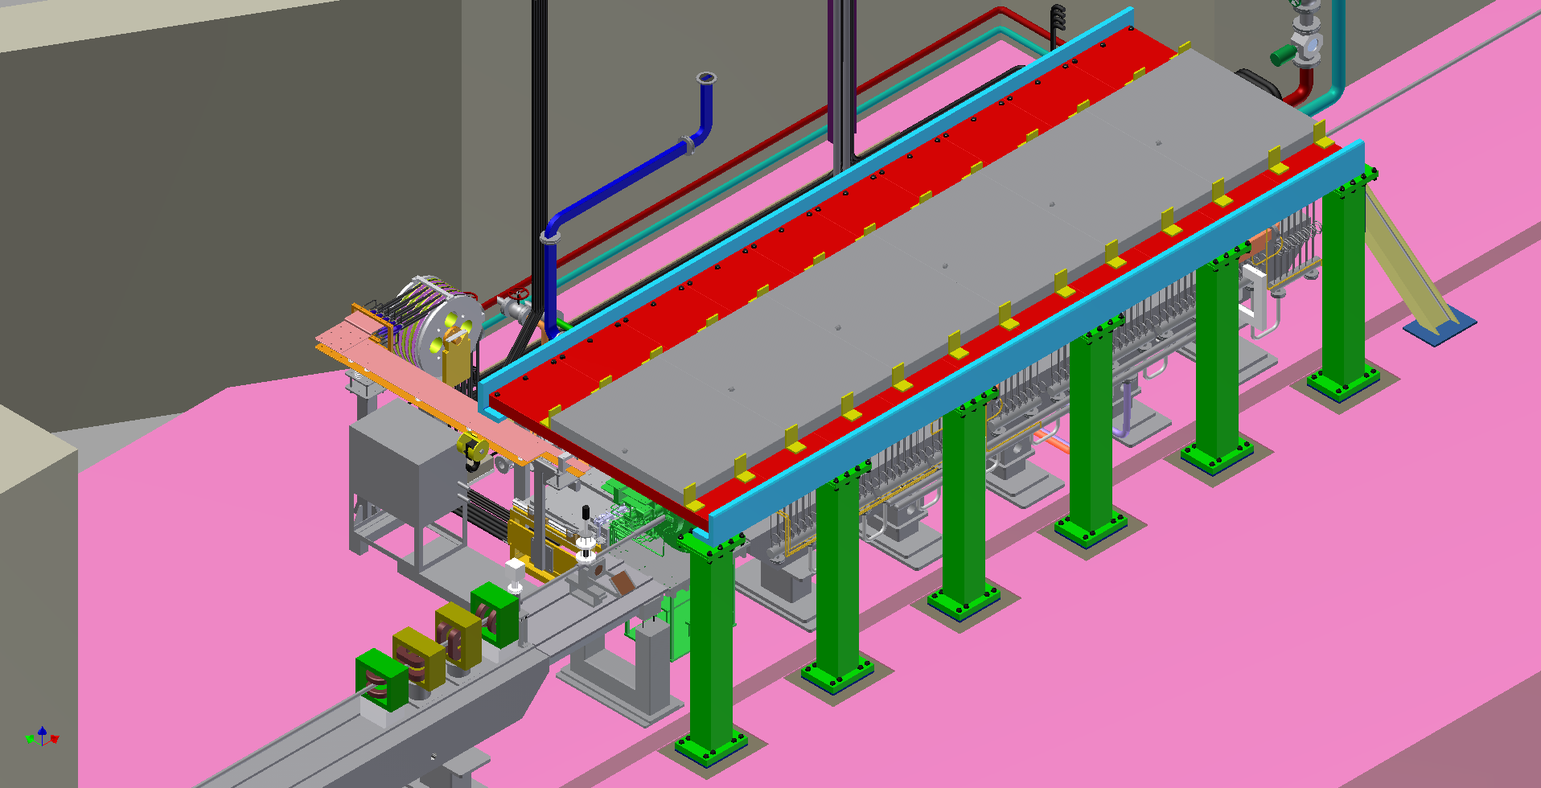
Positron Enhancement
雛 段
通 路
鳥瞰図：南東方向から見た図． トンネル1-5 陽電子ターゲットの60cm上流から６ｍの範囲に設置．今年度は、遮蔽鉄の厚みは200mm（図中の赤＋灰色部）．
200mm角柱 6本が現場通路上ビームラインよりに設置される．鉛カーテンを設置すると、通路の幅が現場では1400mm．3 月末までに建設.

Slide 21
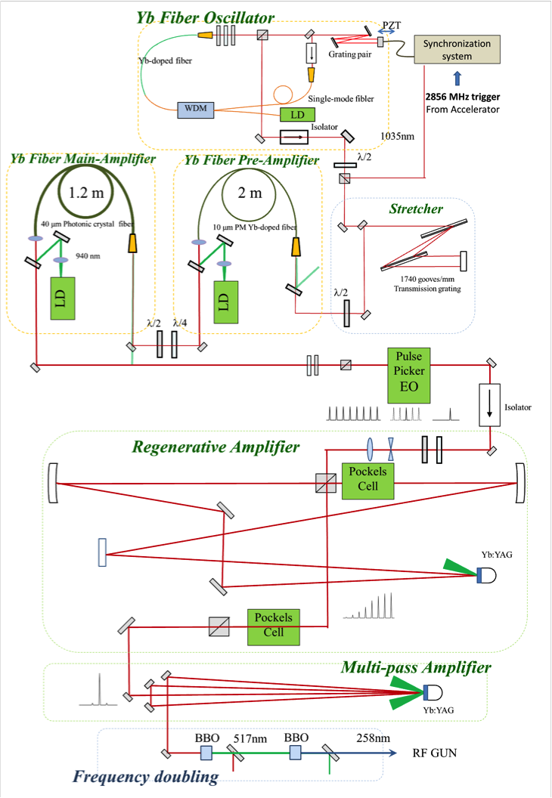
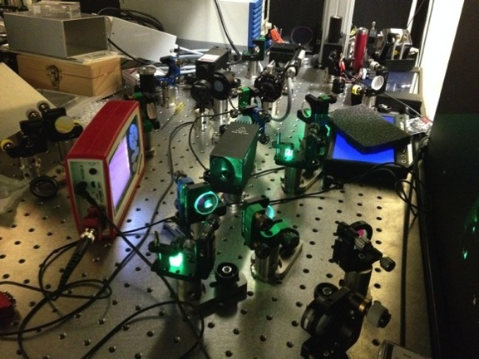
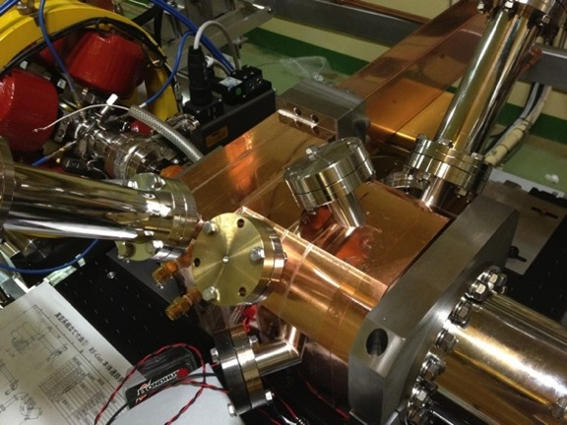
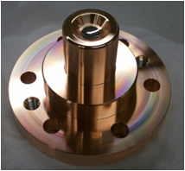
Photo cathode RF gun development
RF gun for low-emittance electron
Cascaded frequency doublers
Quasi traveling wave side couple cavity
Yb fiber and Yb:YAG think disk laser
Ir₅Ce
Cathode
5.6 nC / bunch was confirmed
Next step: 50-Hz beam generation &
Radiation control
Ir5Ce photo cathode

Slide 22
RF-Gun development strategy for SuperKEKB
RF gun for low-emittance electron
Cavity : Strong electric field focusing structure
  Disk And Washer (DAW) => 3-2, A-1(test)
  Quasi Traveling Wave Side Couple => A-1
  => Reduce beam divergence and projected emittance dilution
Cathode : Long term stable cathode
  Middle QE (QE=10⁻⁴～10⁻³ @266nm)
  Solid material (no thin film) => Metal composite cathode
  => Started from LaB₆ (short life time)
  => Ir₅Ce has very long life time and QE>10⁻⁴ @266nm
Laser : Stable laser with temporal manipulation
  LD pumped laser medium => Nd / Yb doped
  Temporal manipulation => Yb doped
  => Minimum energy spread

Slide 23
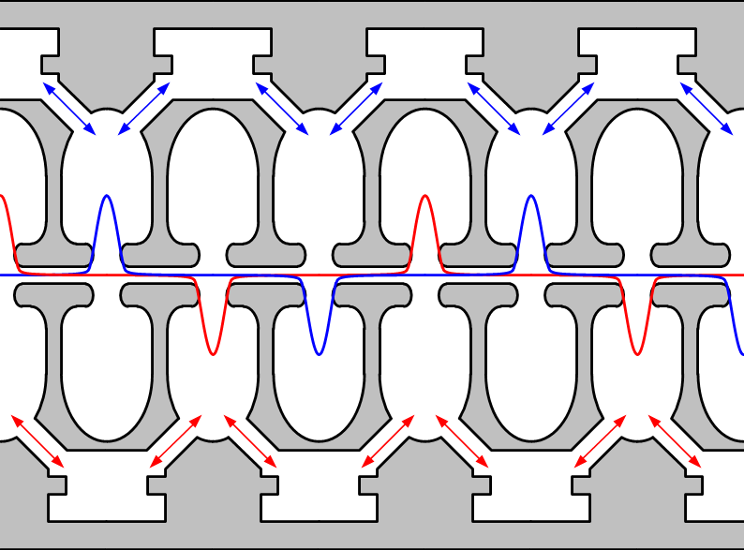
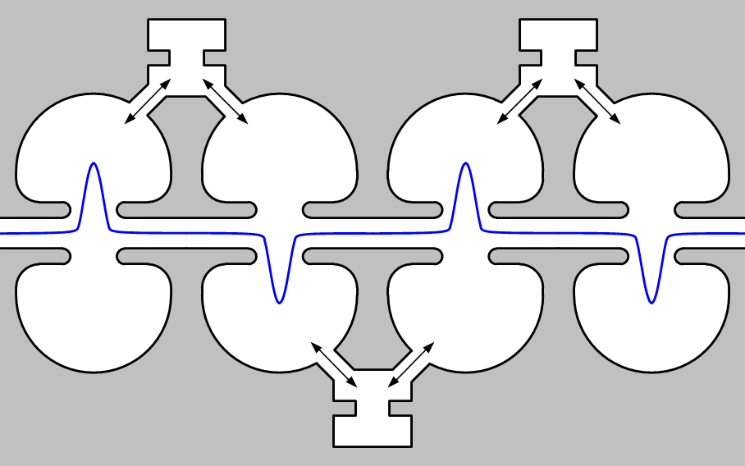
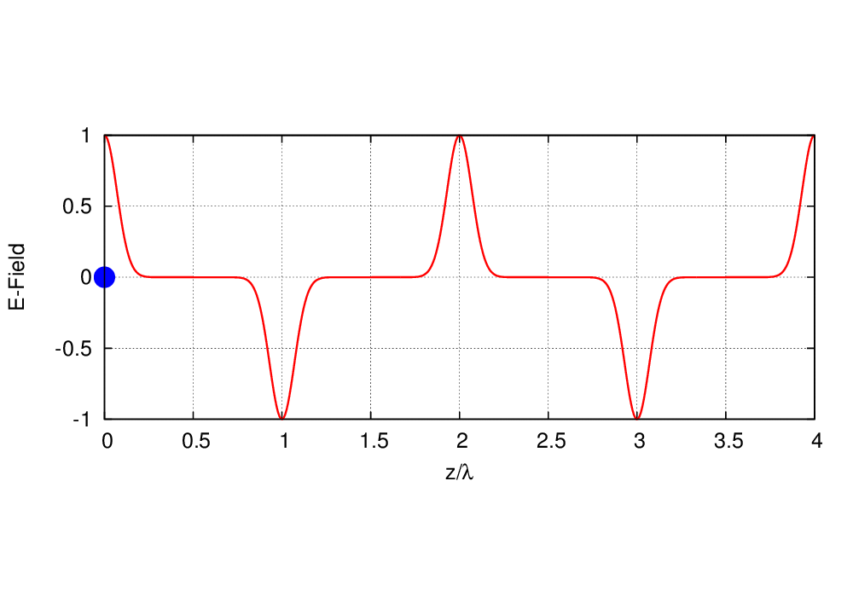
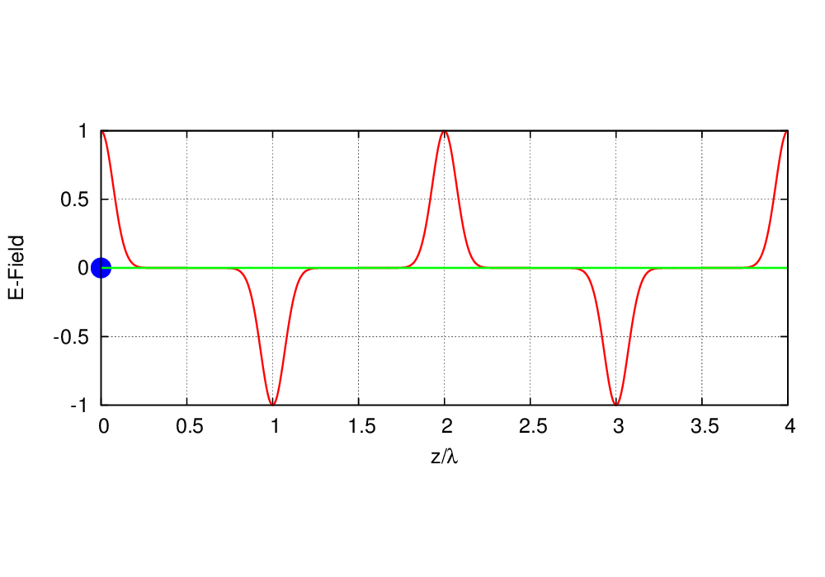
Design of a quasi traveling wave side couple RF gun
RF gun for low-emittance electron
M. Yoshida et al
Normal side couple structure
Quasi traveling wave sidecouple structure
Quasi traveling wave side couple has stronger focusing field

Slide 24
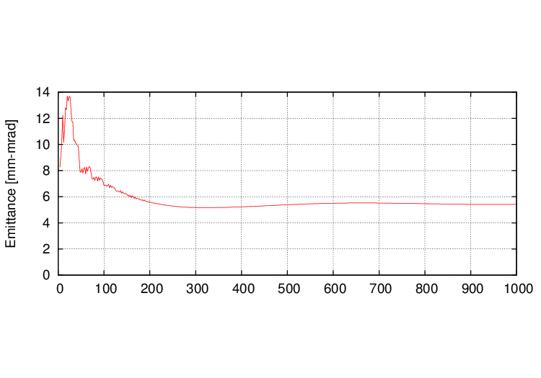
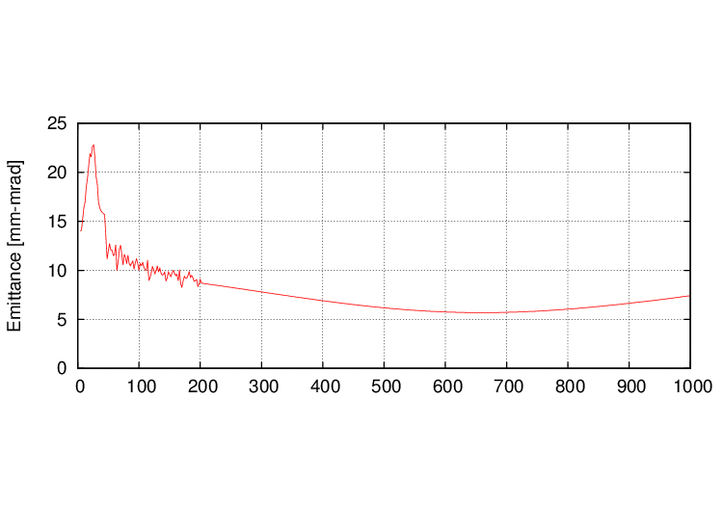
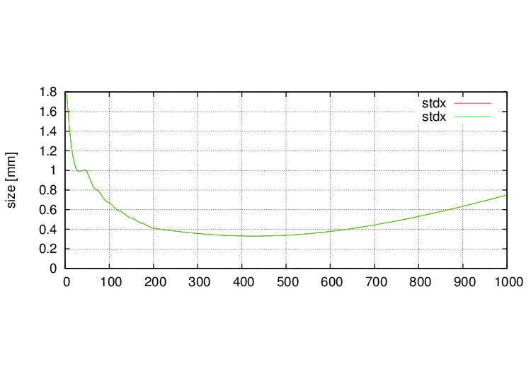
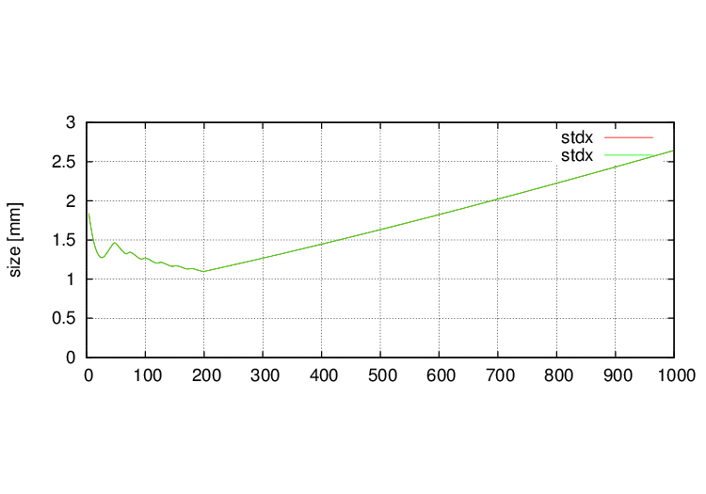
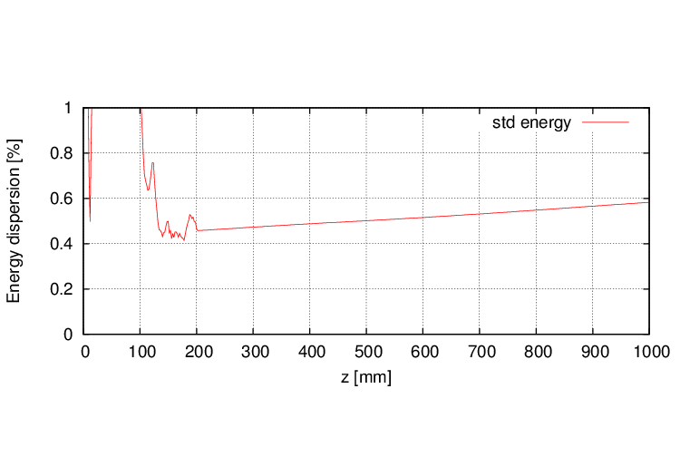
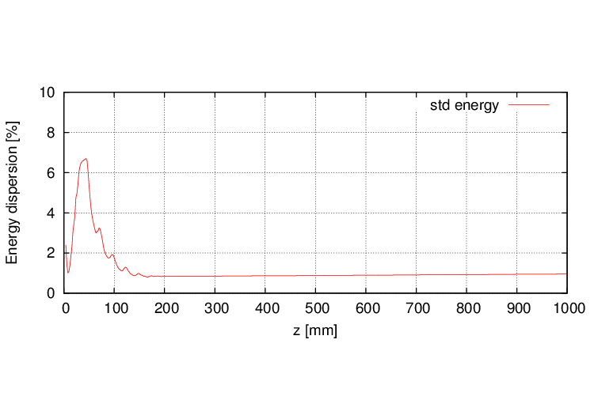
Beam tracking simulation result
RF gun for low-emittance electron
M. Yoshida
5 nC
10 nC
Emittance 5.5 mm-mrad
Gun Exit
Size 0.4 mm
Energy spread 0.6%
Bunch shape

Slide 25
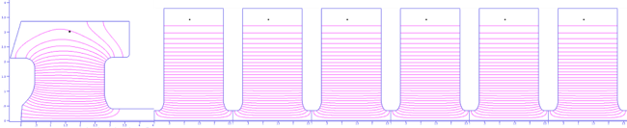
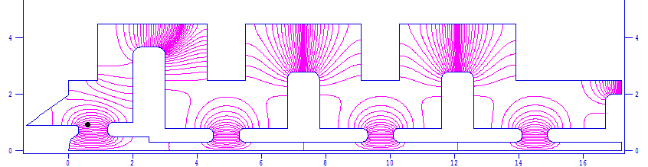
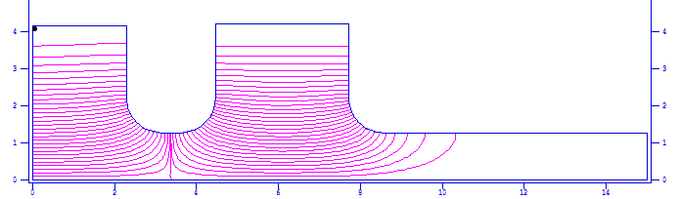
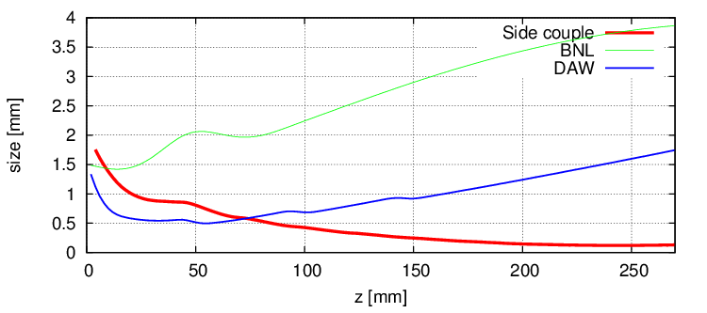
RF-Gun comparison
RF gun for low-emittance electron
M. Yoshida
Quasi traveling wave side couple RF gun
(100 MV/m, 6mm-mrad, 13.5 MeV)
DAW-type RF gun
(90 MV/m, 5 mm-mrad, 3.2 MeV)
BNL-type RF gun
(120 MV/m, 11.0 mm-mrad, 5.5 MeV)
Beam Size
Quasi traveling wave side couple cavity
BNL (3.8 mm)
DAW (1.7 mm)
QTW (0.2 mm)

Slide 26
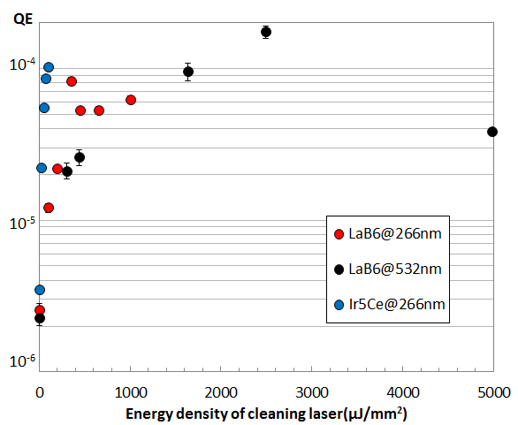
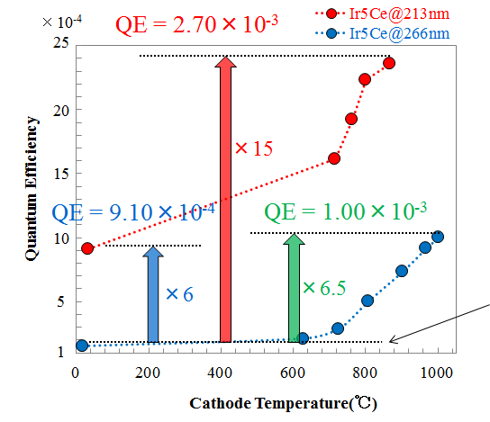
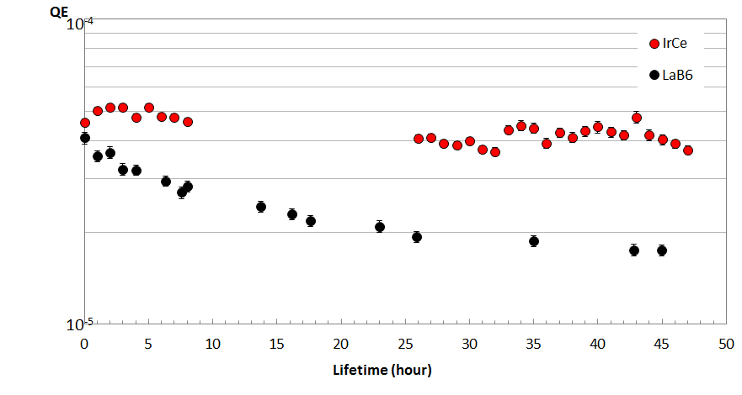
Ir₅Ce Cathode
RF gun for low-emittance electron
Carbon
LaB₆
Quantum efficiency improvement
by Laser cleaning
SEM-EDX
M. Yoshida
Oxigen
Lower energy density
is enough to activate Ir₅Ce
SEM-EDX
Ir₅Ce
Carbon
No oxidization
is observed
×２０
QE Enhancement of IrCe cathode
QE lifetime
Ir₅Ce
Cathode

Slide 27
Energy spread reduction using temporal manipulation
RF gun for low-emittance electron
M. Yoshida
Energy spread of 0.1% is required for SuperKEKB synchrotron injection.
15nC
t
20nC
5nC
10nC
Gaussian
t
Square
5nC
10nC
15nC
20nC
5nC electron
15nC
Primary beam for positron production

Slide 28
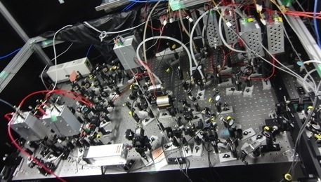
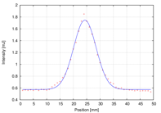
Properties of laser medium
RF gun for low-emittance electron
Nd laser system for 3-2 RF-Gun
Nd-doped
τ～200μs, 40%
○ 4-state laser is easy to operate.
○ High power pump LD is available.
○ Large crystal is available
× Pulse width is determined by SESAM.
(Gaussian)
LD Pump
(808nm)
Nd:YVO4
Nd:YAG
SHG(532nm) 40%
FHG(266nm) 20%
5HG(213nm) 3%
808nm
1064nm
Yb-doped
○ Wide bandwidth => pulse shaping
○ Long fluorescent time => High power
○ Fiber laser oscillator => Stable
○ Small state difference
× ASE
× Absorption
τ～900μs, 40%
LD Pump
(941/976nm)
Yb-glass
Yb:YAG
Yb:BOYS
SHG(520nm) 40%
FHG(260nm) 20%
5HG(208nm) 3%
Best for Linac RF-Gun
941/976nm
1040nm
Ti-doped
τ=200μs, 40%
τ～3μs, 40%
Pump
40%
SHG(400nm) 40%
THG(266nm) 20%
FHG(200nm) 10%
Pump
(808nm)
Nd:YAG
SHG
Ti:Sapphire
808nm
1064nm
532nm
800nm
○ Very wide bandwidth
○ High breakdown threshold
× Low cross section
× Short fluorescent time => Q-switched laser is required for pumping
Ti:Sapphire laser system.
TW laser is based on Ti-Sapphire

Slide 29
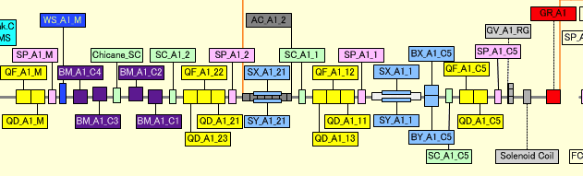
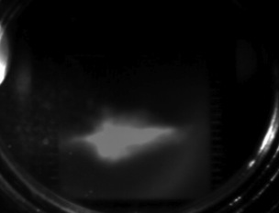
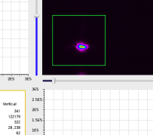
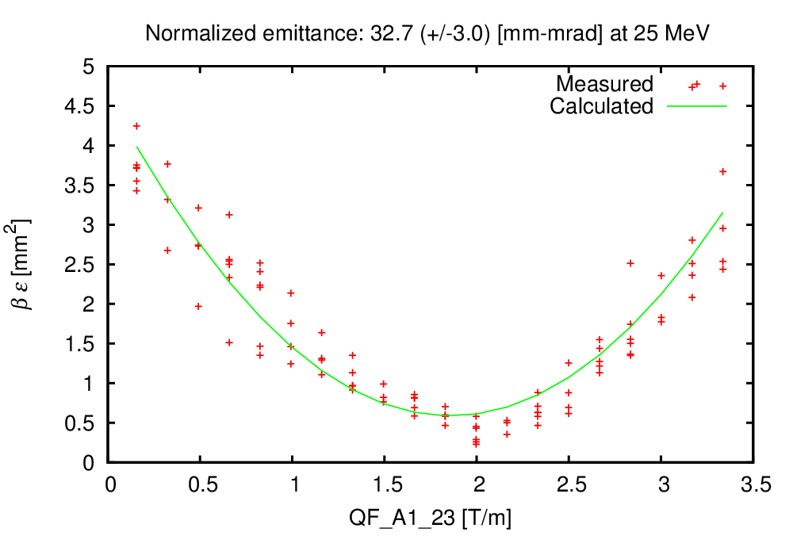
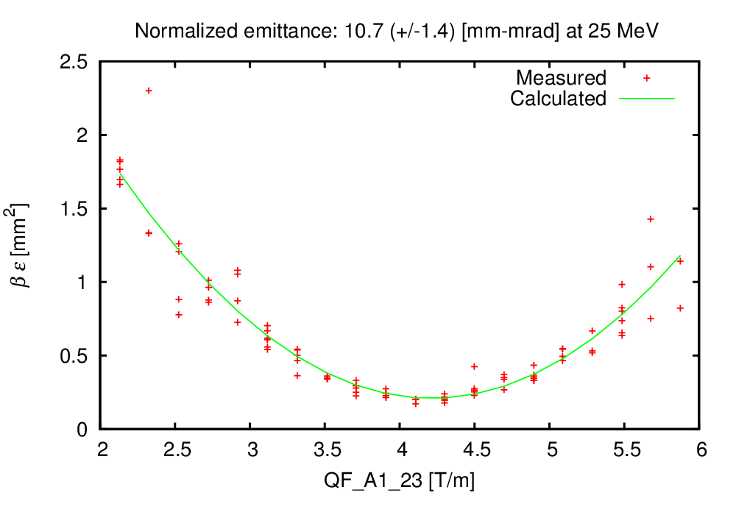
A-1 RF gun results
5.6 nC bunch charge
was observed.
RF gun
A1 sector at KEK linac
Q-scan emittance measurement
beam size measurement for Q-scan
x | y
32.7 ±3.1 mm-mrad | 10.7 ±1.4 mm-mrad

Slide 30
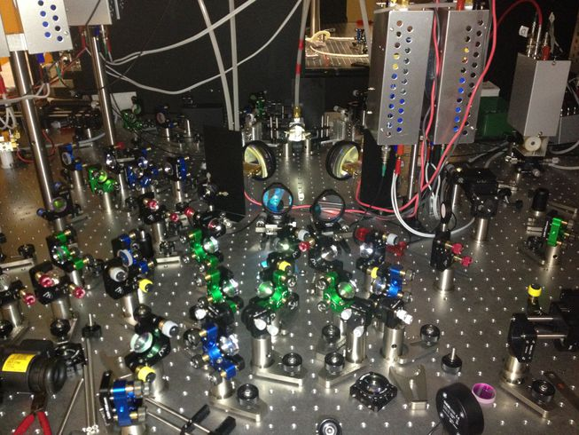
Photo cathode RF gun development
RF gun for low-emittance electron
Cascaded frequency doublers
Quasi traveling wave side couple cavity
Part of multi-pass Amplifier
Yb fiber and Yb:YAG think disk laser
5.6 nC / bunch was confirmed
Next step: 50-Hz beam generation &
Radiation control
Ir5Ce photo cathode

Slide 31
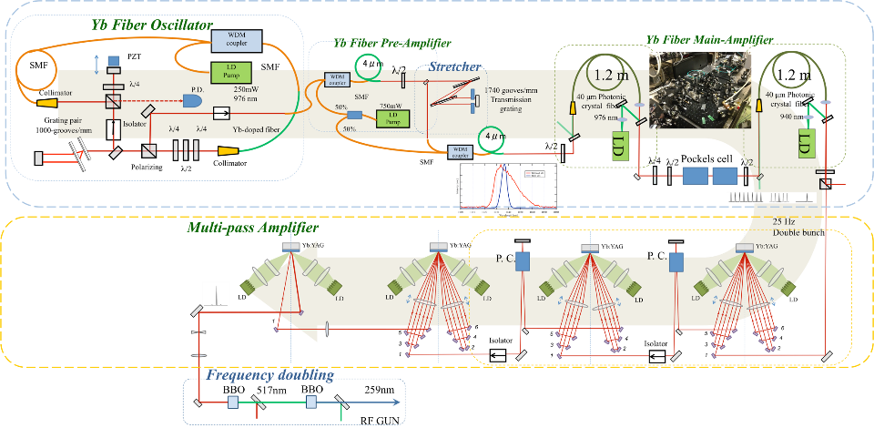
GU_A1 Laser Configuration as of Nov.2014
RF gun for low-emittance electron

Slide 32
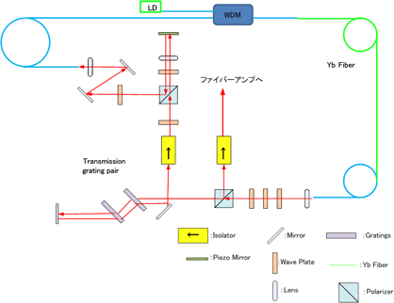
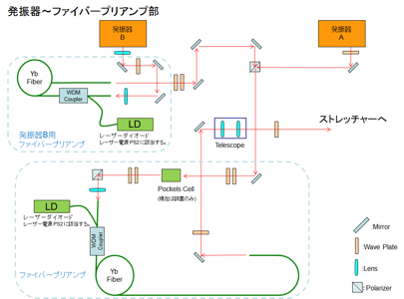
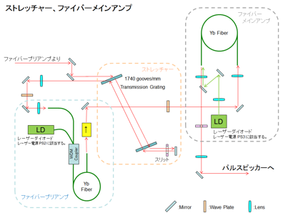
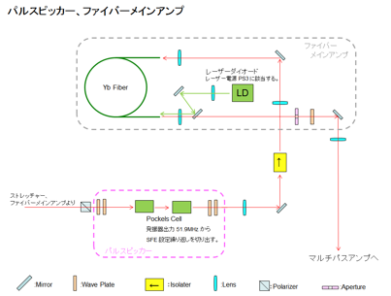
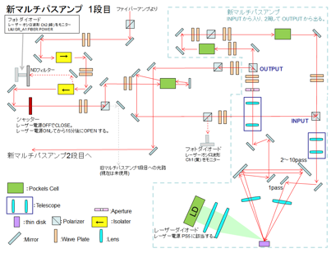
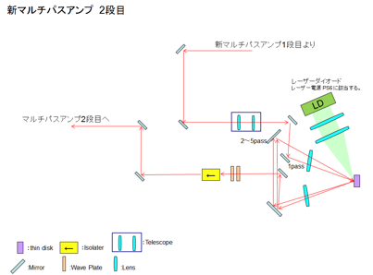





GU_A1 Laser Configuration as of Dec.2014
RF gun for low-emittance electron

Slide 33
Photo cathode RF gun improvement
RF gun for low-emittance electron
Crucial for high-current low-emmittance beam
New Ir5Ce cathode and new cavity QTWSC were successful
Basic features were confirmed at 2 ~ 5 Hz
Expect beam parameter and stability performance at 50 Hz, with multi-pass amplifiers and cooling system
Resolved the issue of oscillator synchronization
Staged laser system improvements with beam measurement system

Slide 34


バンチ電荷量の履歴
Commissioning
最大達成電荷量
電子銃下流： 5 nC
J-ARC出口： 2 nC
入射器終端： 0.74 nC
SP_A1_C5: 電子銃直後
SP_B7_4: Bセクタ終端
SP_R0_63: J-ARC出口SP_58_0: 入射器終端

Slide 35


バンチ電荷量安定性の改善
Commissioning

Slide 36

ビーム軌道の例
Commissioning
PFトップアップ入射を継続しつつ，RF電子銃スタディをおこなっている。3セクタ以降は，PFビーム用パラメタを使用。
X軌道
y軌道
電荷量

Slide 37

A1 部 Dispersion (2014/11/26) の測定結果
Commissioning

Slide 38

シミュレーション２
Commissioning
測定値を再現するようなBMA*の曲げ角をSADのマッチングで探す。
４点でフィット
うまく収束しない。

Slide 39



入射部のアライメント測定（RF-Gun〜A2）
Commissioning
QM_A1_1
QF_A1_C5
QD_A1_C5
QM_A1_1
QM_A1_C5

Slide 40
Commissioning
基準レールに当てた後
測量した

Slide 41
Commissioning

Slide 42

Cathode 面の影響
F. Miyahara
初期分布：
横方向：
カソード面で一様
縦方向：
矩形、
パルス幅 30 ps、
入射角度60
・初期位相が10°変わると横方向の位相空間分布が変わる=レーザーのタイミングに敏感（電子銃内部での収束力は位置、時刻によって変動するので分布が変化すれば出口での 位相空間分布も変化してしまう）

Slide 43

ターゲット周辺の軌道
Commissioning
不自然な水平軌道（要アライメント確認）
43

Slide 44

R0 ARC Dispersion測定： Trackingとの比較
Commissioning
R16
R36

Slide 45
電子ビームコミッショニング
Commissioning
項目 | 設計値 | 現状
バンチ電荷量 (nC) | 5 | 5.01 (電子銃直後) 0.58 (入射器終端)
ビームエネルギー | 7 | 7.5
入射器終端でのエミッタンス (mm⋅mrad) | 50/20 (Hor./Ver.) | 20/7 (Hor./Ver.) (@A1 unit)
電荷量安定性 (%) | 2.5 (KEKB) | 10 ~ 20
バンチ圧縮 (A1ユニット） (ps) | 30 -> 10 | 10 ~ 15
バンチ圧縮 (J-ARC) (ps) | 10 -> 5 | n/a
ビーム分布 （縦方向） | 一様分布 | n/a
エミッタンス保存 | “J-ARCバンチ圧縮” + “オフセットインジェクション” | n/a
最大ビーム繰り返し (Hz) | 50 | 25
最大バンチ数 (rfパルス当たり) | 2 | 2
ビーム入射 | Simultaneous top-up | n/a
45

Slide 46
今季の Commissioning
Commissioning
コミッショニングツール群の整備
  ワイヤスキャナ
  トリガ同期カメラおよびスクリーンモニタによるQスキャン測定
  マッチングソフトウェア
課題
  入射部のアライメント
  A1シケイン，J-ARCでのビームロス低減（アライメント再確認）

Slide 47
入射運転に向けて
Electron gun rearrangement
現状で定常運転向けの Beam が完成しているわけではない
開発は継続する必要があるが、運転向けの体制を考える
Phase-1 では Beam requirement は厳しくない
放射線施設検査を 5-6 月に控えている
RF 電子銃と熱電子銃の併用を進める

Slide 48
Staged Radiation Control License towards SuperKEKB
Electron gun rearrangement
Two licenses were approved in June 2014
[1] Beam diagnostic station at #A2 just after gun
  for 1250nC/s at 50Hz 2bunches
[2] Beam dump at #28 just before damping ring
  for 10nC/s with positrons
Radiation measurements especially at positron generator
  Indispensable to estimate radiation at >100 times higher beam
Both approved
Soon apply for the next license at ~May.2015

Slide 49


Electron gun rearrangement
現状
KL-A1-B
KL-A1-A
移相器・減衰器
第2加速管
RF-gun
（Pre-buncher）

Slide 50


Electron gun rearrangement
現状
KL-A1-B
KL-A1-A
移相器・減衰器
第2加速管
RF-gun

Slide 51
Electron gun rearrangement
M. Yoshida

Slide 52
Electron gun rearrangement
M. Yoshida

Slide 53








Electron gun rearrangement
S.Ohsawa
改造案
KL-A1-B
KL-A1-A
3dB DC
復元
移相器・減衰器
（移設）
他のWG新規製作
又は流用
WG 1本 新規製作
移相器・減衰器
（移設）
加速管１本
(第2RF-gun)
第1RF-gun
加速管2本
Buncher
Pre-buncher
WG 3本を
600mmつめる
(第2RF-gun用パルスベンドと予備スペース)

Slide 54

Electron gun rearrangement
S.Ohsawa
改造案2
KL-A1-B
KL-A1-A
3dB DC
復元
移相器・減衰器
（移設）
他のWG新規製作
又は流用
WG 1本 新規製作
移相器・減衰器
（移設）
加速管１本
(第2RF-gun)
第1RF-gun
加速管2本
Buncher
Pre-buncher
WG 3本を
600mmつめる
(第2RF-gun用パルスベンドと予備スペース)

Slide 55
Summary
Steady progress towards first MR injection in 2015
Finishing earthquake disaster recovery in 2014
Will make staged improvements before 2017
Will balance between final beam quality and staged operation
Will select optimized route depending on available resources
  Incorporate thermionic gun as well as RF gun

Slide 56

Mt. Tsukuba
Thank you
SuperKEKB
dual rings
PF-AR
PF
Injector
Linac

Slide 59

Emittance Preservation and Alignment
If Device is off center of the beam
  Focusing magnet (quad) kicks the beam bunch
  Accelerating structure (cavity) excites wakefield, to bend the tail
Distorted bunch in banana shape
  Emittance dilution or blow-up, even 100 times larger
    Depending on the beam optics and the beam charge
Alignment and orbit correction is crucial to preserve the emittance
Sugimoto et al.
Beam
Focusing
Magnet
Accelerating
Structure
Transverse beam distribution in time direction

Slide 60


Emittance Preservation
Offset injection may solve the issue
Orbit have to be maintained precisely
Mis-alignment should be <0.1mm locally, <0.3mm globally
Mis-alignment leads to Emittance blow-up
Orbit manipulation compensates it
100 samples
Sugimoto et al.

Slide 61
Pulse-to-pulse modulation
Event-based
Control System
Four PPM virtual accelerators
for SuperKEKB project
maybe with
additional PPM VAs
for stealth beam
measurements
based on
Dual-tier controls with
EPICS and event-system
Every
20 ms
F.B
e⁻ Gun
F.B
ARC
PF Injection
e– (2.5GeV, 0.2nC)
F.B
e⁻ Gun
Damping ring
SuperKEKB-LER Injection
F.B
ARC
e– (3.5GeV, 10nC)
F.B
e⁺ Target
e⁺ (4GeV, 4nC)
e⁻ Gun
ARC
SuperKEKB-HER Injection
F.B
F.B
e– (7GeV, 5nC)
e⁻ Gun
F.B
ARC
PF-AR Injection
e– (6.5GeV, 5nC)

