Slide 1
Electron / Positron Injector Linac
K. Furukawa
for Linac division

Slide 2
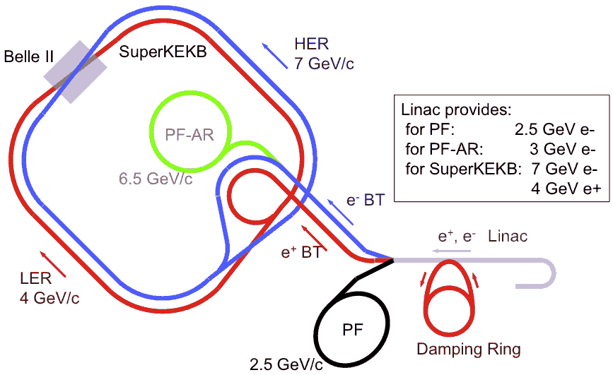
Linac in SuperKEKB Project
Linac Overview
40-times higher Luminosity
  Twice larger storage beam → Higher Linac beam current
  20-times higher collision rate with nano-beam scheme
    → Low-emittance Linac injection beam
    → Shorter storage lifetime → Higher Linac beam current
Linac challenges
  Low emittance e-
    High-charge RF-gun
  Low emittance e+
    Damping ring
  Higher e+ beam current
    New capture section
  Beam transport
  Four ring manipulation
40x Luminosity
e+ increase
RF-gun
2x beam current
Notes:
Higher Injection Beam Current
To Meet the larger stored beam current and shorter beam lifetime in the ring
4~8-times larger bunch current for electron and positron
Reconstruction of positron generator, etc
Lower-emittance Injection Beam
To meet nano-beam scheme in the ring
Positron with a damping ring
Electron with a photo-cathode RF gun
Emittance preservation by alignment and beam instrumentation
Quasi-simultaneous injections into 4 storage rings
SuperKEKB e–/e⁺ rings, and light sources of PF and PF-AR
Improvements to beam instrumentation, low-level RF, controls, timing, etc

Slide 3
SuperKEKB Injector Linac
Linac Overview
Higher Injection Beam Current
  To Meet the larger stored beam current and shorter beam lifetime in the ring
  4~8-times larger bunch current for electron and positron
  Reconstruction of positron generator, etc
Lower-emittance Injection Beam
  To meet nano-beam scheme in the ring
  Positron with a damping ring
  Electron with a photo-cathode RF gun
  Emittance preservation by alignment and beam instrumentation
Quasi-simultaneous injections into 4 storage rings
  SuperKEKB e–/e⁺ rings, and light sources of PF and PF-AR
  Improvements to beam instrumentation, low-level RF, controls, timing, etc

Slide 4
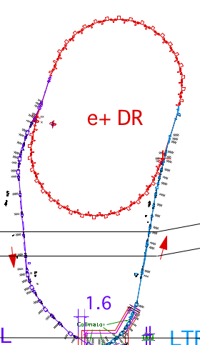
Linac and Positron Capture Section
Linac Overview and Positron Capture
SuperKEKB injector Linac
50 Hz (e+ or e-)
pulse-by-pulse
mode switching
high current
gun
1.1 GeV
Damping Ring
circ. 136 m
PF
low emittance
RF gun
AR (later)
6.5 GeV e-
2.5 GeV e-
0.1nC x 1
Bunch
Compressor
LER, AR
3.5 GeV
10nC x 2 (prim. e-)
5nC x 2 (inj. e-)
Energy-spread
Compression System
S-band
linac
3T
RF gun
4.0 GeV e+ 4nC x 2
ECS
e+ target &
L-band+LAS
capture section
C-band
modules
7.0 GeV e-
5nC x 2
HER
Positron Capture Section
DR
positron target relocation from 2-1 to 1-5
for energy margin in DR injection
1-3
1-4
1-5
1-6
1-7
1-8
2-1
2-2
2-3
2-4
2-6
2-7
2-8
3-2
target
solenoid
FODO singlet system
Q triplet 3m
Q triplet 5m
L-band
LAS
Large Aperture S-band
normal S-band

Slide 5
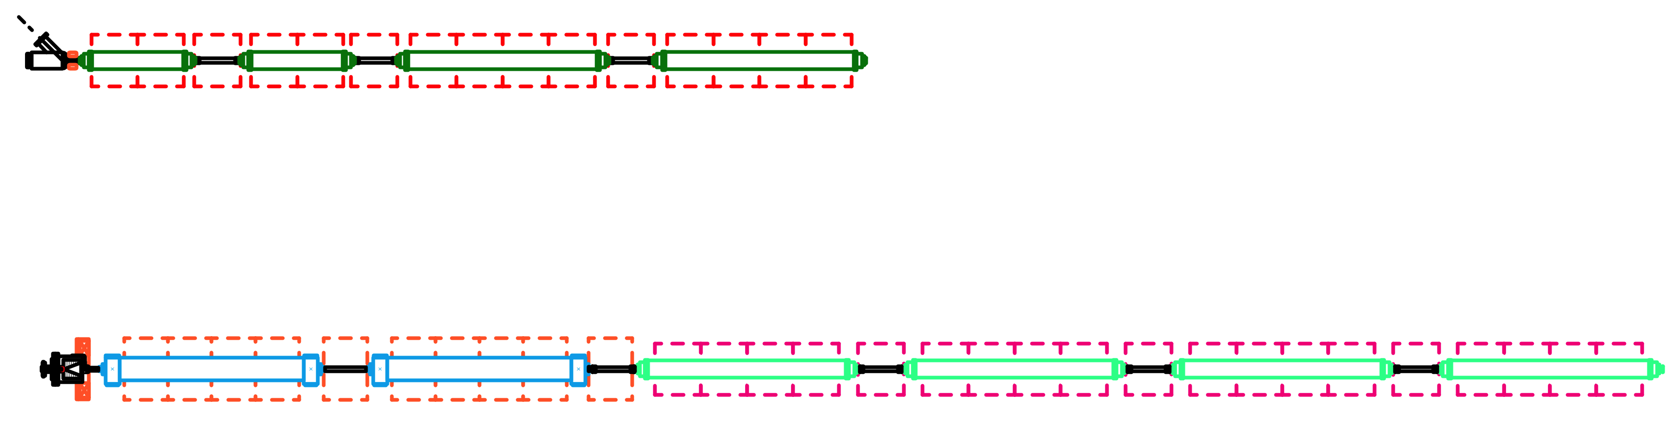
Design of Positron Capture Section
Positron Capture
KEKB e+ capture section
QWT system (2.0 T x45mm + 0.4 T x8m)
air-core pulse coil DC solenoids
KLY1 (S-band) -> 2 x 1m 12 MV/m, aper 2a = 27 -> 25 mm
KLY2 (S-band) -> 2 x 2m 10 MV/m, aper 2a = 25 -> 21 mm
beam energy at capture section exit : 80 MeV
N(e+)/N(e-) = 10 % at 3.5 GeV linac-end
N(e+)/N(e-)/E(e-) = 2.5 %/GeV
SuperKEKB e+ capture section
AMD system (6.0 T x200mm + 0.4 T x15m)
flux concentrator DC solenoids
L-band -> 2 x 2m 10 MV/m, aper 2a = 39 -> 35 mm
LA S-band -> 4 x 2m 10 MV/m, aper 2a = 32 -> 30 mm
beam energy at capture section exit : 110 MeV
Deceleration mode
full L-band configuration
L-band + LAS configuration
for comparable performance
with reduced cost
N(e+)/N(e-) = 65 % at 1.1 GeV DR
N(e+)/N(e-)/E(e-) = 19 %/GeV

Slide 6
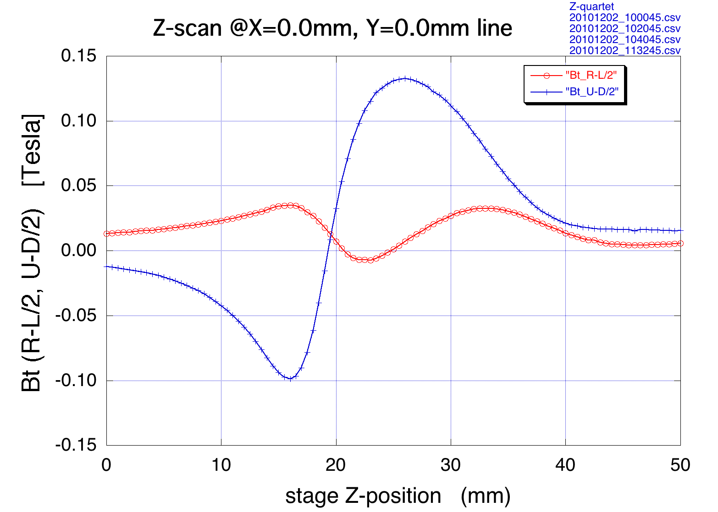
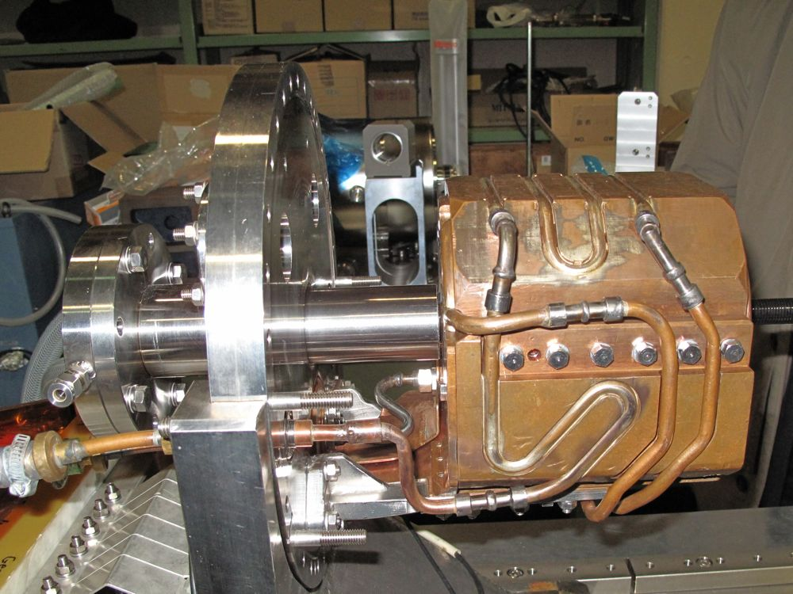
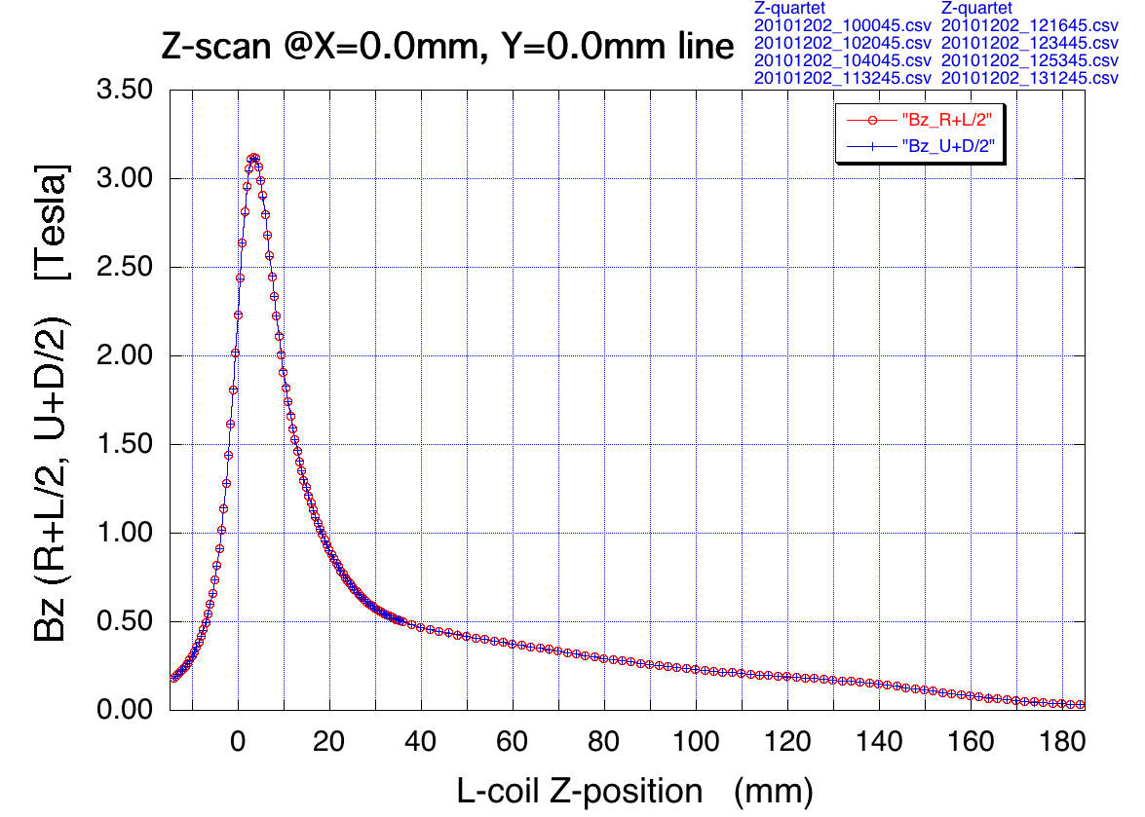
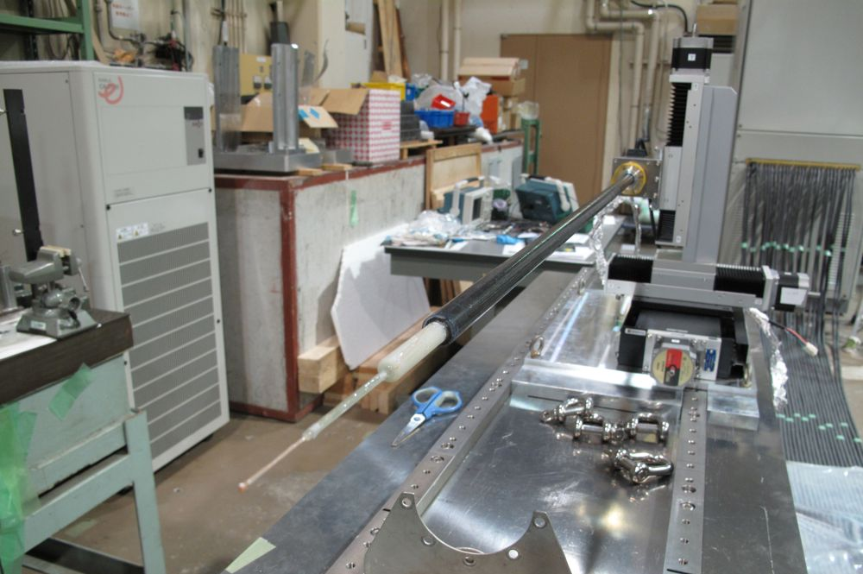
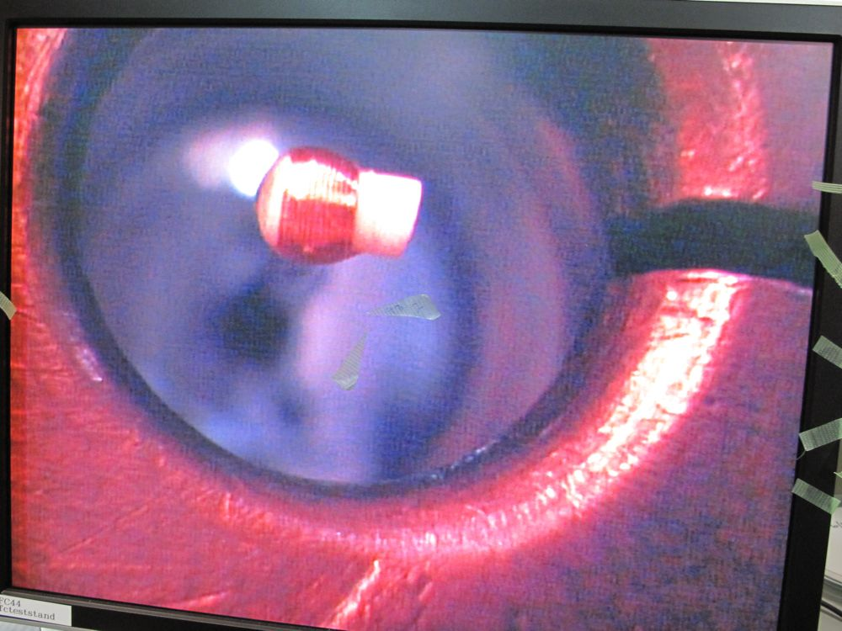
Flux Concentrator BINP-type
Positron Capture
In collaboration with BINP, prototype field measurement & high-power operation test performed at KEK from Nov. 2010 to March 2011.
Breakdown issue with vacuum burst above 7 Tesla was identified. However, the investigation with BINP experts was interrupted by the Earthquake.

Slide 7
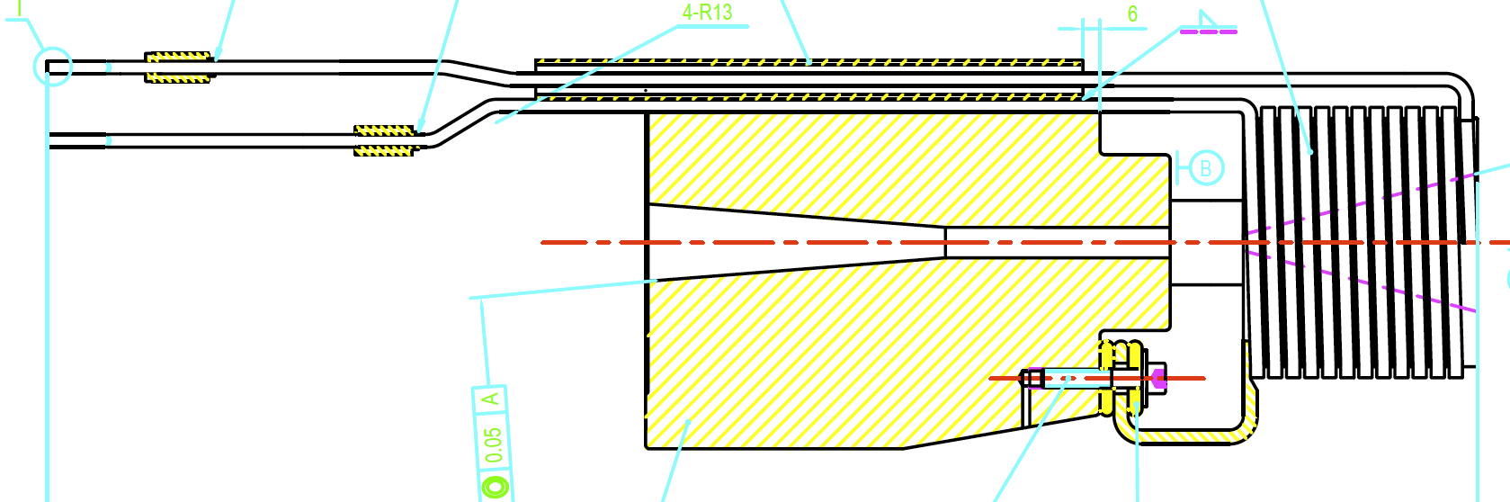
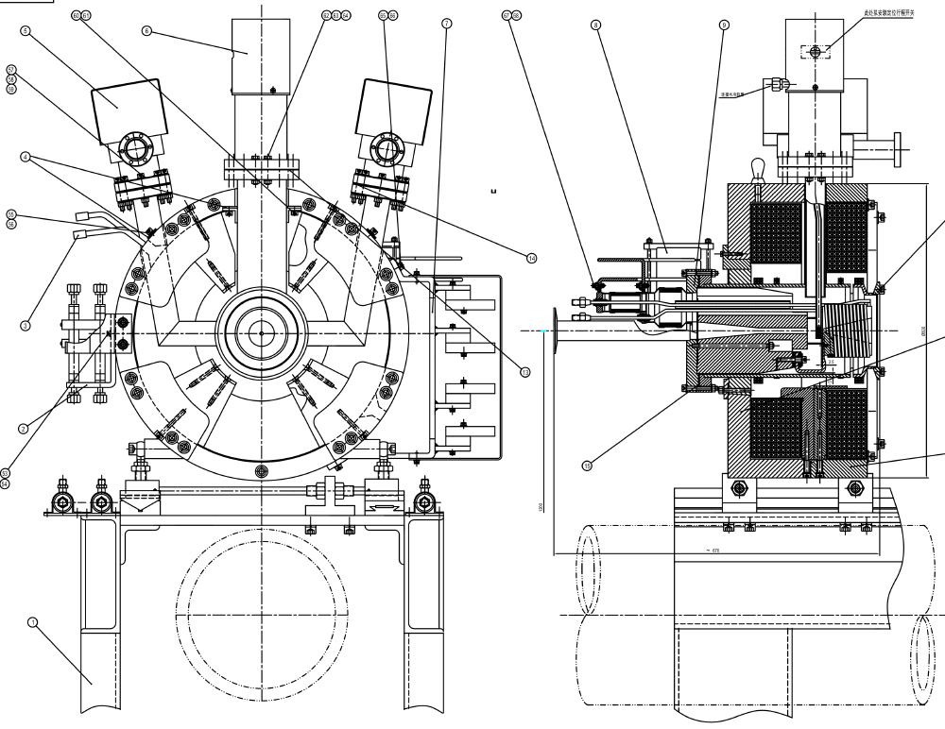
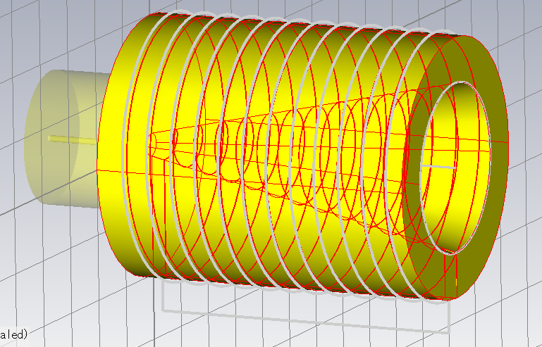
Flux Concentrator SLAC-type
Positron Capture
with helps from SLAC and IHEP we are going to fabricate SLAC-type FC for linac commissioning from 2013 autumn and stable operation at T=0.
Final optimization of field design and mechanical design as well as fabrication system design
SLAC-type FC at IHEP

Slide 8
Capture by L-band and LAS structures
Positron Capture
L-band
  Large aperture (d=39~35mm) of accel. structure is desirable for transverse acceptance of Positron Capture Section
  Coprime (5:11) frequency relation is effective to sweep out satellite bunches critical to DR radiation shield issue.
  Full S-band (LAS) capture section gives comparable e+ yield, but with plenty of satellite particles
LAS (Large Aperture S-band)
  Medium large aperture (d=32~30mm) is desirable for transverse acceptance of PCS and quad focusing system
  Existing S-band rf source, SLED, DC solenoids are available & compact Q at FODO (reduction in initial cost)

Slide 9
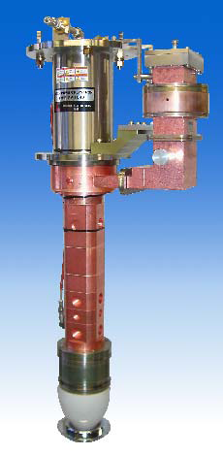
L-band Klystron
Positron Capture
40 MW L-band(1298 MHz) klystron PV-1040 designed by KEK and Mitsubishi Electric
compatible with existing S-band modulator and KLY tank in KEKB linac
first PV-1040 delivered in March 2010
performance test since June 2011
KLY operation spec. at SKB linac
30 MW x 1.5 us x 50 pps achieved !
another two PV-1040 will be delivered,
we will have three L-band klystrons for
(1) positron capture section
(2) bunch compressor at DR
(3) spare
(KLY data by
S. Matsumoto)

Slide 10
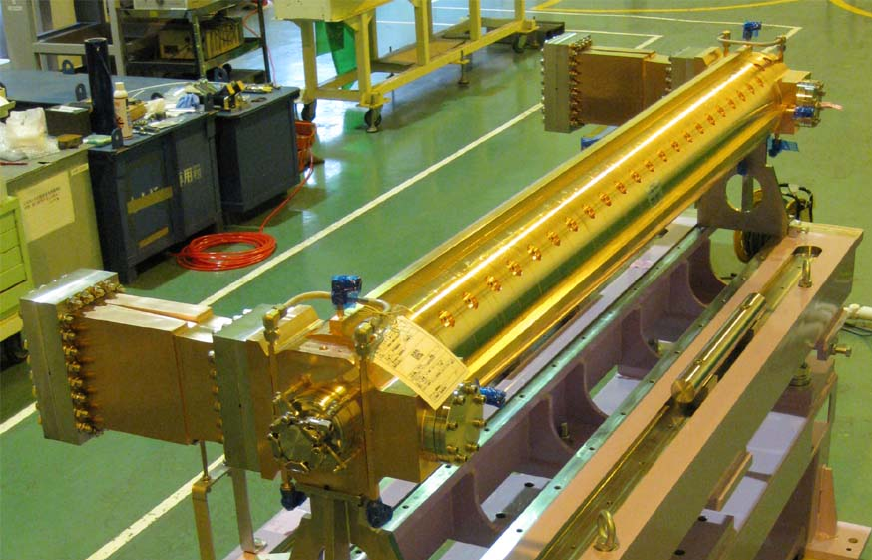
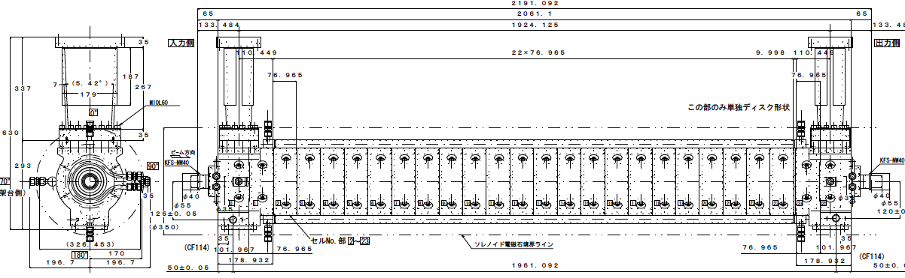
L-band Accelerating Structure
Positron Capture
first L-band structure completed in March 2010
operation test at test stand from April 2012
RF frequency 1298 (=2856 x5/11) MHz
traveling-wave structure (short rf pulse)
constant gradient
(2/3)pi phase advance per cell
structure length 2.2 meter
disk aperture 2a = 39.4 ~ 35.0 mm
field strength 12 MV/m@15 MW input
single feed coupler (with field symmetrized)
attenuation constant tau = 0.26
(structure data by T. Higo)

Slide 11
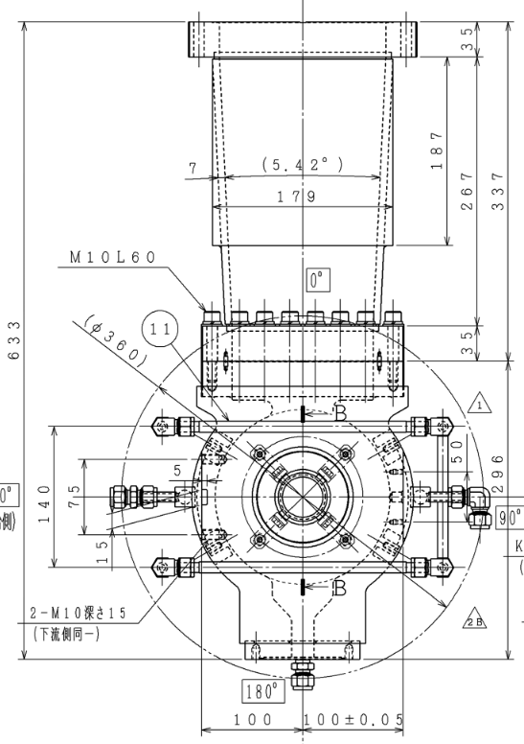
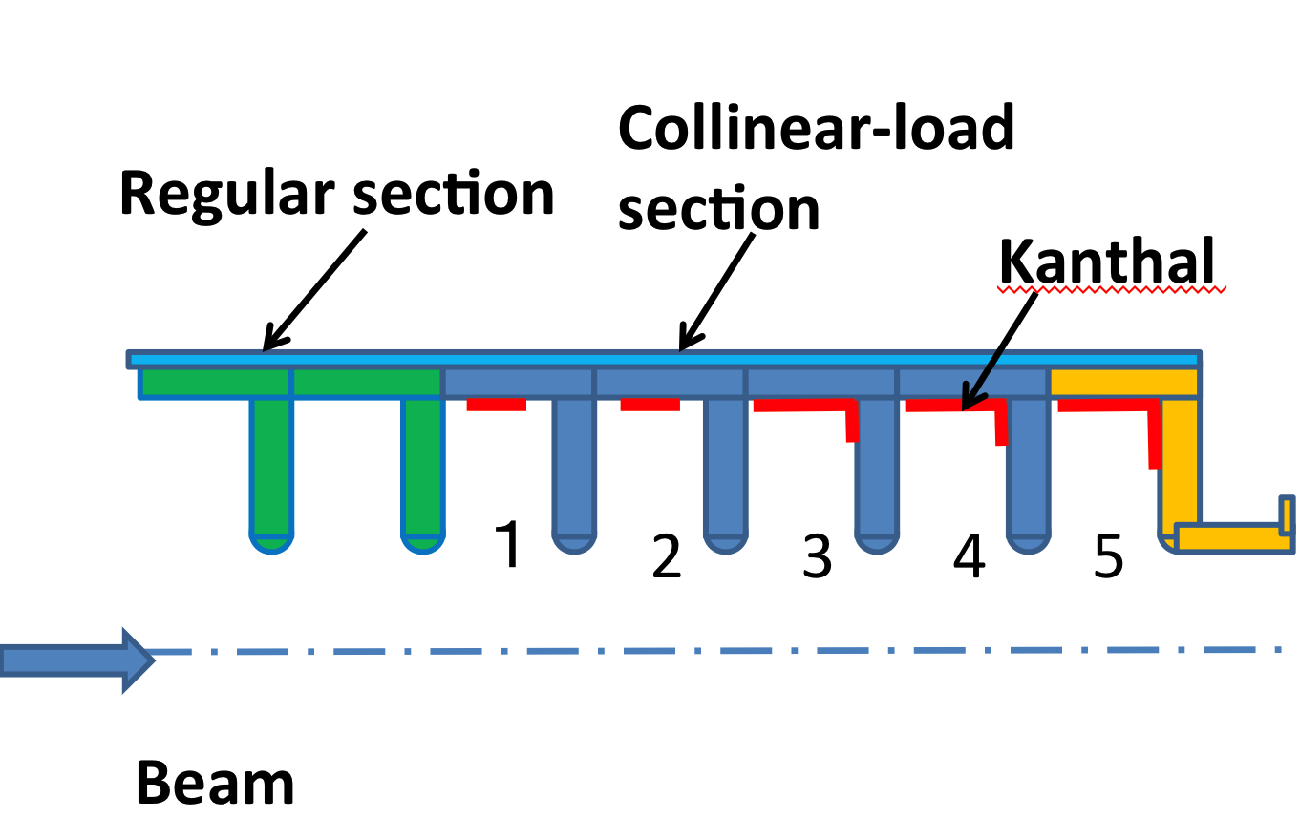
Built-in Collinear RF Power Load
Positron Capture
L-band rf coupler limits DC solenoid inner radius >= 180 mm
for regular cell region, the radius can be 130 mm
with built-in collinear power load, the output coupler can be
omitted and end-tail becomes thin

Slide 12
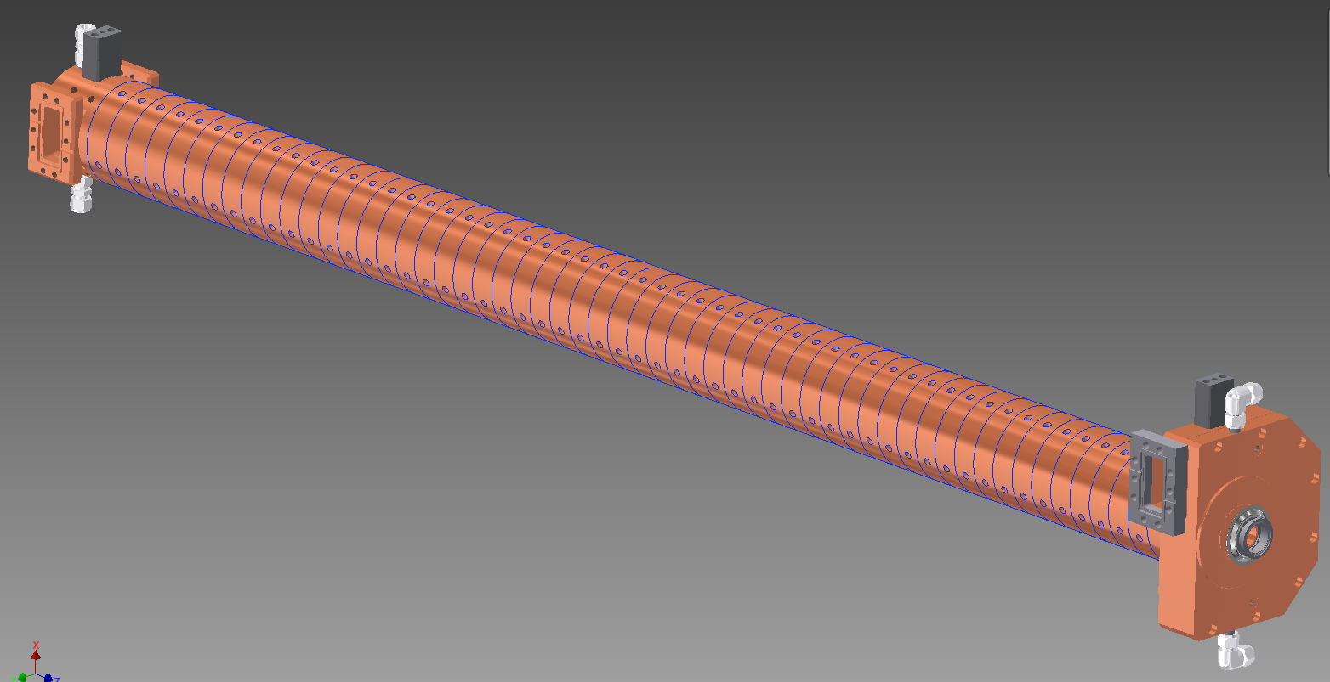
Large Aperture S-band Structure
Positron Capture
LAS structures are used,
  in second unit of capture section
  in two accelerator modules just behind capture section
Large aperture and compact outer diameter
  existing rf source available
  existing DC solenoid available
  compact quad outside LAS structure compared with L-band
Cost-performance balance
traveling-wave structure
constant gradient
(2/3)pi phase advance per cell
structure length 2.2 meter
disk aperture 2a = 31.9 ~ 30.0 mm
field strength 16.4 MV/m with SLED
6.9 MV/m w/o SLED
two port input coupler (J-shape side-couple)
two port output coupler (ordinary shape)
attenuation constant tau = 0.112

Slide 13
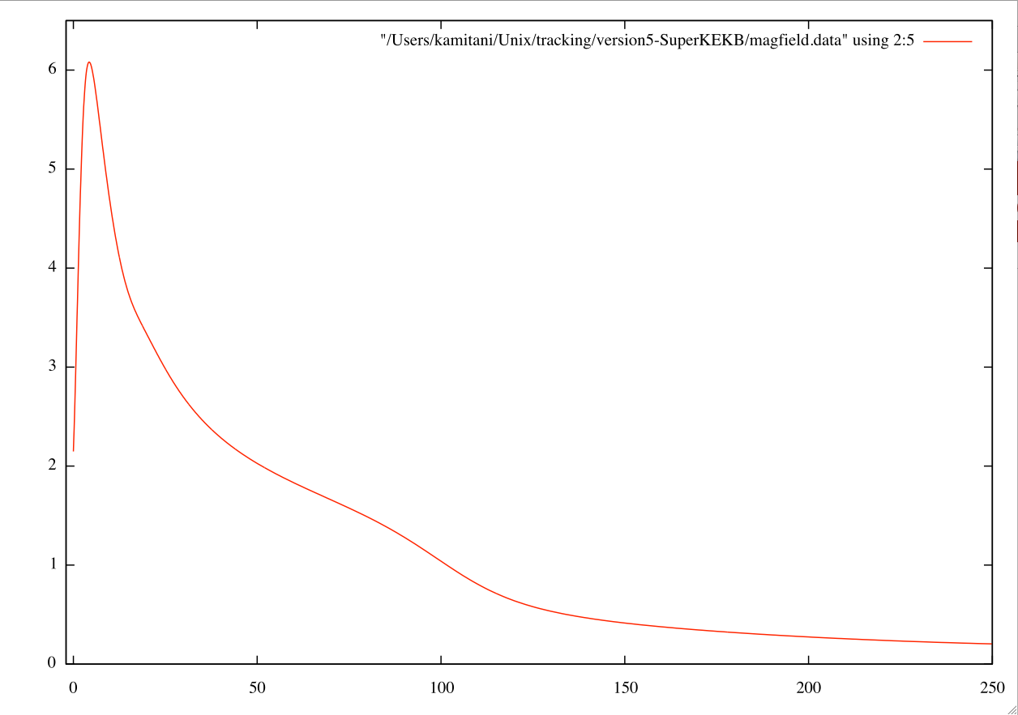
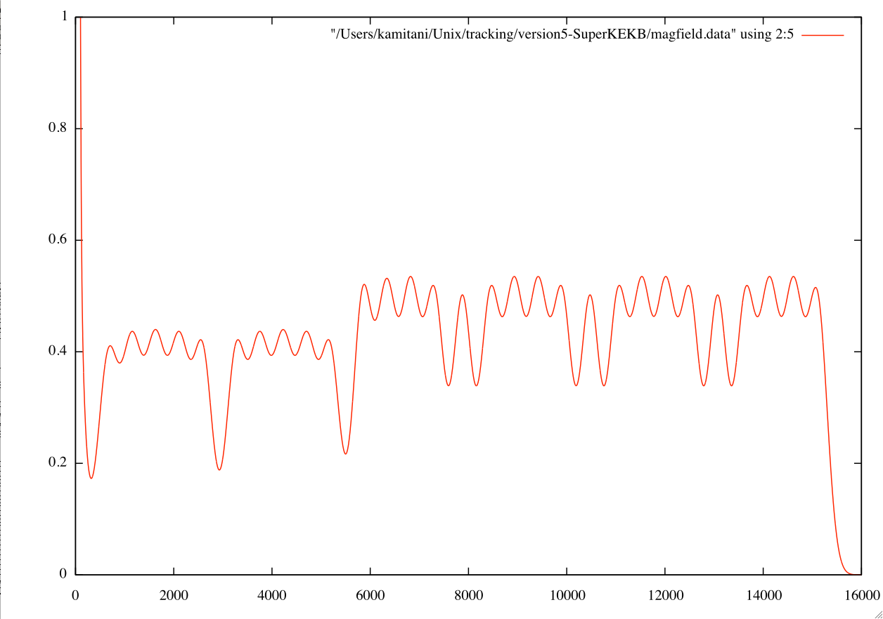
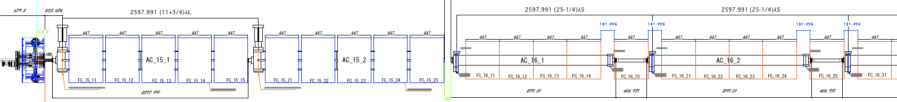
Solenoid Field Design
Positron Capture
FC + DC solenoid field distribution determines transverse acceptance of capture section and e+ initial emittance.
FC + DC Solenoid field
peak ~ 6 Tesla
DC solenoid field
(long range)

Slide 14
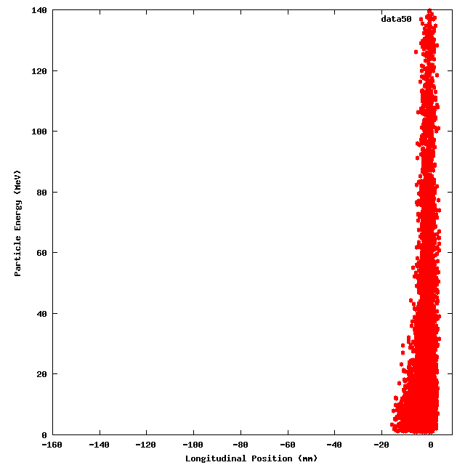
Particle Simulation
Positron Capture
capture section : Zang Lei (GPT), T.Kamitani(EGS4, CST)
linac 1~2 sector + LTR : T.Miura, N.Iida (SAD)
DR beam dynamics : H.Ikeda
RTL + linac 3~5 sector + BT-line : N.Iida (SAD)
Simulation Example
from target to capture section exit (120 MeV)
Acceleration phase mode
in capture section
Deceleration phase mode
in capture section
Energy (MeV)
Energy (MeV)
longitudinal position (mm)
longitudinal position (mm)

Slide 15
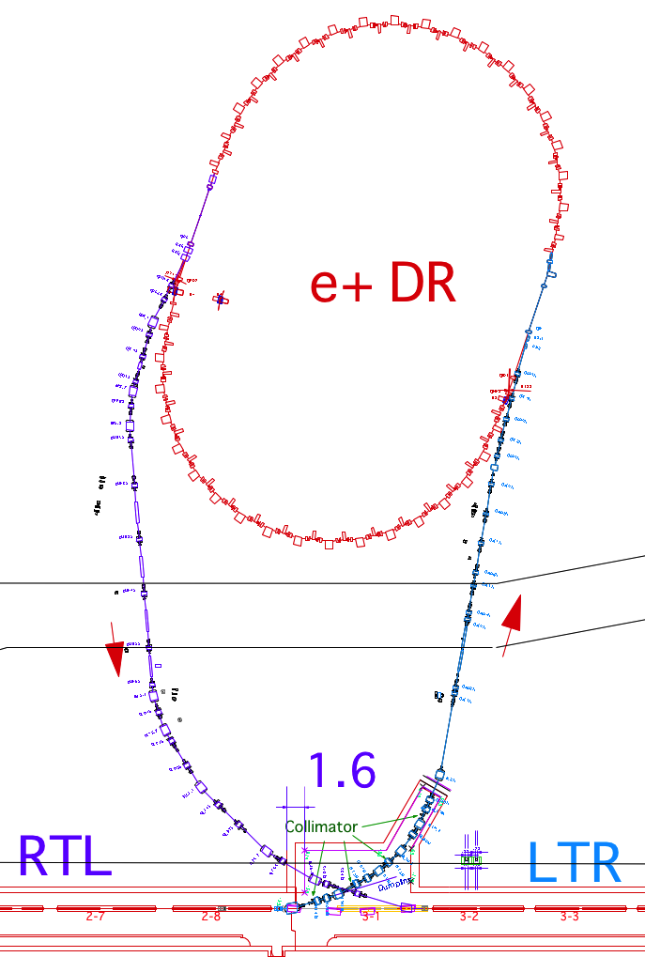
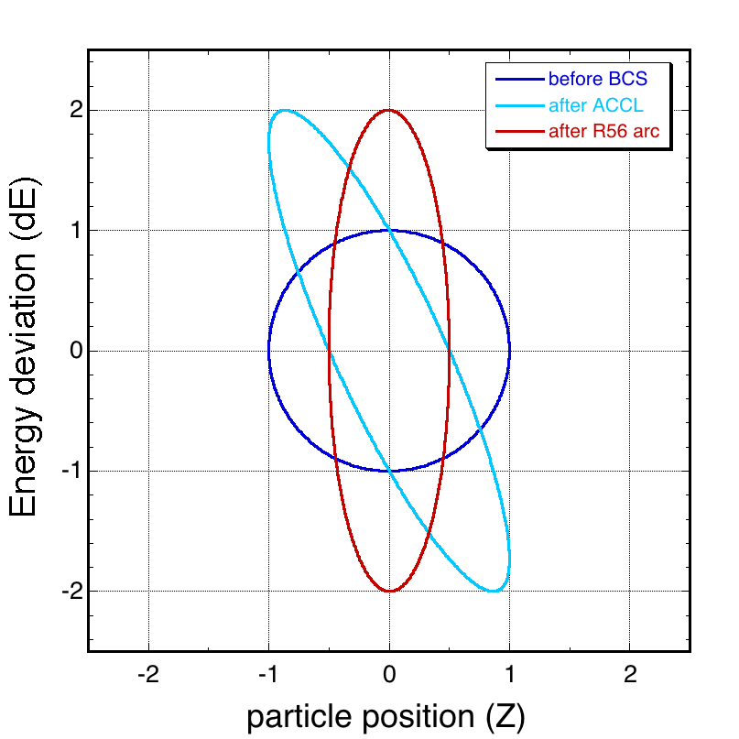
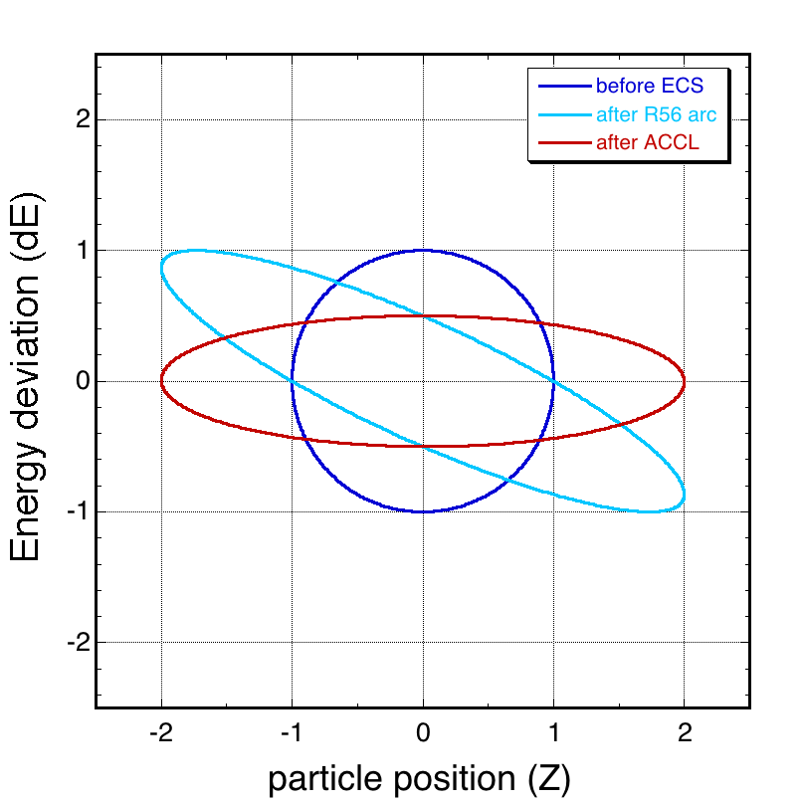
ECS at LTR & BCS at RTL
Positron Capture
Bunch
Compression
System
Energy-spread
Compression
System
BCS reduce bunch-length of e+ extracted from DR
ECS reduce energy-spread of e+ entering DR
energy gradient by RF field
+ non-isochronous arc
non-isochronous arc +
energy correction by RF field
Vc = 37 MV (L-band)
R₅₆ = -1.05 m
compression 1/9
R₅₆ = -0.61 m
Vc = 41 MV (S-band)
compression 1/3
schematic view
scale is not precise !
RTL
LTR

Slide 16
Injector Positron Source Status
Positron Capture
Fabricating SLAC-type FC for T=0
Need consideration on target protection
1st L-band structure to be high-power tested soon
Design of L-band collinear load fixed
Waveguides & loads in fabrication
L-band klystron 1st tube ready
Large Aperture S-band structures in fabrication
DC solenoid field dips are moderated by huge solenoids
Beam optical design almost OK
Particle tracking simulation is ongoing for e+ yield and hardware parameter optimization
Damping Ring, ECS, BCS are in construction

Slide 17
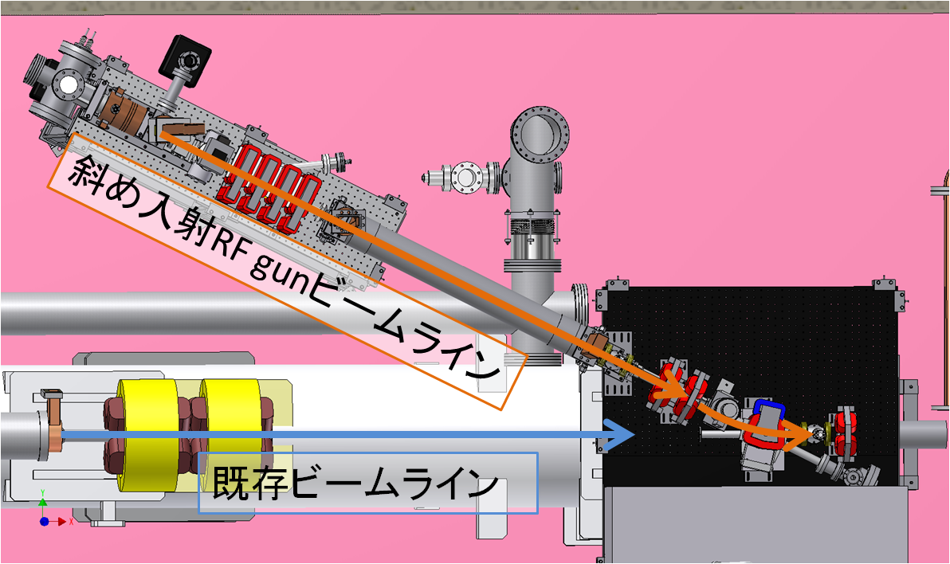
RF Gun at 32 unit for 5nC / 20mm-mrad
RF Gun
Emittance of 300μm in KEKB should be reduced to 20μm
Laser

Slide 18
Laser Development
RF Gun
Oscillator
  Nd:YAG medium, LD excitation
  Change frequency from 114MHz to 52MHz
    Synchronized through 10.39MHz Clock
  Successful stable excitation
Amplifier improvements
  ~1.5mJ / 30ps / pulse at 266nm

Slide 19
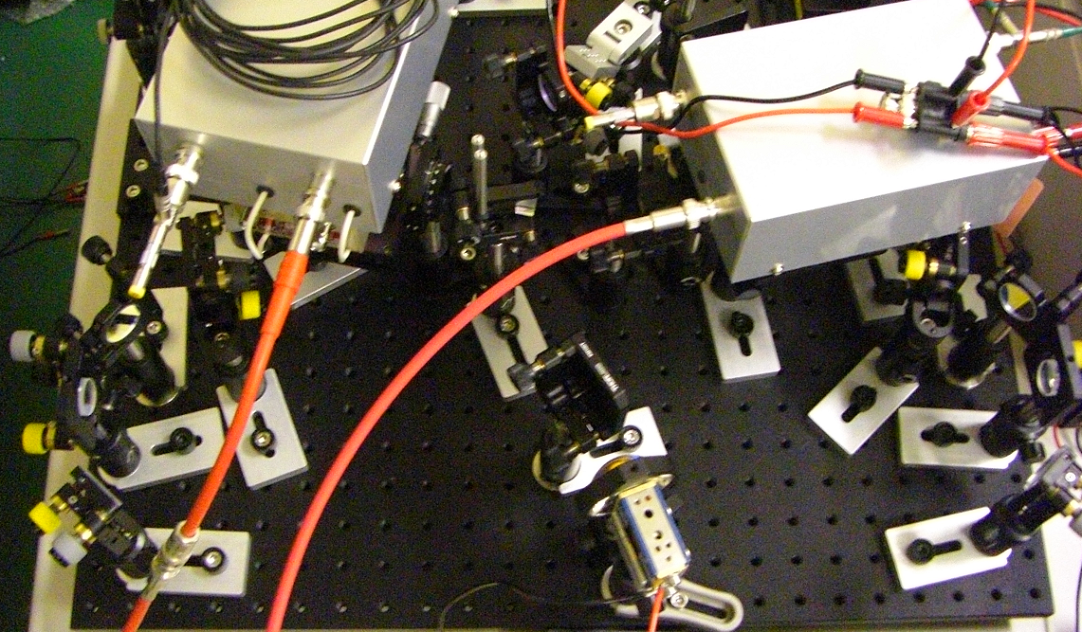
RF Gun
Laser Amplifier Development
Output
R=0.5m
f=250mm
R=0.5m
f=250mm
Nd:YAG
R=99%
PD
λ/4
Input

Slide 20
Laser Amplifier Development
RF Gun
Multi-pass
Amplification
Cleaner
Amp.
with
EO and AO
components

Slide 21
Photo Cathode Development
RF Gun
Started with LaB₆
  Successful up to ~0.3nC before April
Replaced with Ir₅Ce
  For better quantum efficiency
  Achieved up to ~1nC / bunch in April
Surface cleaning cut & try
  With high power laser with/without RF
  LaB6 and Ir5Ce are rather stable
Other possibilities in the future
  CsTe, etc

Slide 22
Slant Laser Injection
RF Gun
Perpendicular laser injection
  Before May.2012
Slant laser injection through CaF2 windows
  Non-zero perpendicular electric field (?)
  Increased up to ~3nC / bunch
  Emittance should be confirmed
Polarization dependence (Ir5Ce)
(東工大/佐藤)

Slide 23
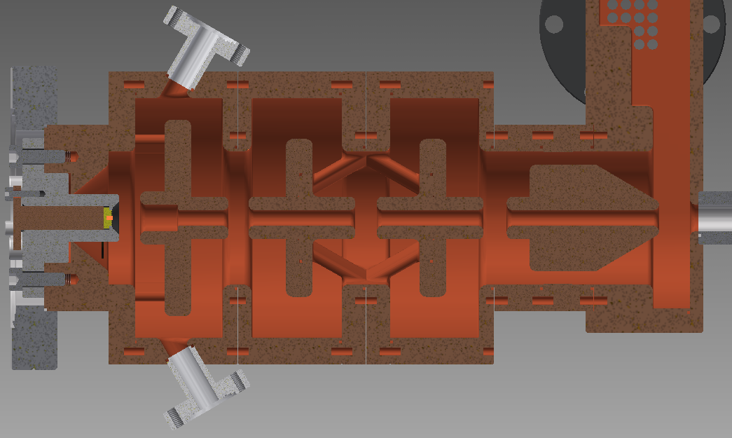
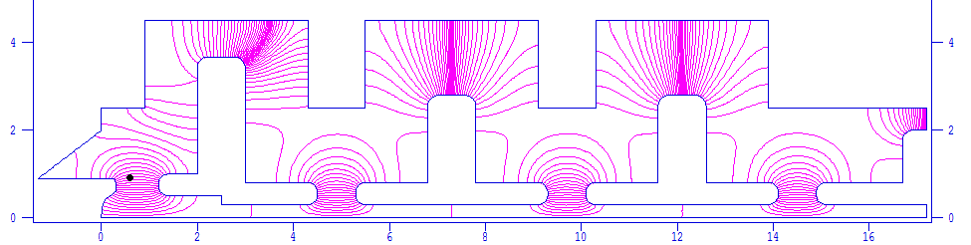
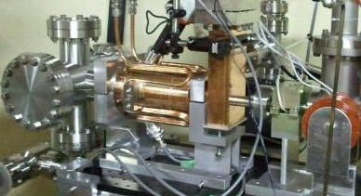
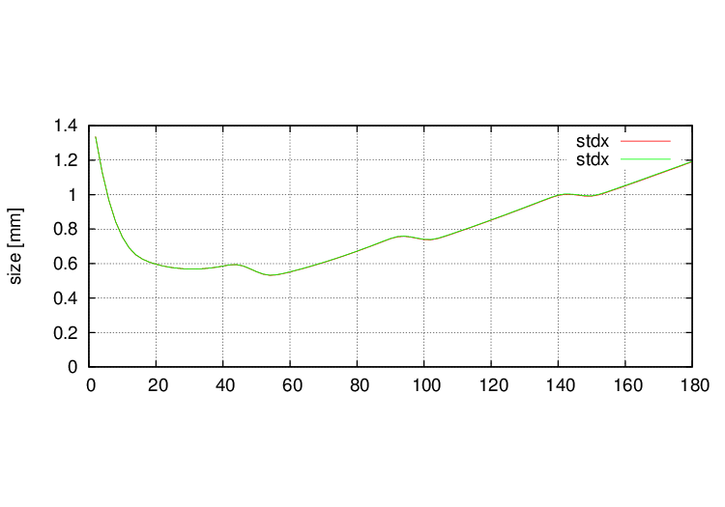
Stable Operation of RF Gun
RF Gun
DAW (Disk and washer) type photo cathode RF gun
  Strong RF beam focusing
  With stable cathode
  Should experience
  continuous PF injection
  in autumn 2012
  With backup laser
Electric field and beam tracing simulation

Slide 24
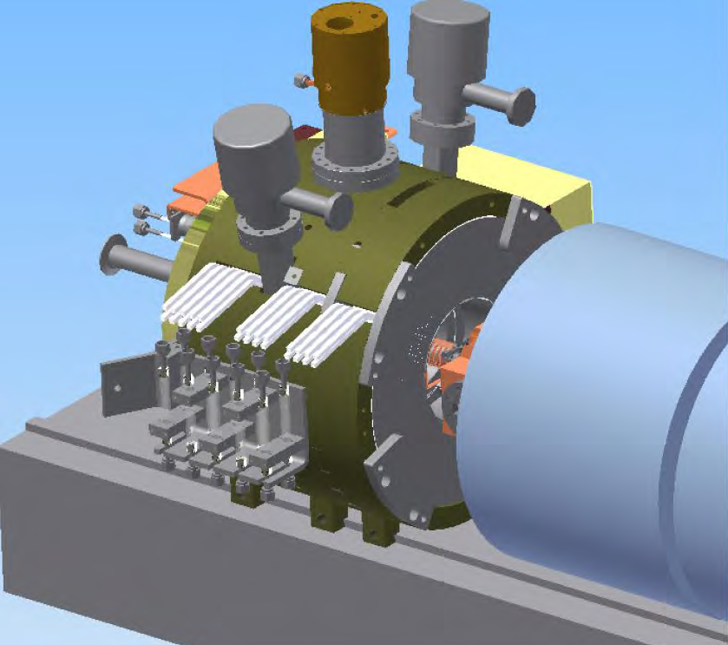
Fast Recovery at Failure of Positron Generator
Fast Recovery
Positron capture section replacement
  How components should be designed/installed in order to be replaced under high radiation condition?
  (replaced twice in KEKB)
  Positron target,
  Flux concentrator,
  Bridge coil,
  Acceleration structure,
  Solenoid, Girders,
  Vacuum components, etc.
  Large unit should be replaced
  with special links
  Under discussion

Slide 25
Reliability with Failed Acceleration Unit
Reliability with Energy Management
Linac Beam Energy Management
  At least one backup acceleration unit should available with two units for an energy knob in regions of ;
    Before 180deg arc
    before damping ring
    after damping ring
  In each of electron and positron modes (and PF/PF-AR)
  The plan was fixed
  While troubles at several important units (like capture section) can prevent operation, others should be backuped

Slide 26
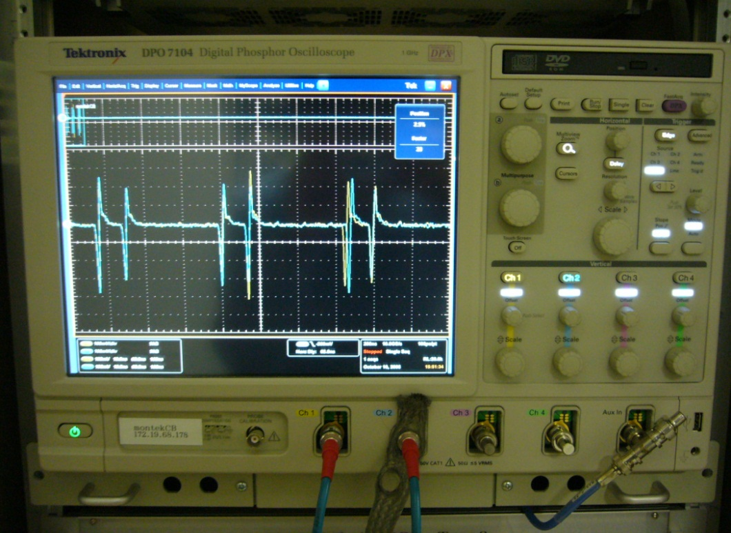
Beam Position Monitor Development
BPM
Requirement
  50Hz with event synch., 2bunchs 96ns apart, 10micron resolution, 0.1~10nC variation at 50Hz
Present system
  8bit oscilloscope, Windows-EPICS, 50Hz,
  50~100micron resolution
BPM is essential for
  Low-emittance transport
  with wakefield compensation
  Beam stability monitor

Slide 27
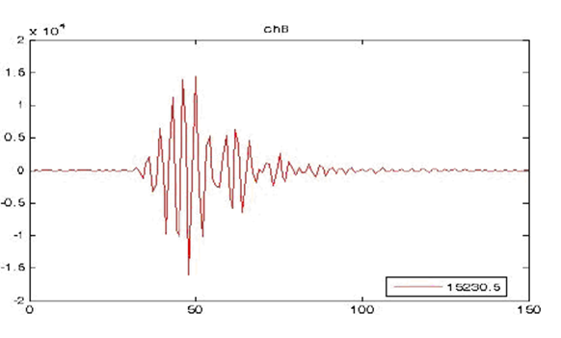
BPM Development
BPM
Modifications to commercial module Libera
  Event-based control capability and embedded EPICS
  Fast attenuator for variable beam modes
  Modifications to filters and ADCs for 2-bunches 96ns apart
New development at local company
  In VME form factor, with external CPU and event-based controls
  Additional on-line pulse test capability
Both evaluations in this year
  Lab tests during summer
  Beam tests in autumn
  Resolution, price, reliability,
  flexibility, manageability, etc
  Installation in 2014
band-pass + saw filters

Slide 28
4 Ring Injection Timings
Four Ring Injection and PF Sync.
SuperKEKB will have integer RF clock relation with Linac
  Needs ring circumference compensation with frequency modulation
PF / PF-AR will not have common clock with Linac
  As they need independent circumference compensation
  Linac injects beams at accidental synchronization
  No synchronization opportunity if integer relation
Damping ring and L-band introduction
  Requires further condition restrictions

Slide 29
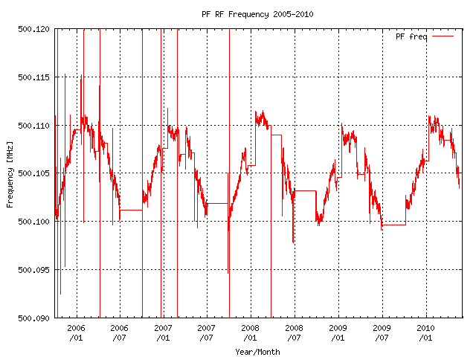
PF Synchronization
Four Ring Injection and PF Sync.
PF Frequency modulation in a year
  Approx. 2 x 10^-5

Slide 30
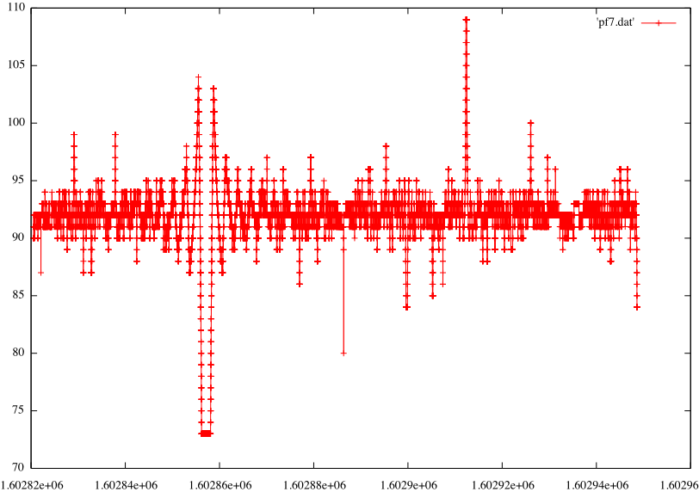
Injection Synchronization with 114MHz
Four Ring Injection and PF Sync.
For PF
with KEKB
Duration Jitter
20ms
+/-500μs
Clock Jitter
500 ps
Plot in 10⁻⁴
No problems

Slide 31
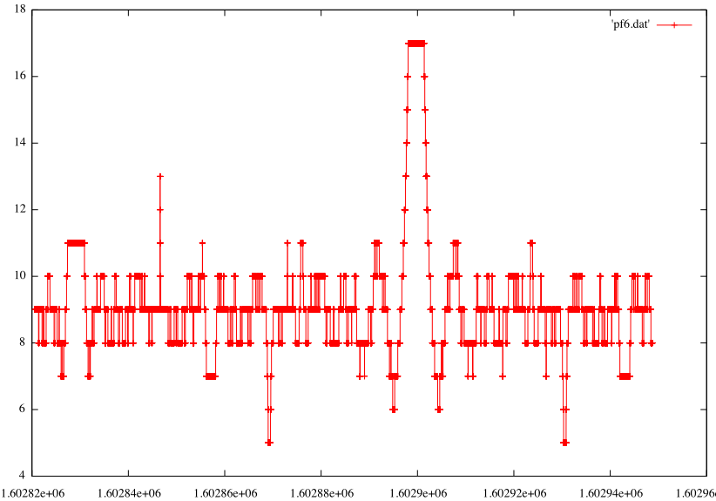
Injection Synchronization with 10.39MHz
Four Ring Injection and PF Sync.
For PF with
SuperKEKB
Duration Jitter
20ms
+/-500μs
Clock Jitter
500 ps
Plot in 10⁻⁴
Bad region
have to be
avoided

Slide 32
Investigation
Four Ring Injection and PF Sync.
This issue is different than the bucket selection challenges at SuperKEKB
  Bucket selections both at DR and MR
Was not well investigated under 10.39MHz
  May require pulse-to-pulse LLRF manipulation between RF systems of PF / PF-AR / SuperKEKB
  Should be investigated further

Slide 33
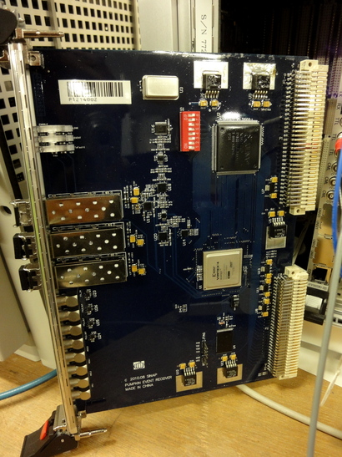
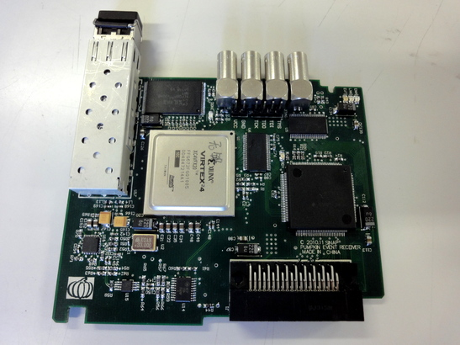
Event System Development Collaboration with SINAP
For PLC (F3RP61 Linux CPU) as well as VME
Under testing
Many more synchronous controls
at a reduced cost

Slide 34
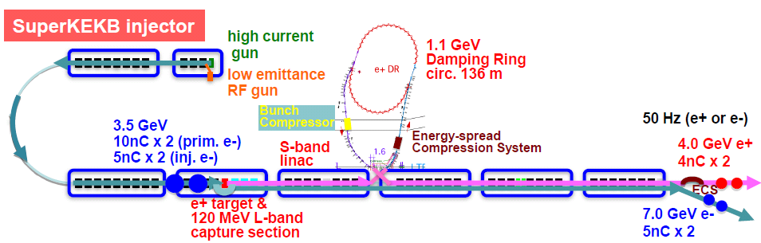
Facility for Electric Power and Cooling Water
Facility
Linac needs electricity and cooling water extensions, especially for positron generator upgrade
First estimation was performed, and was found that it may impact the construction
Under discussion how to extend the facility
[I] 第1～2セクター
陽電子ビーム強度の５倍化に向けて、収束用電磁石の数と強度が大幅に増加する。
増加分920 kVA, 900 L/min
現状 401kVA
1211 / 1430 L/min
[II] 第3セクター
DRの入射＆出射路の新設に伴って、その電磁石の一部が入射器トンネルに新たに設置される。
増加分310 kVA
現状 6.7kVA
136 / 500 L/min
[III] 第３スイッチヤード
１）陽電子エネルギーの増大（3.5GeV→4GeV）に伴う偏向磁石系の電力増及び ２）RF偏向によるエミッタンスモニターの新設に伴って熱負荷が増大する。
増加分300 kVA, 460 L/min
現状 158kVA
（587+α）/ 750 L/min

Slide 35
Schedule
Schedule
Summer 2012 : Alignment, SY3, 3T-gun, 32-gun
Autumn 2012 : 32-RF-gun, A1-gun(0.2nC)
Winter 2013 : SY2 / DR
Spring 2013 : A1-gun
Summer 2013 : Installation of many components
Autumn 2013 : e– then e+ commissioning
  Half Linac: PF injection, Day: construction, Night: commissioning
Spring 2014 : Pulsed Quad, Steering, Alignment
Summer 2014 : Installation of remainings
Autumn 2014 : Possible ring injection (?)
Winter 2015 : DR then MR injection commissioning
…

Slide 36
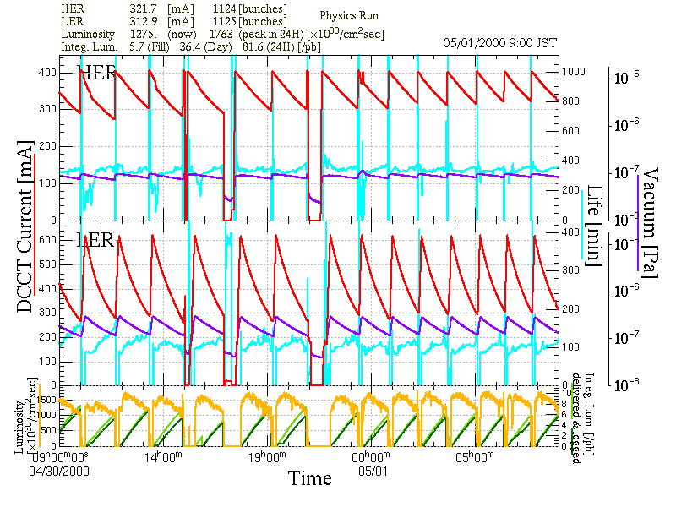

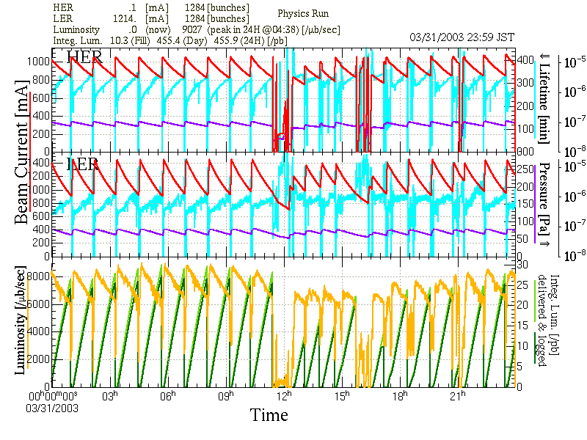
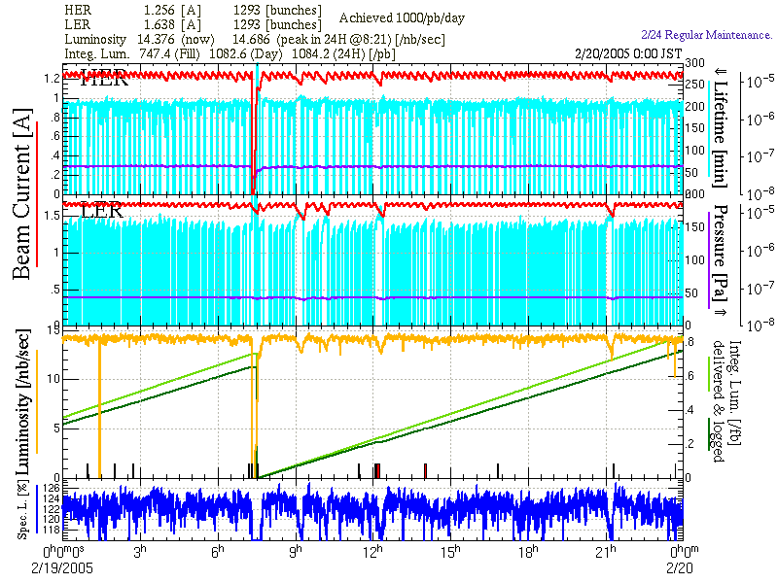
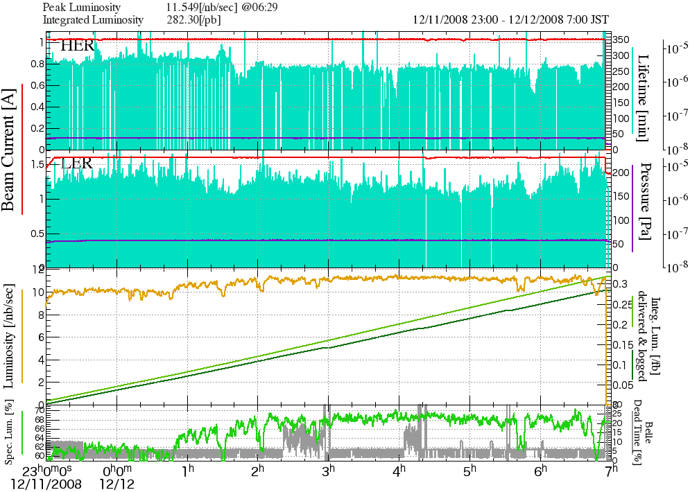
Change in Operation Modes at KEKB
KEKB
Summary
Belle/KEK
Linac provided basis of robust operation
and daily advances in KEKB
So in SuperKEKB as well
May.2000
Apr.2003
Dual Bunch e⁺
Feb.2005
Continuous
Injections
Dec.2008
Crab Cavities and
Simultaneous Injection

Slide 37
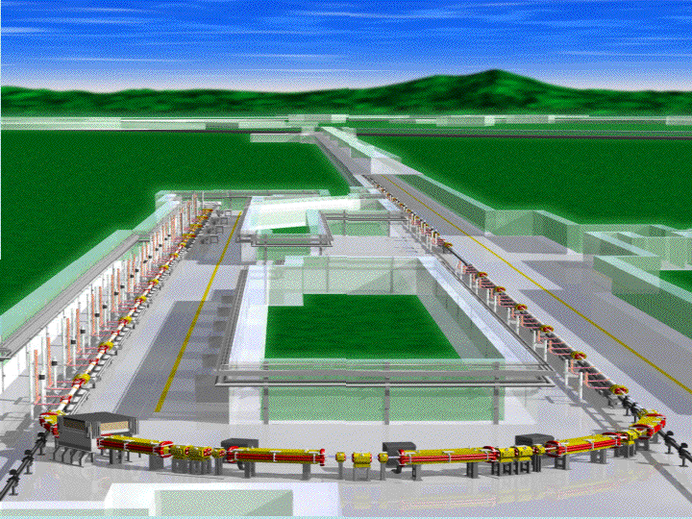
Thanks
Thank You for Your Patience

