Slide 1

EPICS Based Control System for Microtron at RRCAT, Indore
Prachi Chitnis
Raja Ramanna Centre for Advanced Technology
Indore, INDIA

Slide 2
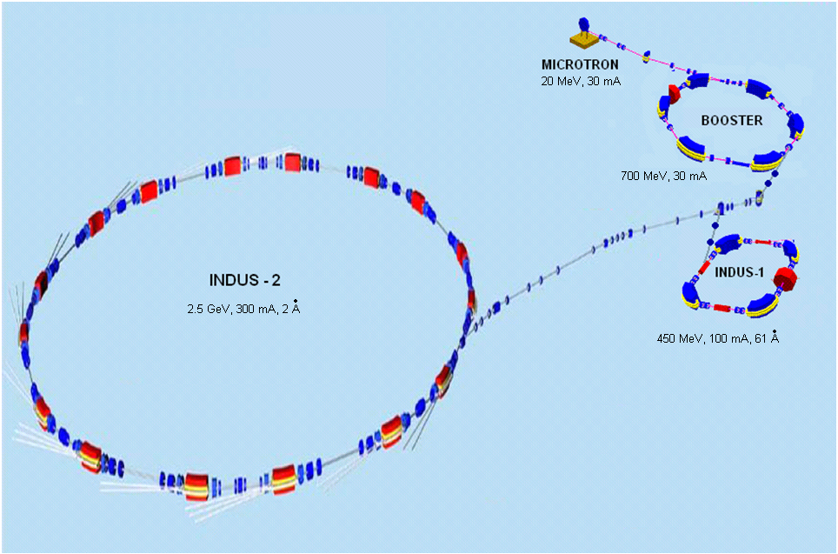
Indus-1 & Indus-2 Synchrotron Radiation Sources at RRCAT

Slide 3
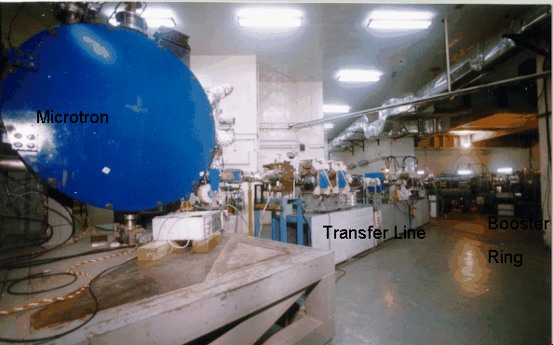
Injector System of Indus Rings

Slide 4
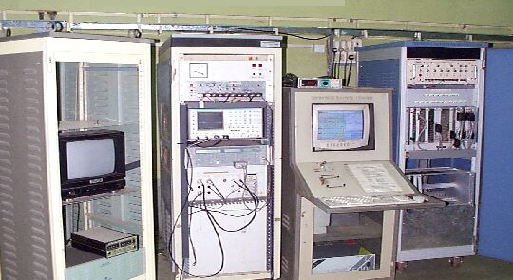
Microtron Control Room

Slide 5
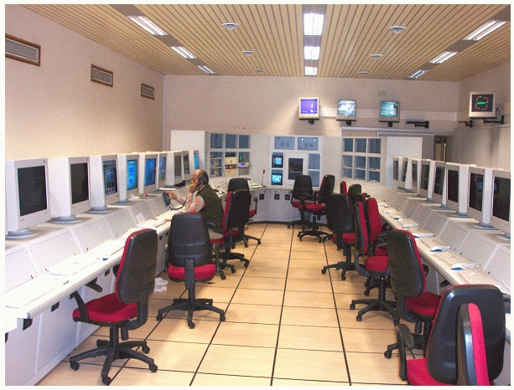
Main Control Room

Slide 6
Existing Microtron Control
LabVIEW 6.1 based, Windows 2000
Old system
Expandability issues
  Control hardware upgradation of Indus-1
  System enhancements
One-to-one control
Heterogeneous SCADA
Version upgrade cost
First experience with EPICS [3] at RRCAT

Slide 7
Microtron Control System Design

Slide 8
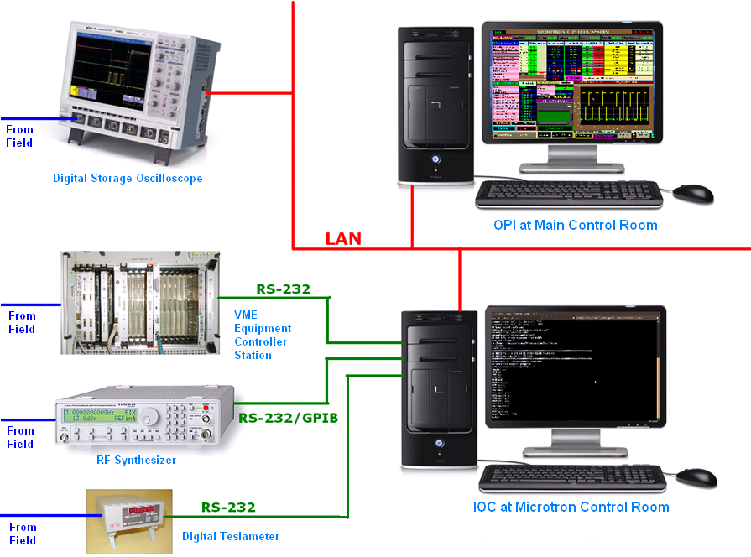
Microtron Control Scheme
10 Mbps

Slide 9
Microtron Control Scheme
Linux-x86,
EDM 1-11-0z,
Base 3.14.9
Standard commands by manufacturer
Running assembly program, polls & receive bytes from serial port, resolves commands
Linux-x86
Base 3.14.9
10 Mbps
Standard commands by manufacturer
Standard commands by manufacturer

Slide 10
Microtron field variables
  ~150 process variables to be administered by EPICS
Interfaced to | Devices | Link Type | No of I/O points
VME station | 11 Power Supplies – Klystrons, Dipole, Quadrupoles, Correction coils, Cathode & Steering coils Remote/Local status signals ON/OFF status signals Analog status signals(current/voltage/power) ON and OFF control signals Analog control signals (current/voltage) Polarity 6 Safety Interlocks signals 10 Temperature signals AC Mains Voltage Vacuum level Cycling control | RS-232 | 103

Slide 11
Field variables
Interfaced to | Devices | Link Type | No of I/O points
RF Synthesizer | RF synthesizer make RF Status (ON/OFF) RF Level RF Carrier Frequency | RS-232 / GPIB | 4
Digital Storage Oscilloscope | RF Forward Power RF Reflected Power Cathode emission signal FCT Signal – bunch current | Ethernet | 4
Digital Teslameter | Dipole magnet field | RS-232 | 1
Derived | Trip alarms of all power supplies Cathode runtime | - | 11
Miscellaneous | VME program status VME CPU reset User data DSO settings RF synthesizer settings Fault information |  | ~35

Slide 12
IOC Features
Hierarchical design of IOC database
Error checking modules
Event based processing given precedence over periodic processing (scanning (event/passive)/output on change)
While the CPU being reset, readback polling is disabled
Setting records disabled during Local status of Power supplies

Slide 13
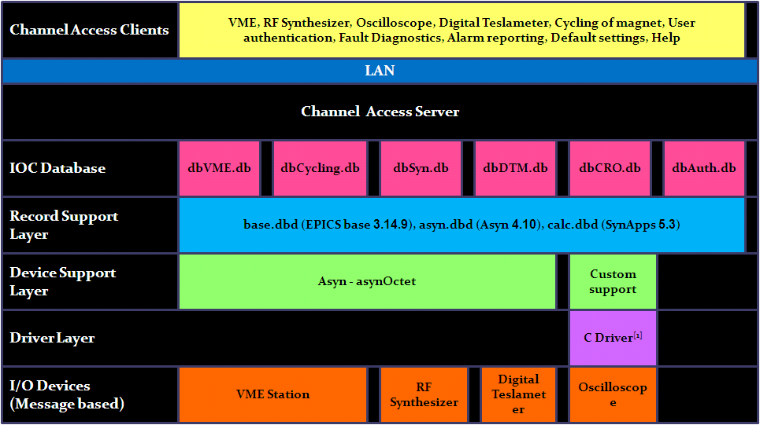
IOC design

Slide 14
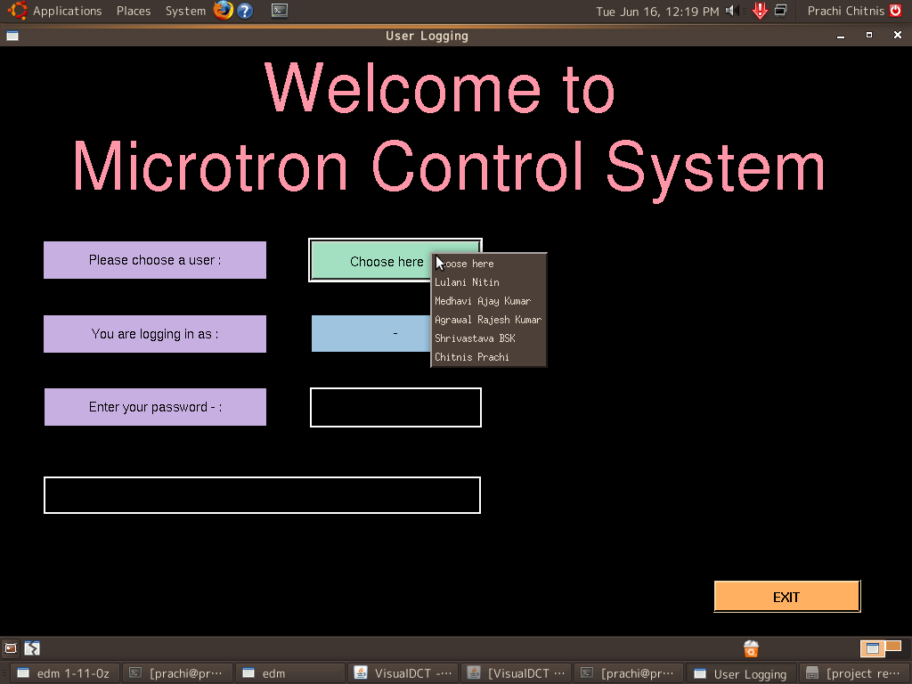
User Authentication

Slide 15
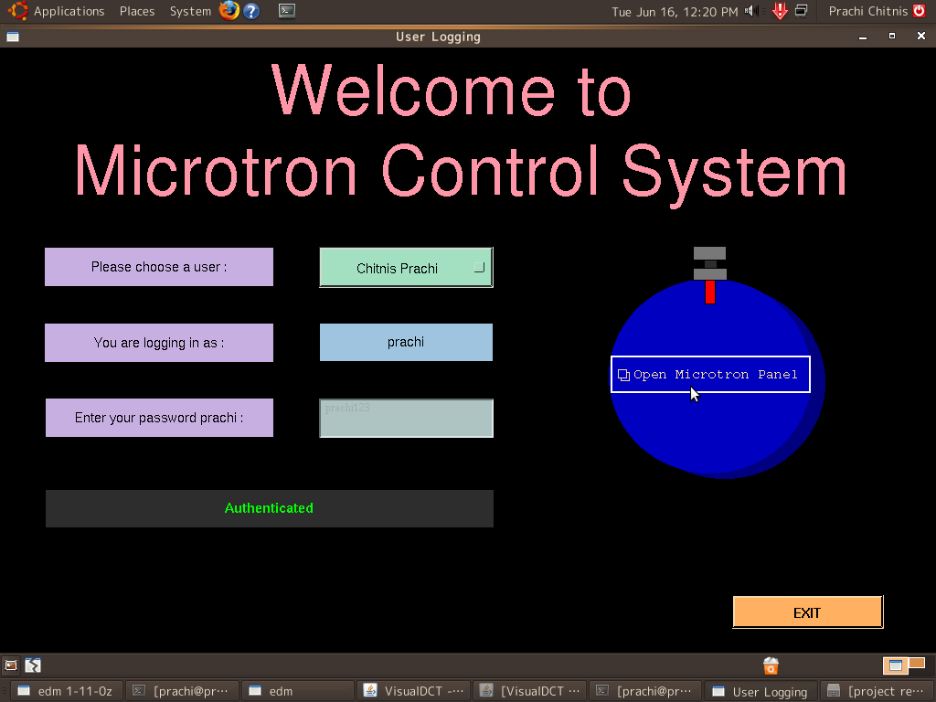
User Authentication

Slide 16
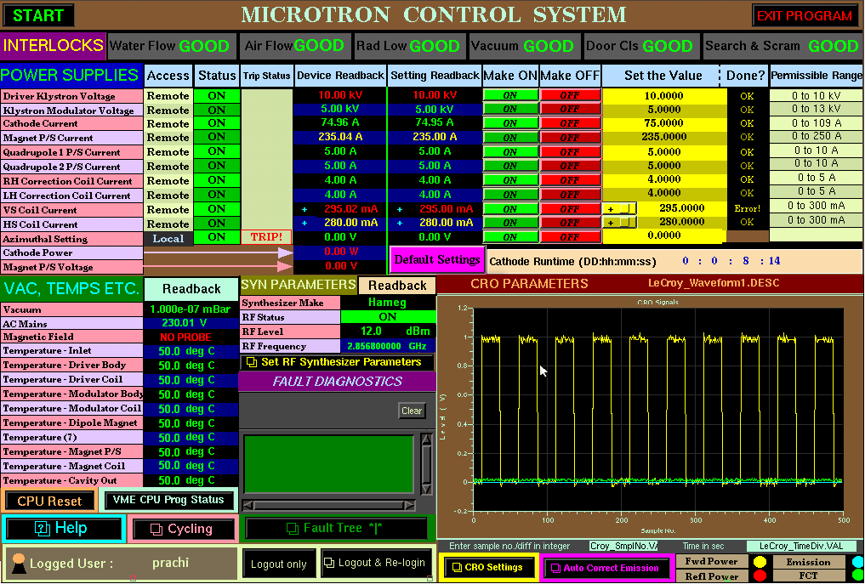
The OPI
EDM 1-11-0z

Slide 17
The OPI
EDM 1-11-0z – MEDM – client commands in terminal
VME
RF Syn
DTM
DSO

Slide 18
OPI Features
Coloring guide – MEDM –no white widget
Clipped settings
Alarm levels
Disabled on reset, interlock fail, cycling, logout, local mode
Contrast for visibility
Help feature
Two user modes

Slide 19
Database logging
logging interval, group log, file size,

Slide 20
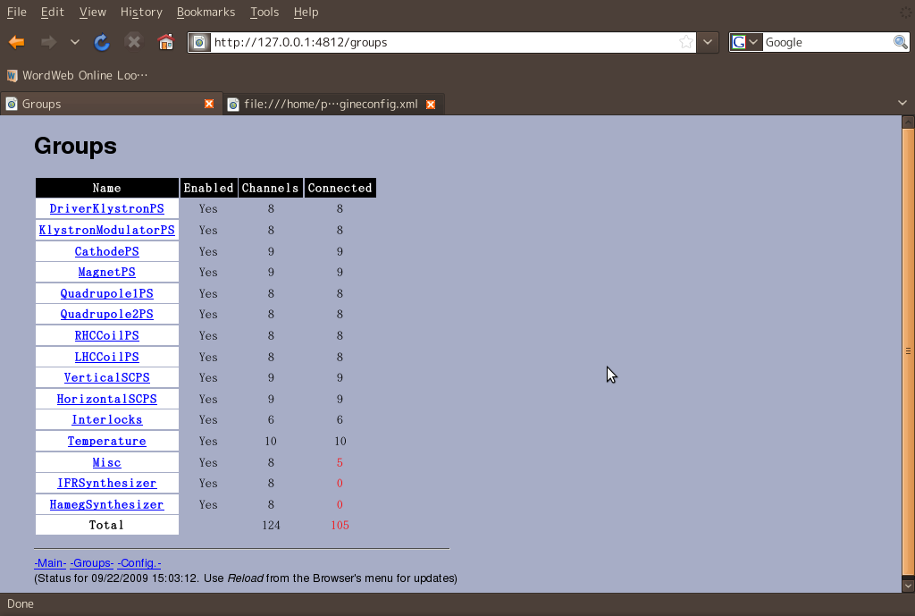
Web browser

Slide 21
Database logging
Central database for Indus systems – SQL server based
Using JCA
Java script and JDBC

Slide 22
Fault Diagnostics [4,5,6]
Detection of anomalous system behavior
Identification of the cause for the deviant behavior
Expert System Diagnosis – knowledge based on experience and expertise encoded in machine storable structure
Fault tree n rule based reasoning system
Forward chaining algorithm technique
Non-expert operators can troubleshoot a fault

Slide 23
Fault Diagnostics [4,5,6]
3 categories of fault prone systems in accelerators ^{[2]}
  Hardware components (cavities, magnets etc.)
  Auxiliary infrastructure (water, air, electrical power etc.)
  Control system.
Availability of control faults at a place
  Online fault logging system – 2 years data
  Operational logbooks – 1 year data
Two modules
  Fault prediction
  Fault diagnosis

Slide 24
Fault Prediction
Active - Monitors the anomalies occurring - Warns user
  AC mains voltage fluctuations
  Dipole magnetic field changing
  Vacuum pressure rising
  Error checking modules
  …
~13 different predictions

Slide 25
Fault Diagnosis
Passive – helps operator to troubleshoot a fault observed – reaches a probable cause
~40 different types of faults
Two parts
  System-wise hierarchical fault tree
  Rule based reasoning system for each leaf fault
  Check panel on EDM
E.g. current setting for a power supply not done

Slide 26
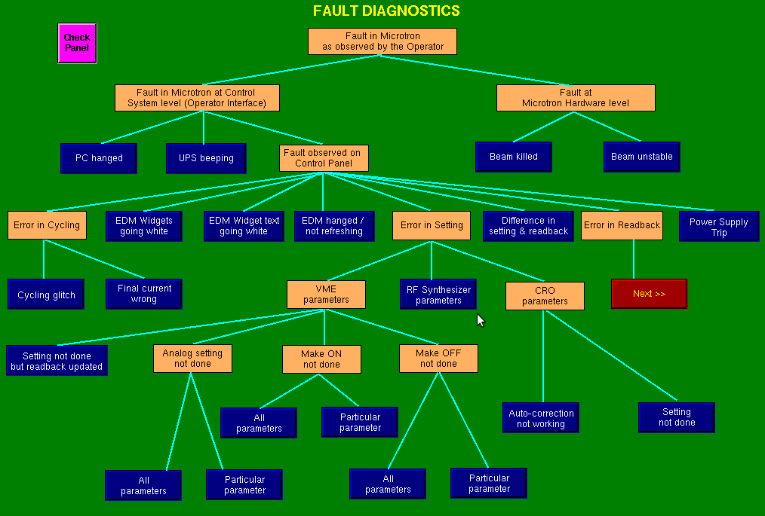
Fault Tree

Slide 27
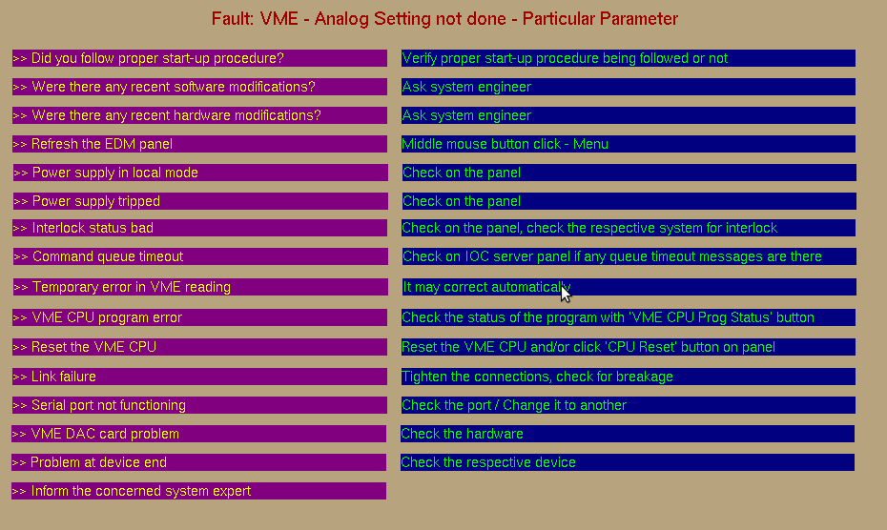
Rule based reasoning

Slide 28
Improvements achieved by using EPICS
Interaction between controllers – Access to PVs
Integration of Indus-1 controls
Homogeneous system
Accelerator specific tools
Free n open source
Modularity – suits to control hardware upgradation of Indus-1
Huge EPICS community

Slide 29
Conclusion
The testing of the project is done in lab environment, field testing is on
Due to its easy adaptability to hardware changes, EPICS is best suited prospective to hardware upgradation.
Mostly involves graphical programming, eases enhancements and changes, and debugging.
The knowledge gained will be utilized for upgrading the Indus-1 control systems.

Slide 30
References
[1]http://optics.eee.nottingham.ac.uk/lecroy_tcp/driver_source/tarballs/lecroy_tcp-1.00.tar.gz
[2] D. Barni et al., “Basis for the reliability analysis of the proton linac for an ADS program”, Proceedings of the PAC ’03
[3] http://www.aps.anl.gov/epics/
[4] P. Duval et al., “Fault identification in accelerator control”, http://adweb.desy.de/mcs/Mst_content/ fault_identification.pdf
[5] T. Himel et.al., “Availability and reliability issues for ILC”, Proceedings of PAC’07
[6] S. Narasimhan et al., “Automated diagnosis of physical systems”, Proceedings of ICALEPCS07, Knoxville, Tennessee, USA

Slide 31
Thank You!

